Slide 1
Online News Readership
How people find, read/watch, and share online news
Impact of social media and mobile usage
Headline length & article length
Notes:
Online News Readership
How people find, read/watch, and share online news
Impact of social media and mobile usage
Headline length & article length

Slide 2
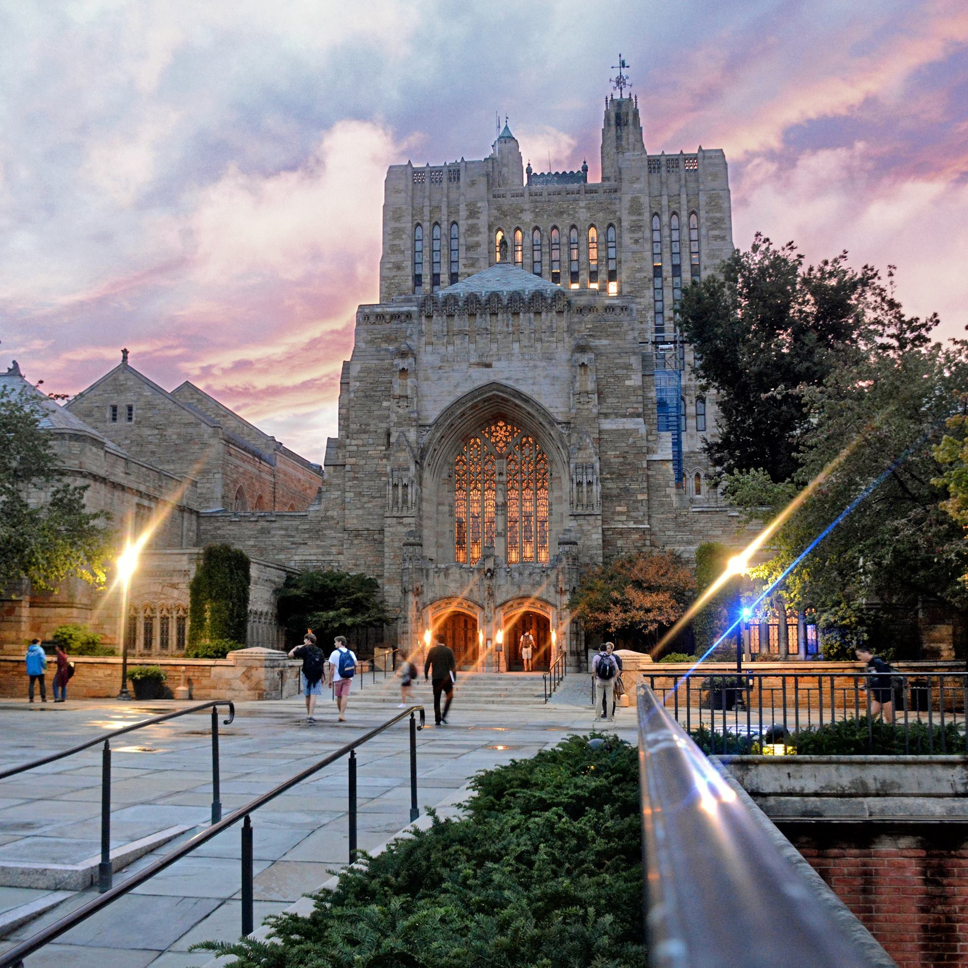
Notes:
All the research on online news engagement emphasizes that the first goal is to create quality content—text, images, or video — the main factor in how well it will perform online is the quality of the content.
So, starting with that premise-- once you have excellent content -- how can you ensure you're not impeding your own success.
Traditional media sources—in order to succeed or survive financially—now focus on how to monetize digital news by sharing it through social media. This is a shift: It’s not about having the big scoop.

Slide 3
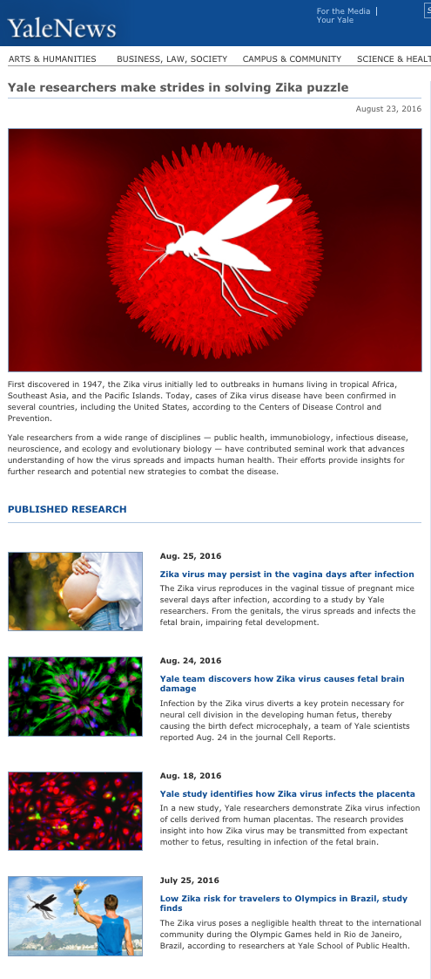
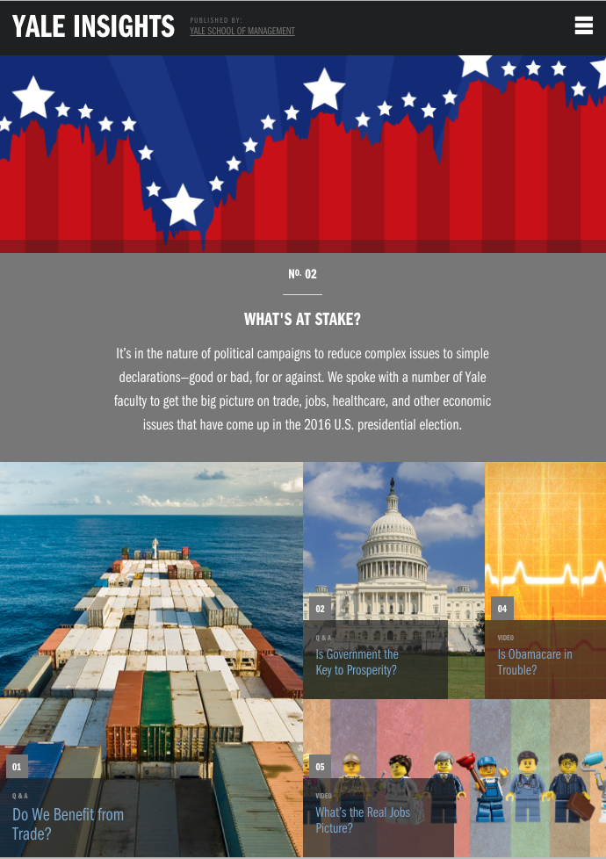
Notes:
Instead, nontraditional news sources — like ours — have the opportunity to be placed alongside traditional media and to perform well.
Stories that do well on social media are not same things that would have drawn an audience to a TV news program.
We can measure, immediately, how well a story is performing, and that measure in itself can tell us that this is newsworthy, which provides Yale the opportunity to jump in with our expertise.

Slide 4
YaleNews numbers
2015-2016
3.4 million unique page views
759,545 visits to YaleNews from the email to students, staff, faculty, & alumni
YaleNews articles shared 655,000 times on social media (vs. 196,000 shares from Yale Daily News)
2015-2016 vs. 2014-2015
Sessions & users increased 22%
Page views increased 74%
Pages per session increased 42%
14% increase in staff, student, faculty (19% alumni) traffic from YaleNews email

Slide 5
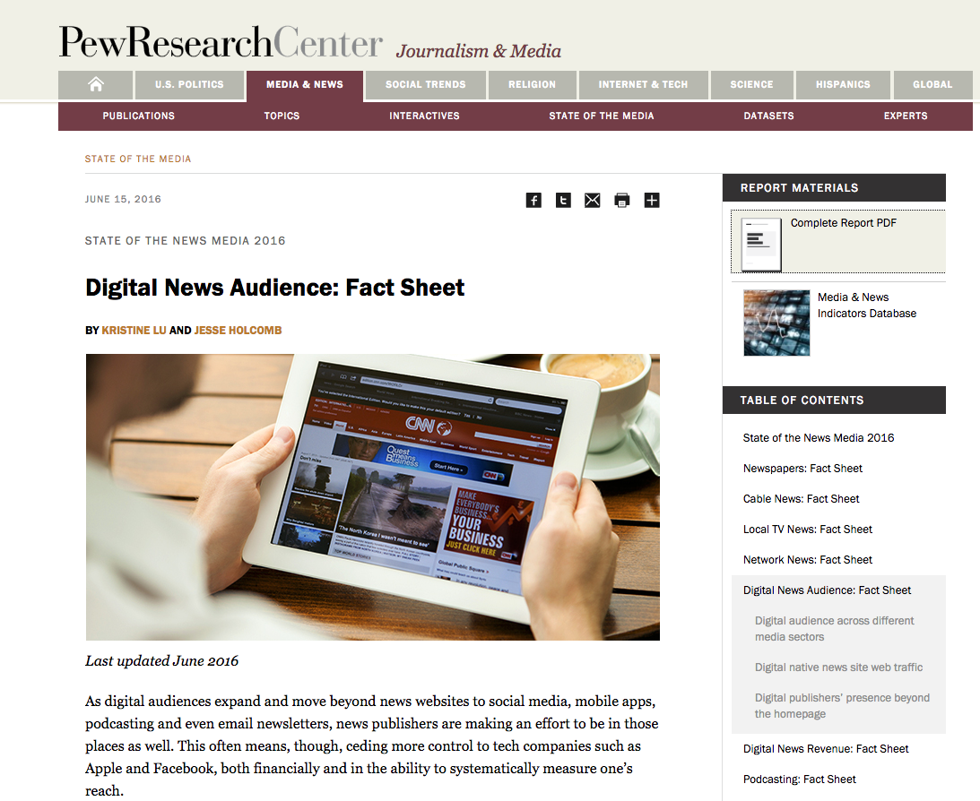
Notes:
The Pew Research Center published a detailed report this year on the “State of the News Media,” which reflects radical changes in the news industry. Full report very detailed, segmented by print, digital, tv, radio, and by audiences. It’s all online for free.
The report is aimed at for-profit news organizations with information to help them survive financially. It is not designed around the needs of reputational news sites like Yale’s.
With that in mind, I pulled out the big take-aways for born-digital publications, leaving out the sections that talk about things like pay walls and subscriptions.
My research was done in support the redesign of the YaleNews website. For all of us here, I hope it will be useful for understanding--when you have a story in the media, how does it proliferate online?

Slide 6
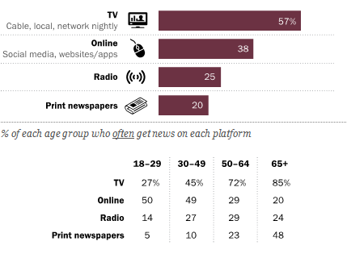
4 in 10 Americans often get news online
Notes:
PEW 2016 SURVEY TAKE-AWAYS / DIGITAL NEWS READER BEHAVIOR
News sources: TV, digital, radio, print:
% of adults who often get their news from each platform
4 in 10 US adults OFTEN get news online
TV news: 57% (72% ages 50-64, 27% ages 18-29)
Print newspapers: 20%
Radio: 25%
There is quite a significant age gap in these preferences.
in online news users:
50% ages 18-50
20-30% ages 50 and up
in print news users:
5-10% ages 18-50
23% ages 50-64
48% ages 65+

Slide 7
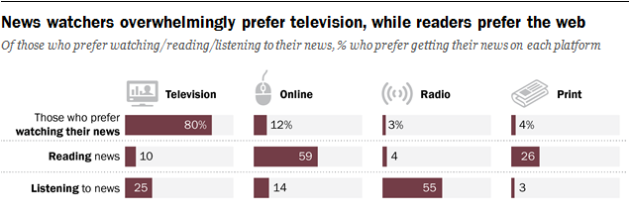
Notes:
Among those who prefer to watch their news, the overwhelming majority prefers watching it on television, rather than online.
By contrast, among those who prefer to read their news, the great majority prefers to read it online, rather than in print.
Pew Report made headlines in just 2 weeks ago when it announced:

Slide 8
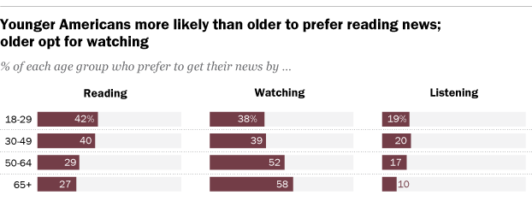
Young people don’t like video news content
Notes:
Young people don’t like video news content
Unlike their elders, young people have a strong preference for reading, rather than watching their news. And again, people who watch their news prefer TV to online video.

Slide 9
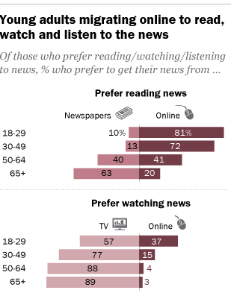
Notes:
And among those young adults who like read the news, 81% of them prefer to read online, rather than in print. Compare that 81% with the 20% of people over age 65, and 40% of those ages 50-64.
So you can see in the category of audiences for online video news, there is no one there. Drilling deeper into the behavior of online news readership:

Slide 10
Rapid growth since 2013 in % using mobile to get news Desktop/laptop usage holds steady
Notes:
Among digital news sites:
Desktop readership still greater than mobile, and while desktop readership is holding steady, but mobile gaining every year and at a quick pace.

Slide 11
Preferences of mobile over desktop for digital news, by age: 70% ages 18-29 53% ages 30-49 29% ages 50-64
Notes:
People who read the news on both desktop and mobile have a clear preference for mobile.
Big age difference in preferences of mobile over desktop for digital news:

Slide 12
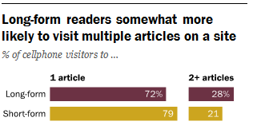
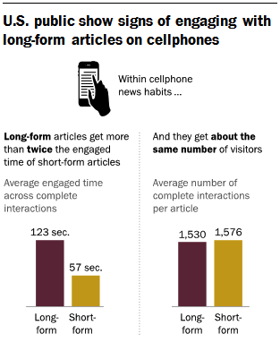
Notes:
Mobile readership seems to have an impact on the length of time spent on news stories, but maybe not the way you’d predict.
It turns out people are reading longer articles on their cell phones. And if you think about your own habits, that does make sense. The Pew study goes into great detail about time of day and reading habits.
Defining Long-form story as 1,000 words or longer
Long-form articles get twice the engaged time as short — (2 minutes vs 1 minute)
Cell phone users are also more likely to visit other pages on your site.
An important goal is keeping readers on your site through web design.

Slide 13
YaleNews Usage & Behavior
Pageviews doubled since 2012. Average 1.5 per visit.
Top traffic drivers: e‐newsletter and social media.
Mobile usage on YaleNews has more than tripled since 2012 (from 11% to 38%) with desktop usage dropping from 84% to 55%.
Industry-wide: rapid growth of mobile, desktop usage flat
Homepage traffic has declined 10% since 2012. Most users access an article or category page first instead of the homepage.
Notes:
Let’s turn to news.yale.edu specifically to see how our reader behavior matches up with the national trends.
Homepage traffic has declined 10% since 2012. Because most users access an article or category page first instead of the homepage.
And since our goal is keeping people on our site, the design of the story page becomes important.
Moving on to social media.

Slide 14
6 in 10 Americans get news from social media
(at least some of the time)
Notes:
Social Media
60% of Americans get news from social media.
44% of US general public gets news from Facebook. 9% from Twitter.
% increases each year.
GETTING news is very different from SEEKING OUT the news.

Slide 15
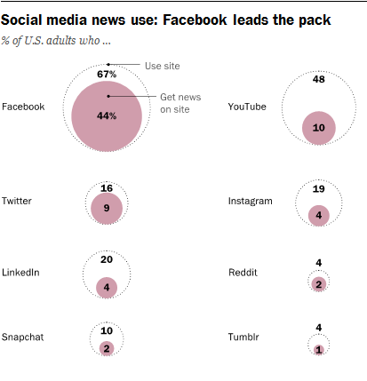
Notes:
This is comparing diff social media platforms as sources of news.
White circles -- % of US adults use each social media platform.
Pink circles -- % who get their news from each.
80% of social media click-throughs are coming from Facebook. The remaining 20% is split between all of these. Twitter 15%.
You can see the difference between FB and all other platforms.

Slide 16
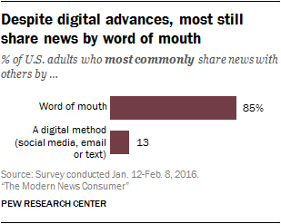
Notes:
The good news is --- human to human.

Slide 17
60% cannot recall the source of a story 2 hours after reading it
Notes:
60% of people cannot consistently recall the source of a story just 2 hours after reading it.
What does this mean for attracting people back to our news sites over and over? Social media and e-newsletters are the top drivers of traffic to online news.

Slide 18
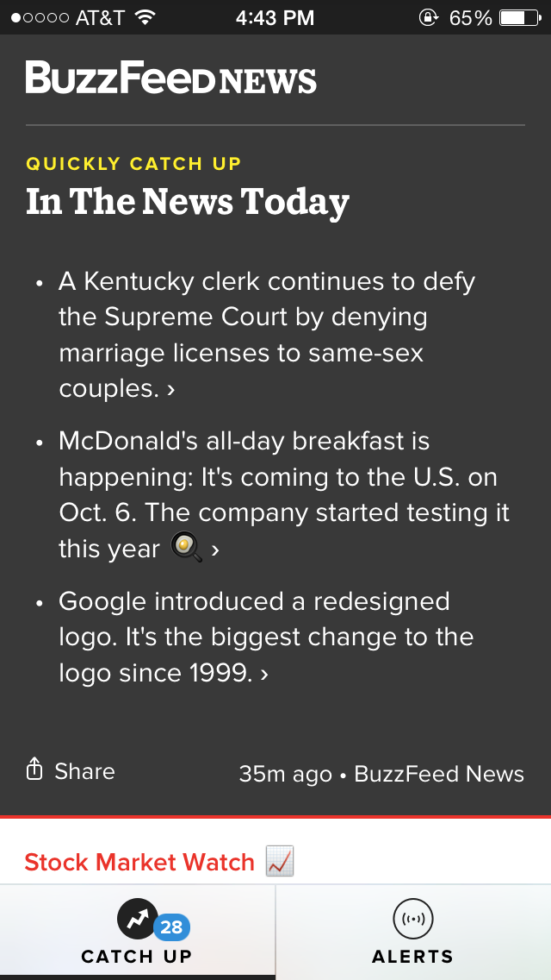
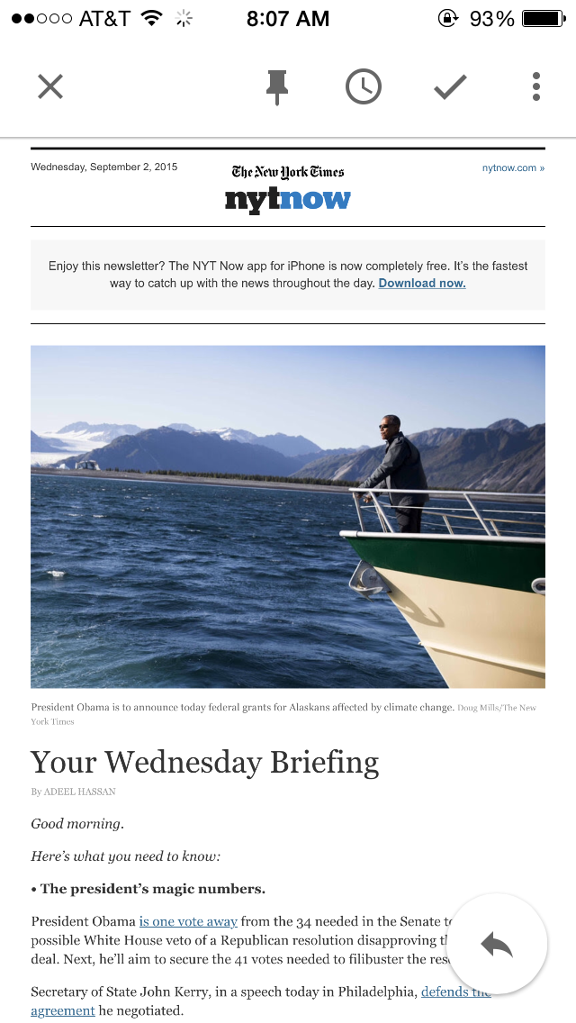
E-NEWSLETTERS Almost all digital native news sites have e-newsletters, some with multiple subtopics E-newsletter design should relate to the news site design
Notes:
So E-NEWSLETTERS deserve careful attention. The last part is not from the Pew study, but from round-ups of best online practices.
Info re Digital Native news publications. NOT online versions of print newspapers. Rather, news sources that exist only online.

Slide 19
IDEAL HEADLINE LENGTH
Round-up of best practices for:
social media
SEO (clarity)
e-newsletter opens (subject lines)
e-newsletter click-throughs
Notes:
Finally, I’m going to talk about IDEAL HEADLINE LENGTH
Round-up of best practices for:
social media
SEO (clarity)
e-newsletter opens (subject lines) – does the subject line motivate the reader to open the email?
e-newsletter click-throughs – and once the email is open, does the headline spur them to click on the headline and read more?

Slide 20
50-70 characters
35-40 characters for Facebook
5-6 words
People read first 3 and last 3 words → 6 is ideal
Frontload: Start with keywords
Understandable without context
Matches expectations
IDEAL HEADLINE LENGTH
Round-up of best practices for:
social media
SEO (clarity)
e-newsletter opens (subject lines)
e-newsletter click-throughs
Notes:
Drawing from a large number of sources, there’s a great deal of agreement around headline length

Slide 21
50-70 characters
35-40 characters for Facebook
5-6 words
Frontload keywords
Understandable without context
Matches expectations
Example headlines – ideal length
Helping More Kids Beat Anxiety Disorders
6 words, 35 characters
Yale Sailing Continues Its Olympic Legacy
6 words, 36 characters
Notes:
Each has 6 words and 35 characters. Each conveys clear content.

Slide 22
50-70 characters
35-40 characters for Facebook
5-6 words
Frontload keywords
Understandable without context
Matches expectations
YaleNews version
Low cost and desire to quit smoking spur prolonged e-cigarette use among youth
13 words, 66 characters
Facebook version
Teens use e-cigarettes due to low cost and desire to quit smoking
12 words, 54 characters
Notes:
Each of these headilnes conveys the same information, but one is much shorter,
and the key content comes right at the beginning.
And I’ll show you why this matters.

Slide 23
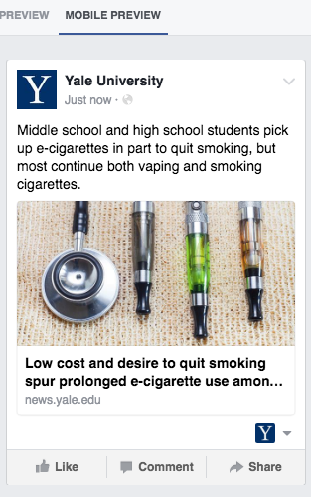
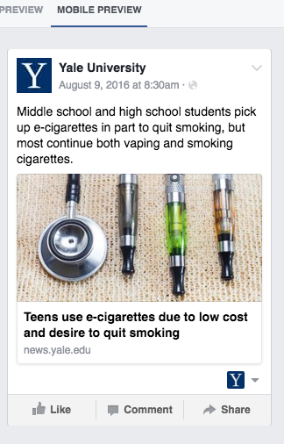
Notes:
cuts off before the words “among youth” — most important info
Following practice of “front loading” the key words
In my daily work, I pay careful attention to getting the teaser text on top to fit in that small mobile FB space, and especially to make sure that the entire headline will fit.
What best practices can we institute to make sure our headlines are working for email and for social? And why does that matter?

Slide 24
Mobile, Facebook, & YaleNews
YALENEWS
Top traffic drivers to YaleNews: e‐newsletter and social media.
Most users go to an article instead of the homepage.
Mobile usage on YaleNews has more than tripled since 2012 (from 11% to 38%) with desktop usage dropping from 84% to 55%.
NATIONAL TRENDS
Rapid growth in % of adults using getting news on mobile; desktop usage holds steady.
80% of social media traffic to news stories comes from Facebook
As of 2016, the portion of users accessing Facebook via mobile is 50% and climbing.
Notes:
Mobile, Facebook, & YaleNews
YALENEWS
Top traffic drivers to YaleNews: e‐newsletter and social media. Headlines are key to the success of both.
Most users go to an article instead of the homepage. The headline is the reason they get to us.
Mobile usage is increasing while desktop decreases, so mobile is becoming a more important way to reach our audiences.
NATIONAL TRENDS
Rapid growth in % of adults getting news on mobile.
80% of social media traffic comes from Facebook
As of 2016, the portion of users accessing Facebook via mobile is 50% and climbing.

Slide 25
Notes:
Yes, worth our time.

