Slide 1
Yale Digital Conference 2019
Justin Fansler
YSM Technology Director
Mark Albis
YSM Technical Lead

Slide 2
YSM Digital Signage
Leveraging Centralized Data for Public Distribution

Slide 3
Why we built this in the first place
YSM has lots of content available via centralized tools including news articles, events, and people profiles
This content all appears on the YSM websites, but it updates much more often than users visit
The public touchscreens promote this content to people working at YSM locations and visitors to those locations

Slide 4
What the YSM Digital Signage Website does
Displays content from various already-existent tools in the YSM Profile System
Displays other relevant content for staff and visitors, like weather forecast and Yale shuttle information
Is configurable per screen, e.g. Surgery can display only Surgery news and events
Notes:
Communications personnel and website editors are already trained to enter news articles, calendar events, etc. in the systems used to power this touchscreen application

Slide 5
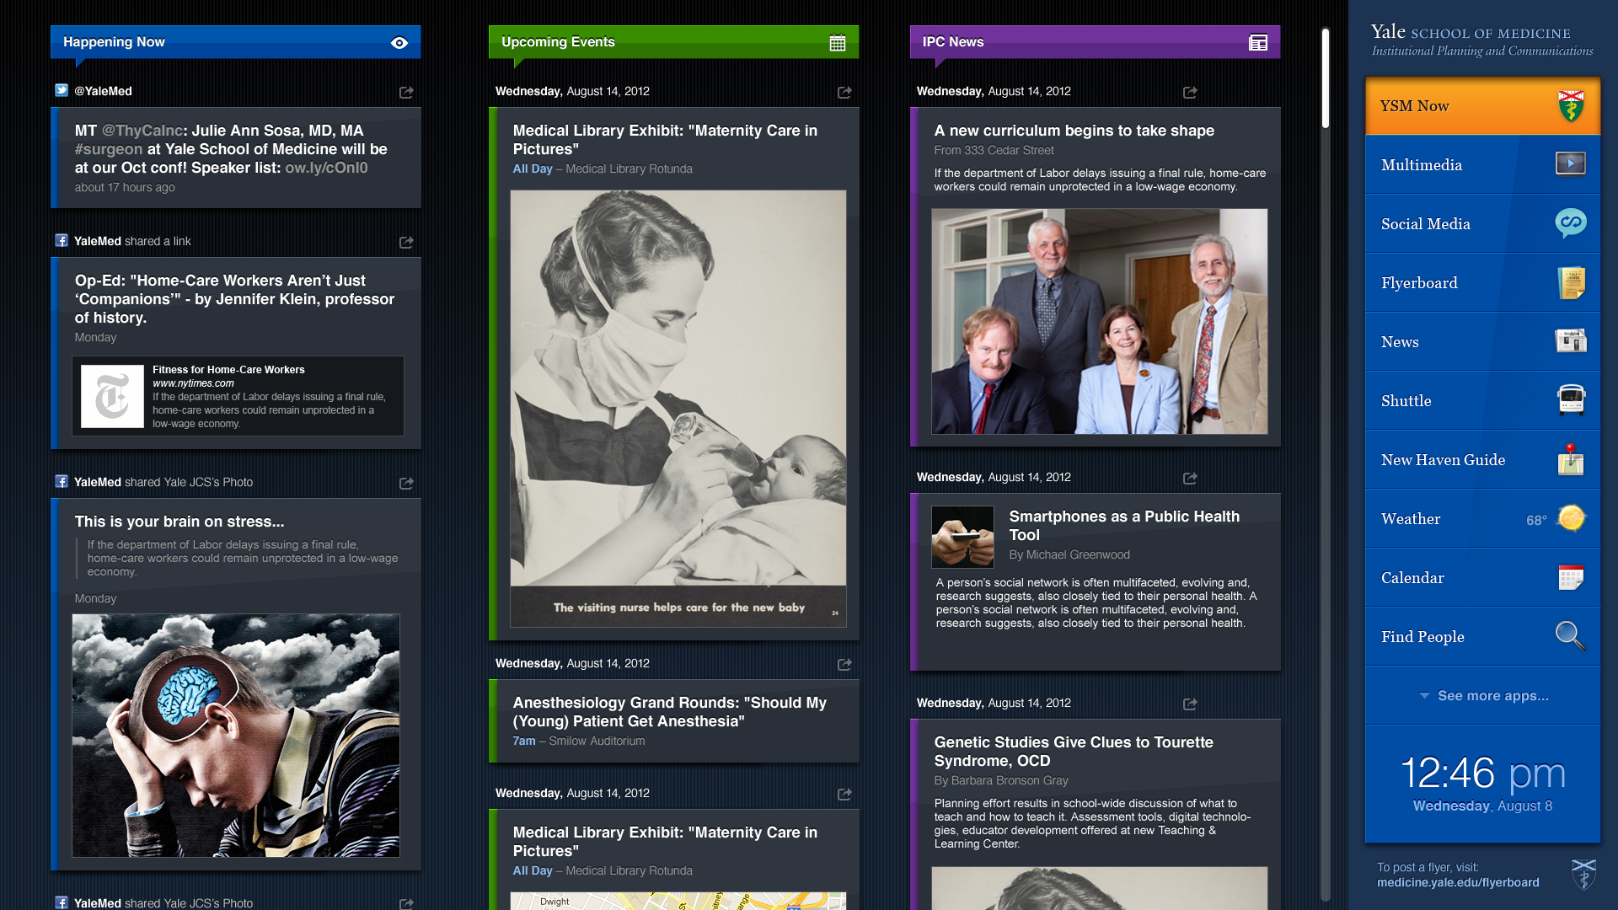
What we started with (Signage 1.0, 2012)
Notes:
This is an application that was originally built by an vendor in python, eventually was rebuilt in .NET, and just recently was totally redesigned

Slide 6
Why redesign the UI?
It looked old, original design was from 2012
Content was too crowded
We needed to streamline the types of content displayed
It didn’t look like you could touch it!
Notes:
As far as streamlining goes: we removed social media since it was usually duplicative of news. We also removed the “Flyerboard” module which was a nice concept but totally duplicative of calendar. In addition we removed the foursquare integration (New Haven Guide) which was riddled with bad data.

Slide 7
Where we are now (Digital Signage 2.0, 2019)
Notes:
New design is far less cluttered and streamlines content to focus the user’s attention once they’ve interacted with the screen

Slide 8
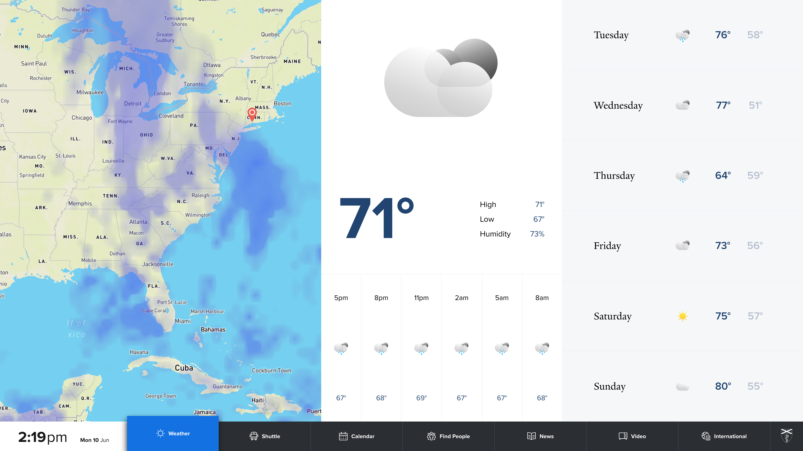
Notes:
Weather, one of the most popular modules

Slide 9
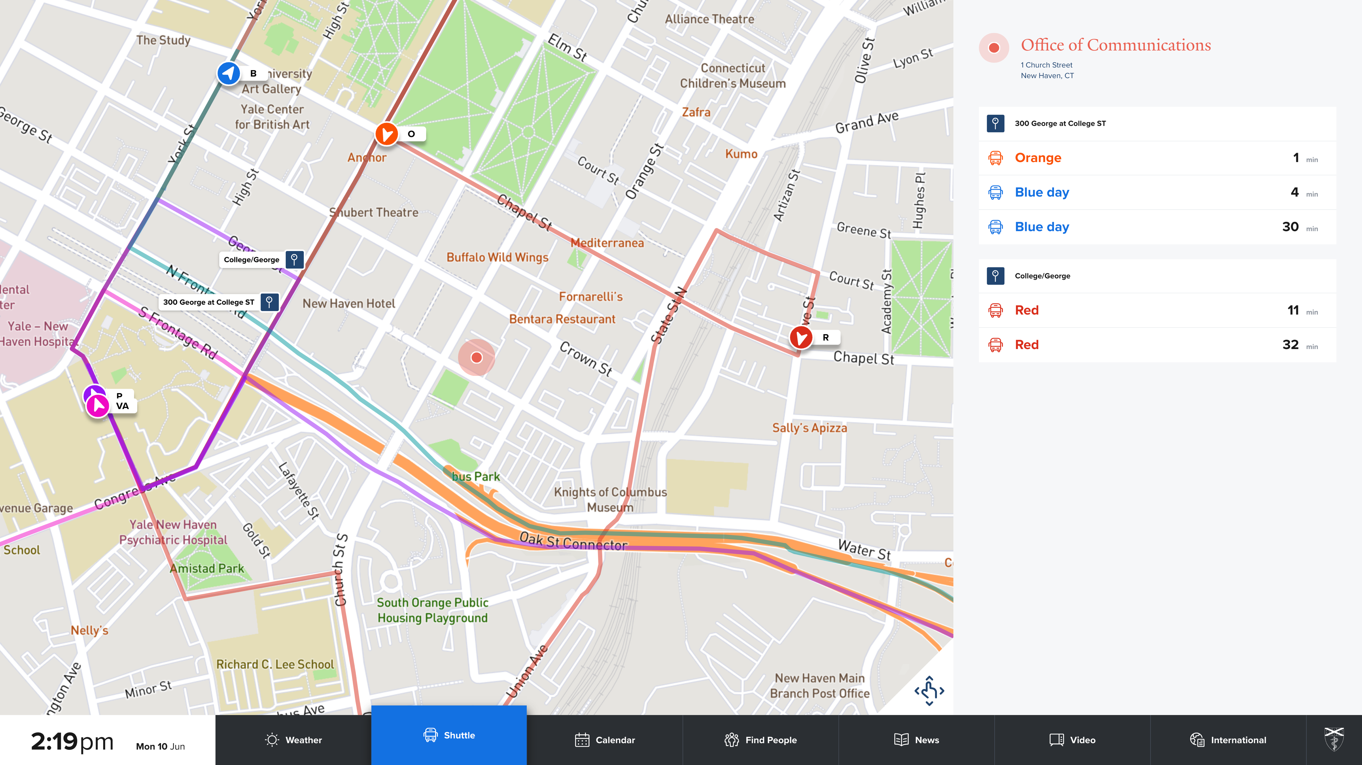
Notes:
Shuttle map, the other most popular module!

Slide 10
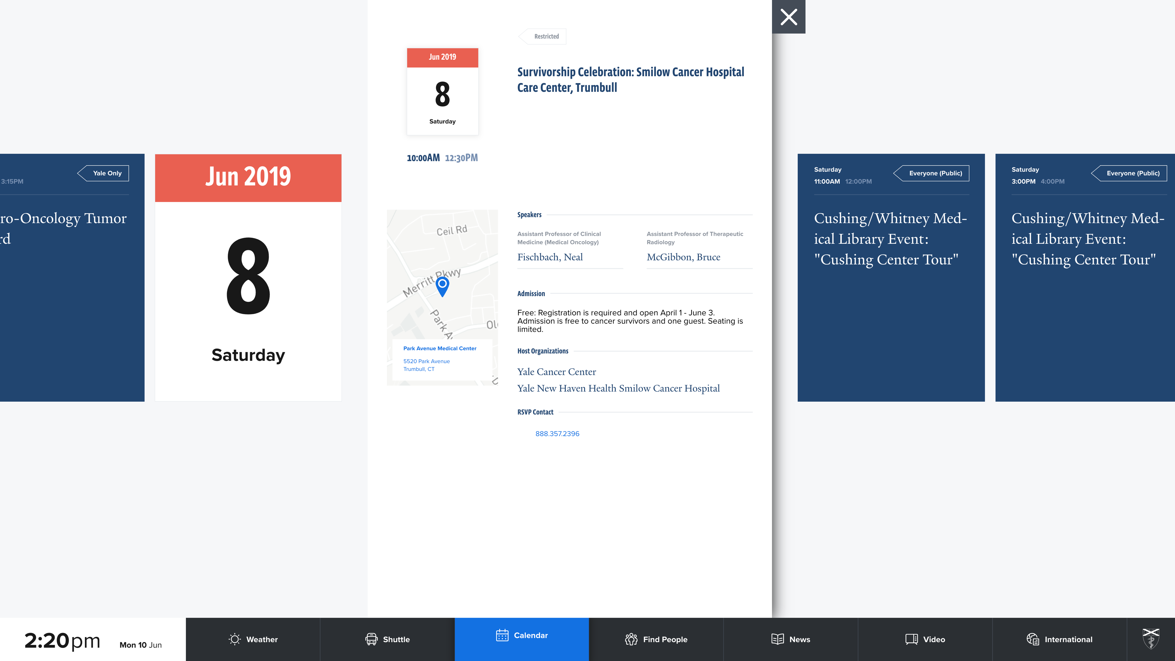
Notes:
Event calendar module

Slide 11
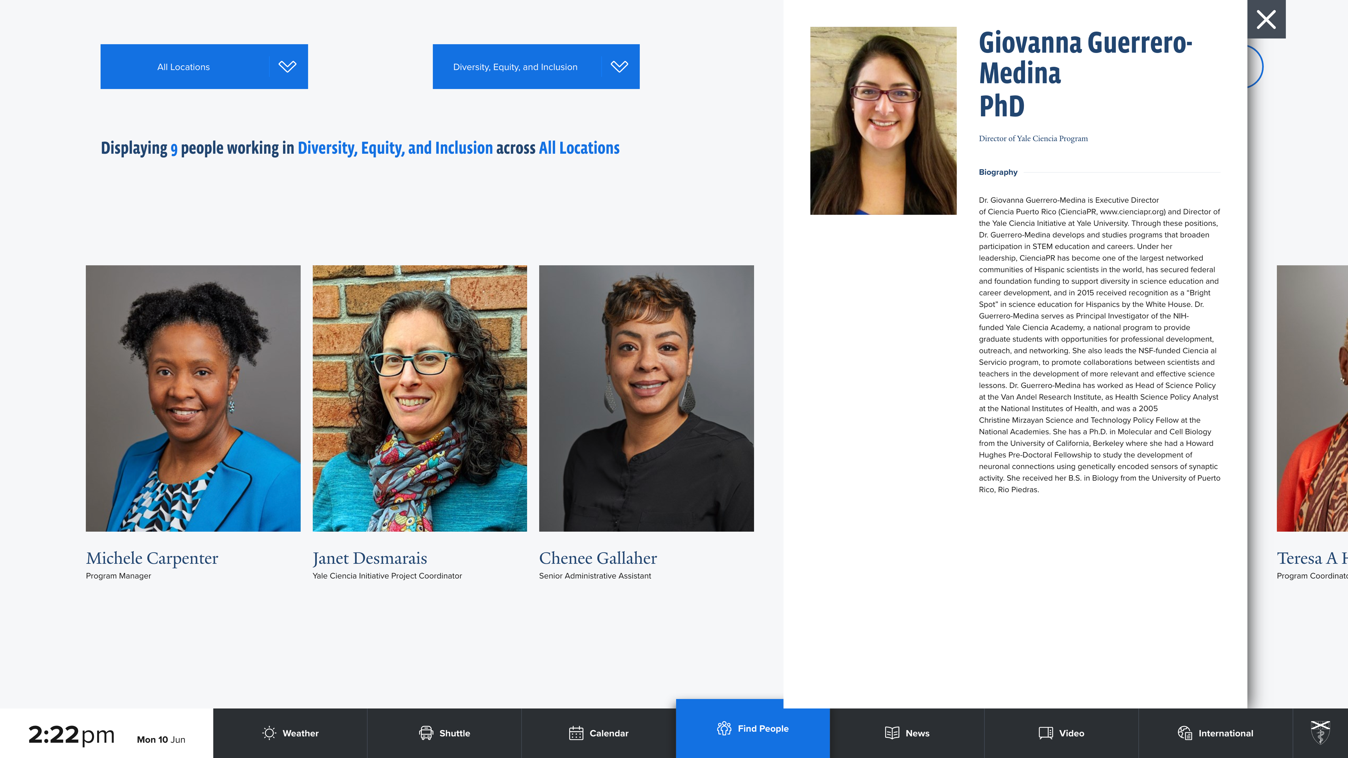
Notes:
People Module

Slide 12
Notes:
News Module

Slide 13
Notes:
Video, these screens do have sound but can be muted if desired. Closed captions display for all video.

Slide 14
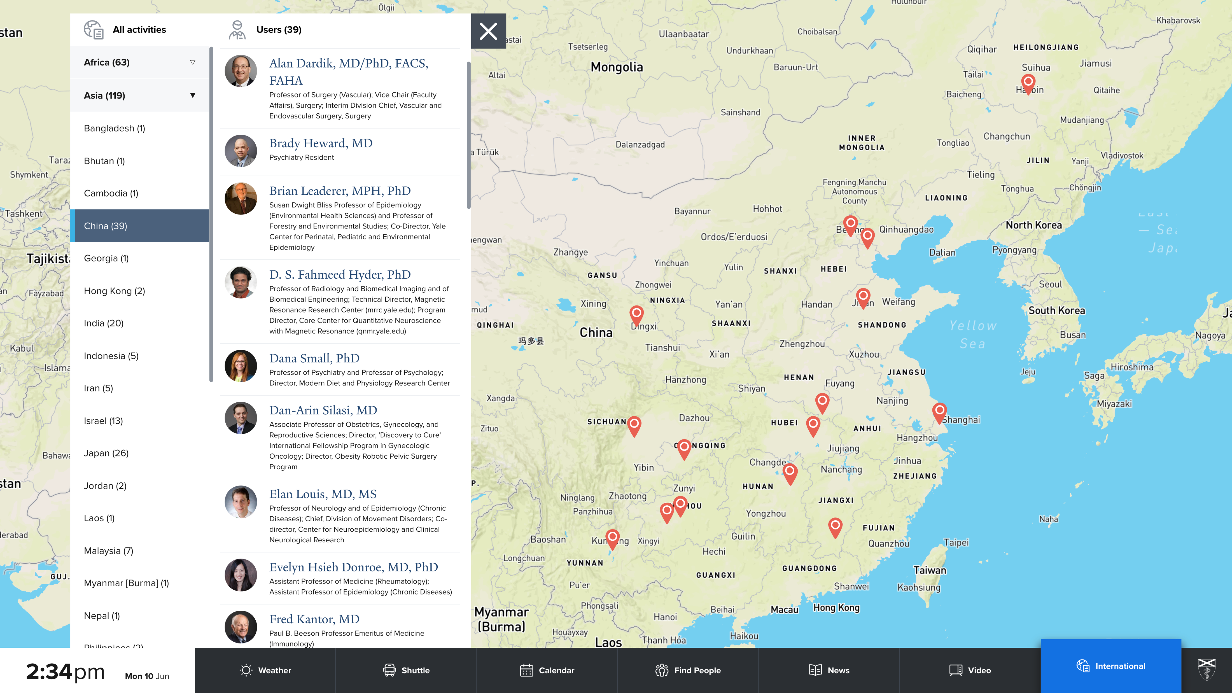
Notes:
International Activity

Slide 15
New Concept in DS2: Attract Screens
Attract screens were introduced to:
Promote timely, relevant content
Present easily digestible content for users walking by the screen
Encourage users to interact
Notes:
The idea behind attract screens is to promote timely and relevant content in a focused way that is quickly and easily digestible for users who happen to be walking by one of our touchscreens, and to encourage users to interact with the device

Slide 16
Notes:
News attract screens can put the spotlight on recent articles added to the system

Slide 17
Notes:
Weather provides timely weather updates

Slide 18
Notes:
Event attract screens display upcoming event information, with different messages based on the event content, like refreshments, event type (training, grand rounds, or student events)
Made us re-evaluate the data we allow users to input in the system (water, cheez-its, "none") These screens look a little odd because I screen captured them from my desktop, they are optimized for display on our 4k screens.

Slide 19
Notes:
Shuttle attract screens are the most complex because they are so time-sensitive. Generally we force shuttle attract screens to override other screens to ensure timely delivery
Configurable for several stop locations, in which case the location is included in the message

Slide 20
Notes:
“static” attract screens: Hey we have this content too, even though it doesn’t change very much

Slide 21
Digital Signage 2.0: How it works
Rise Vision is used to manage the touchscreens themselves
The UI that displays is a website that you can (technically) access on any device with a browser
Attract screen management is a separate application queuing up content for each touchscreen

Slide 22
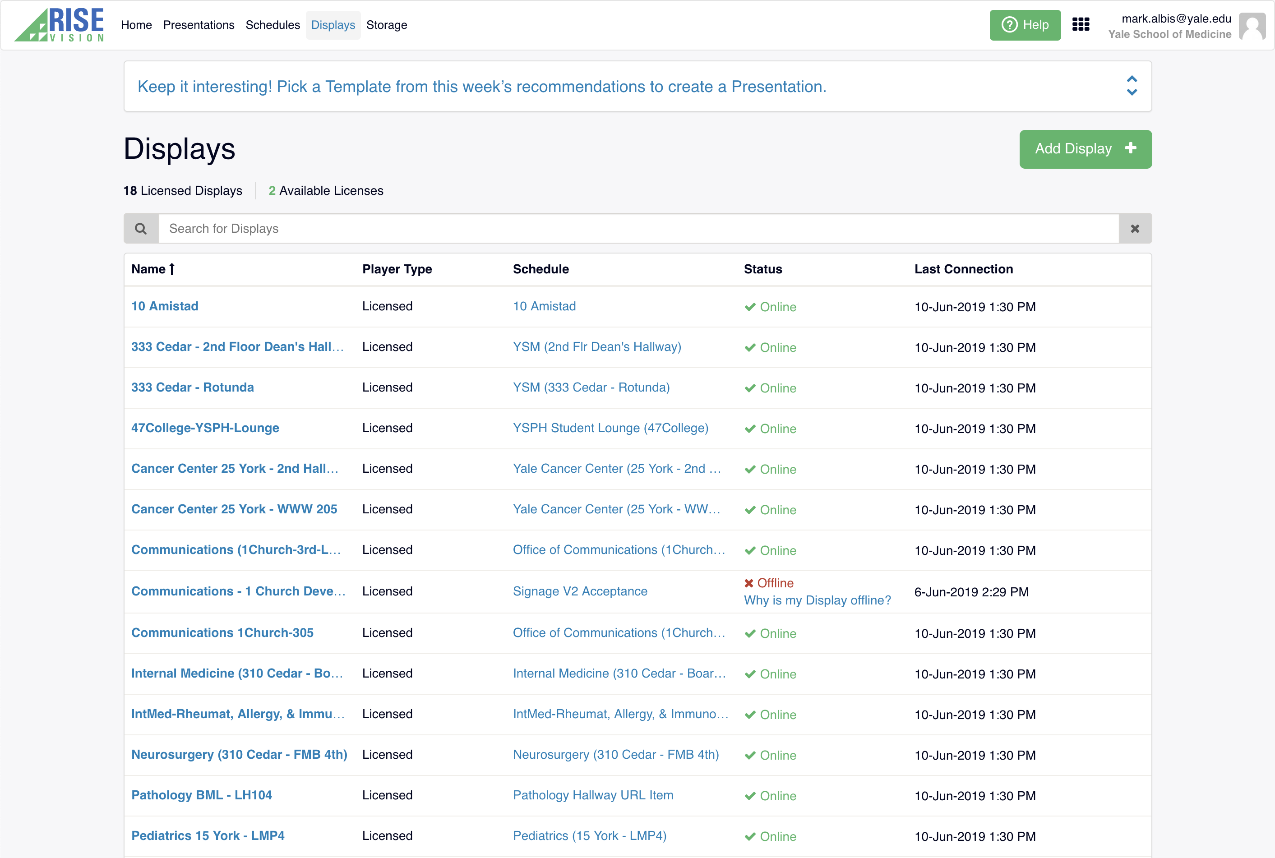
How it works: Rise Vision
View device status and get current screen captures
Free software but we use a paid version that provides email alerts for device status and other bonuses
We still have to do some hardware management
Notes:
Rise vision allows us to get a screen capture of what the screens are displaying remotely, restart the screens, and point them toward the proper website content. We can also remote desktop into the touchscreen computers to schedule windows updates or perform other maintenance tasks. If network goes out in a building, sometimes this means we need to visit the device in person, i.e. Mark rides his bike over to the screen to take a look
Don’t worry it’s just the development screen in our office that’s offline

Slide 23
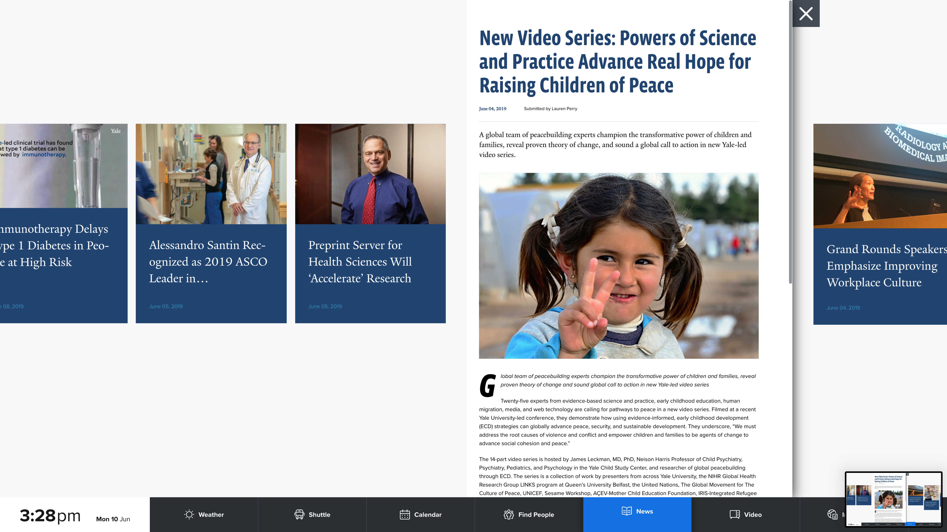
How it works: Digital Signage Website
Single page .NET Core application
The design matches new design for the YSM websites that will roll out this summer
Streamlined content for quick and easy navigation
Notes:
Design was provided by the same firm that completed the designs for the new look and feel for the YSM websites to be released this summer

Slide 24
How it works: Attract Screens
Attract screen manager is a separate application
Continually assesses available content and queues up attract screens to be requested by each signage website
Logic to ensure content is delivered in a timely manner
Notes:
Shuttle attract screens override other content because it’s not helpful if it doesn’t appear at the right minute

Slide 25
What’s next?
New attract screens, for example featured people profiles
Responsive version of the site
Additional accessibility considerations
Notes:
Accessibility concerns could be further addressed by providing an accessible, mobile version of the site, the tricky part would be how to guide people that need it to the site

Slide 26
Thank you!
Questions?
Comments?
Suggestions?

