Slide 1

Yale Digital Conference 2019
Yalesites: The Nuts and Bolts
Vincent Massaro
Senior Web Engineer

Slide 2
What is Yalesites?
A self-service platform that allows Yale websites to be created on the Drupal open source content management framework
Spin up sites on demand
Enforce Yale branding and visual identity
Secure, reliable, and easily maintained
Reusable, deployable start state

Slide 3
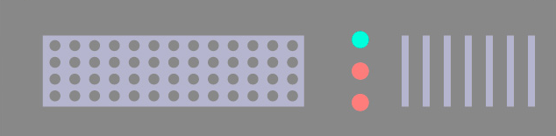
Past: How did we begin?
Many disparate static websites on one server
Dreamweaver templates
Limited resources
The need for standardization
Many websites on many platforms
The need for a unified service
elsinore

Slide 4
Past: Hosting
On campus, large multi-tenant Apache/MySQL
Hosted Drupal 6 and 7
Scaling was difficult
Noisy neighbors

Slide 5
Past: Cloud hosting v1 – Acquia, 2015
Multi-tenant, 50 sites per virtual machine hosted by Acquia on Amazon Web Services
Deploying new sites was hard, needed to wait for new hardware provisioning
Noisy neighbors still problematic on some servers

Slide 6
Present: Cloud hosting v2 - Pantheon
All sites moved to Pantheon over 6 months, April to September 2018
Began moving 10 sites per week and scaled up to 100 sites per night at end of project
  12AM - 7AM: copy site, run visual regression test
  7AM - 5PM: review test results and fix issues
  5PM - 9PM: resync database/files and repoint DNS

Slide 8
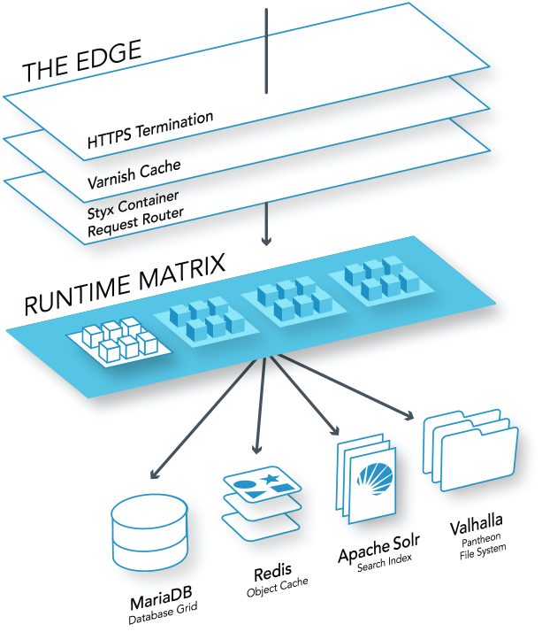
Present: Cloud hosting v2 - Pantheon
Every site lives in its own application container with dedicated resources
Self-service deployments, no need to wait for server provisioning
Noisy neighbors no longer an issue
Notes:
Container contains nginx, APC cache, and PHP worker agent

Slide 9
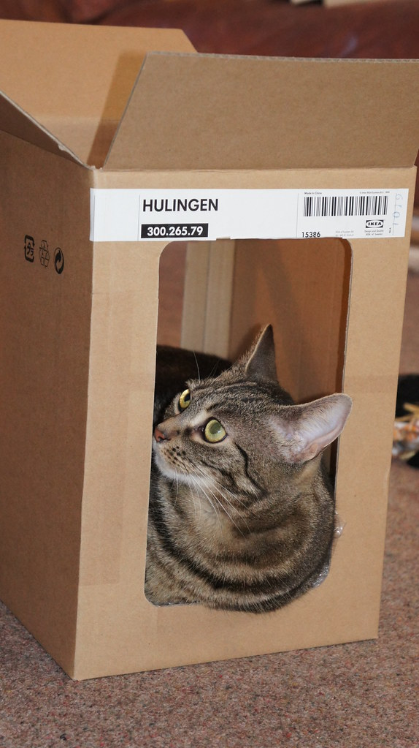


Present: Cloud hosting v2 - Pantheon
Before
After
Notes:
Sites now have room to breathe

Slide 10
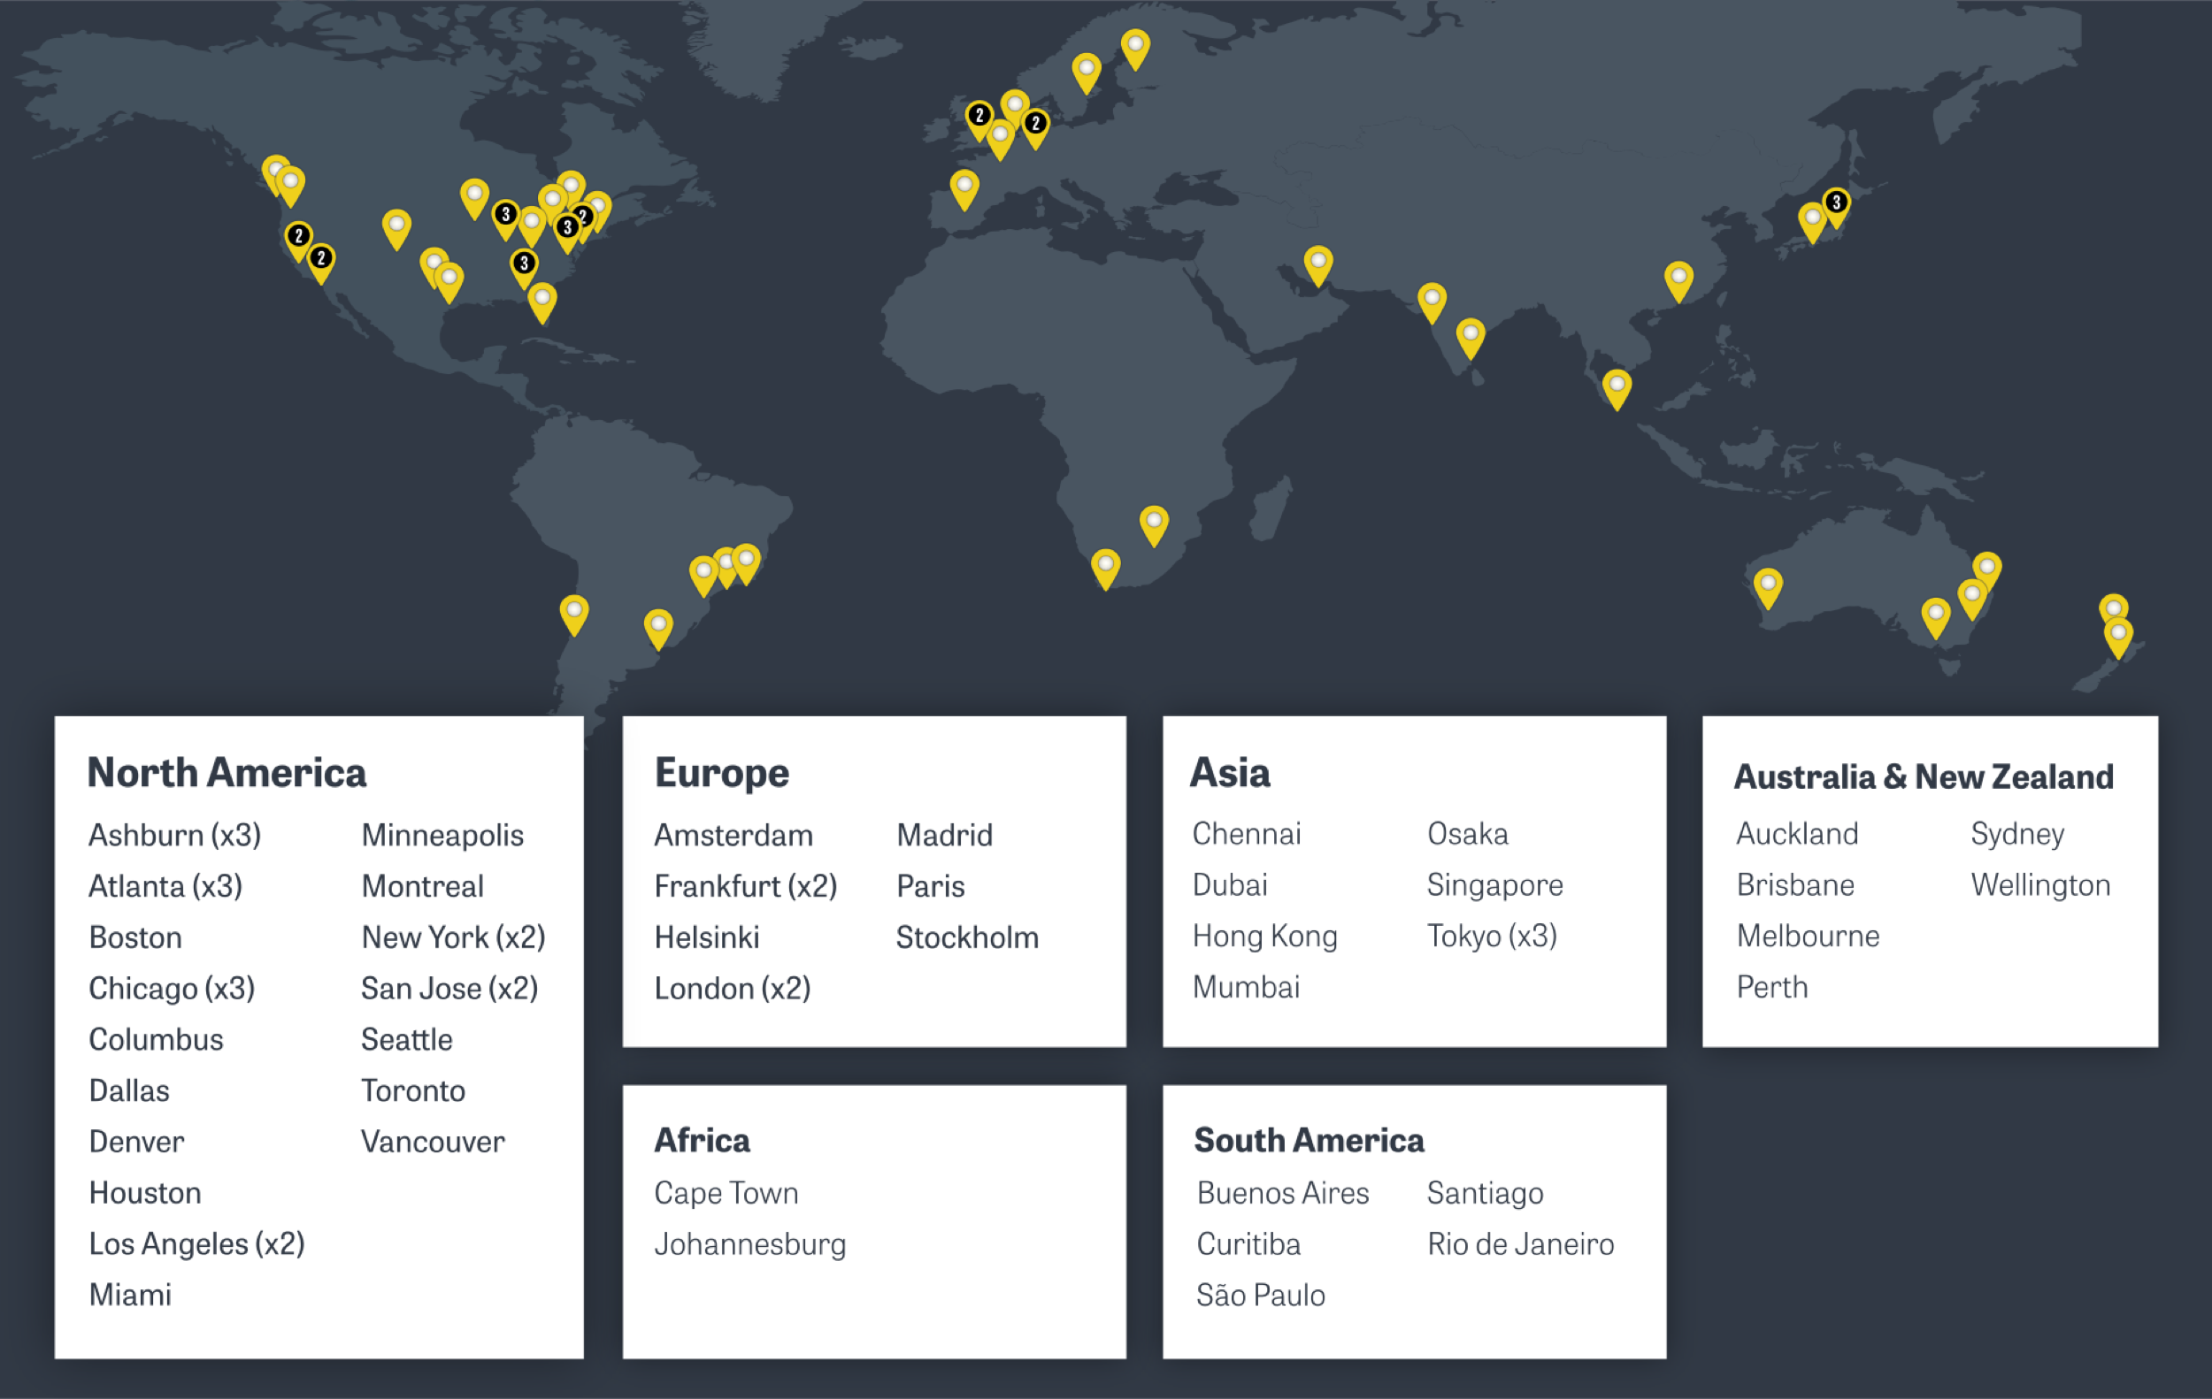
How: Pantheon architecture
Global CDN delivering sub-second cached page loads from 60+ points of presence
Content delivered from nearest point of presence eliminates many round trips
Notes:
Demo CDN headers

Slide 11
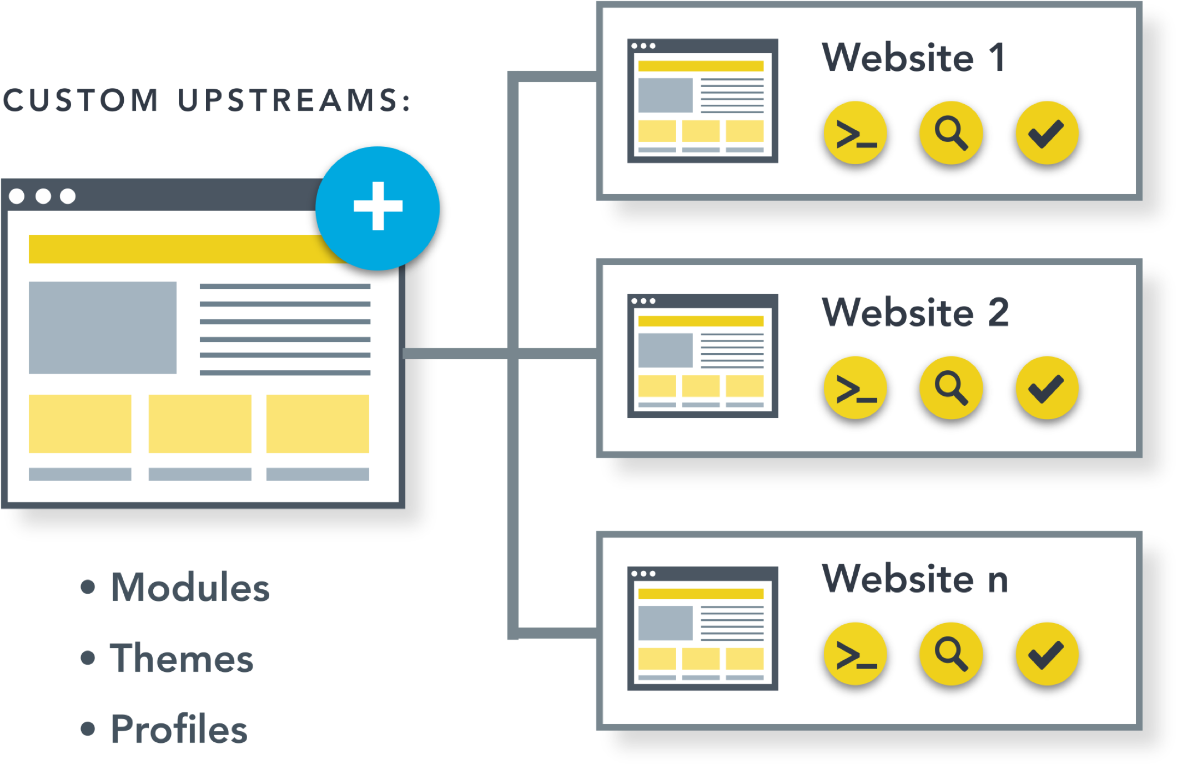
How: Pantheon architecture
A single custom upstream code base allows us to update code once and propagate it to all sites

Slide 12
How: Installation Profile
Acts as a rubber stamp to create many site copies
Contains modules, themes, default configurations

Slide 13
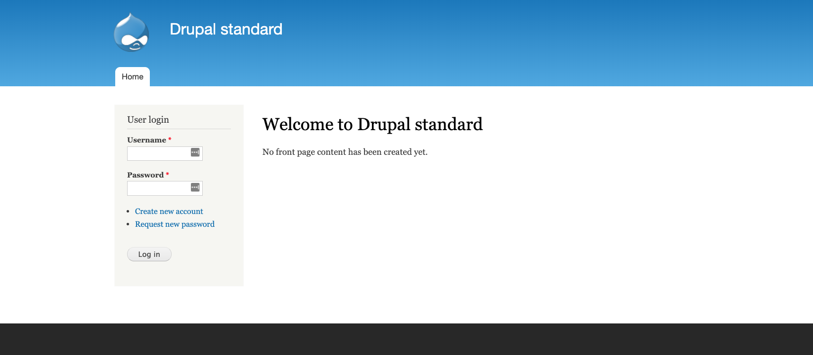
We go from this:
What about Drupal 8?
Didn’t I hear about it coming at the 2016 Digital Conference?

Slide 14
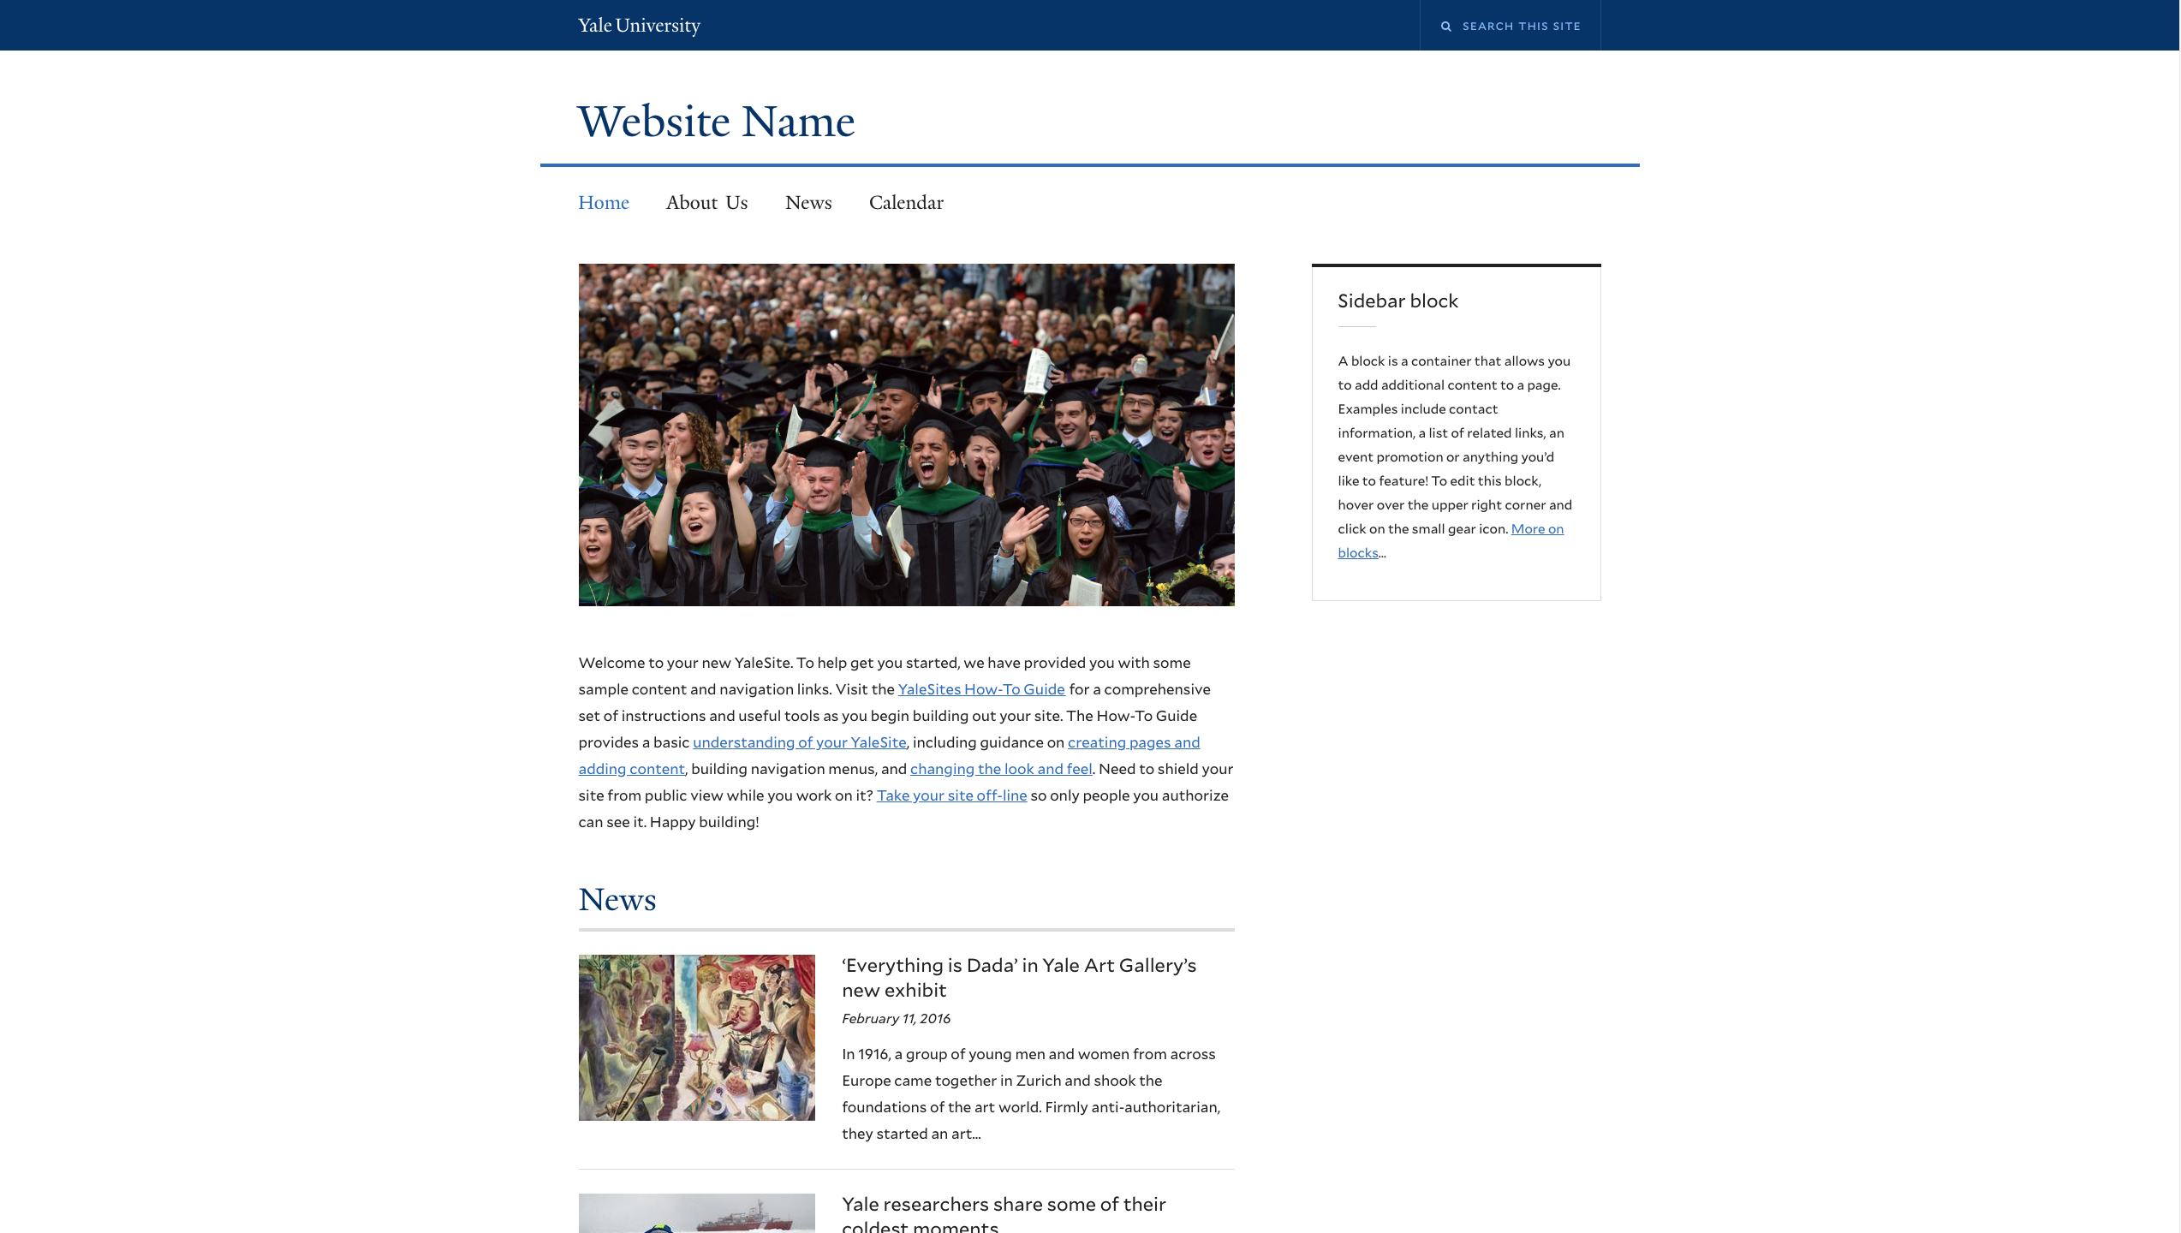
To this:
What about Drupal 8?
Didn’t I hear about it coming at the 2016 Digital Conference?

Slide 15
How: Updates
Push code change to source repository (Bitbucket)
Trigger mass update via shell script
Toolchain: Git, Terminus (Pantheon CLI tool), GNU Parallel
  $ SITES=$(terminus org:site:list yale-university --field=name)
  $ echo "$SITES" | parallel -j50 "terminus upstream:updates:apply {} --updb"
  $ echo "$SITES" | parallel -j50 "terminus env:deploy {}.test --updb"
  $ echo "$SITES" | parallel -j50 "terminus env:deploy {}.live --updb"
Notes:
Tell Dubai story

Slide 16
Future
What happened to Drupal 8?
Didn’t I hear about it at the 2016 Digital Conference?

Slide 17
Future
You did!
There are a few reasons we decided to wait.
Notes:
Drupal core major restructuring
We focused on operations (move to Pantheon)

Slide 18
Future
Here are some operational things we are excited about!
Notes:
Drupal core major restructuring
We focused on operations (move to Pantheon)

Slide 19
Future: Drupal 8
Composer dependency management
“Getting off the island”
Download and update Drupal, modules, dependencies
More easily integrate other PHP projects, libraries

Slide 20

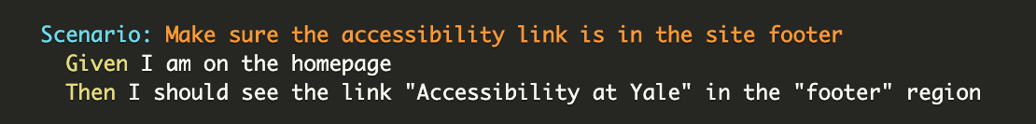
Future: Drupal 8
Automated testing to ensure consistency of installation profile build
Notes:
Behat test scenarios are written with Gherkin,[3] a business-readable domain-specific language following defined patterns.

Slide 21
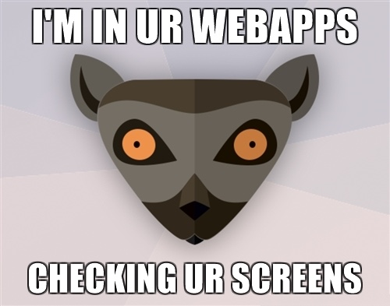
Future: Drupal 8
Visual regression testing via BackstopJS…
For when updates shouldn’t change CSS!

Slide 22
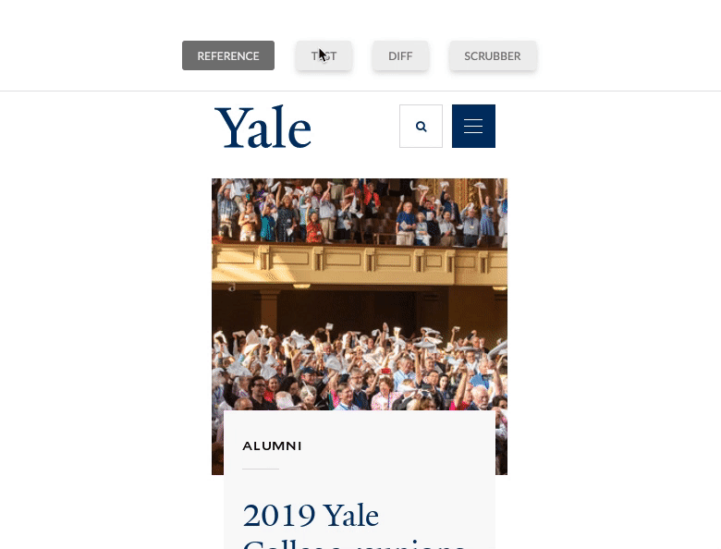
  compare | ERROR { requireSameDimensions: true, size: isDifferent, content: 44.22%, threshold: 0.1% }
  report | Test completed...
  report | 0 Passed
  report | 1 Failed

Slide 23
Future
Drupal 7
D7 end of life is November 2021. Long-term support to follow.
Drupal 9
D9 will be a refactoring release that will deprecate APIs, clean up, and allow for a straightforward upgrade from D8.

Slide 24
Thank you! Questions?

Slide 25
References and further reading
References
https://github.com/garris/BackstopJS
Drummer photo from Wikimedia Commons
"Cat in a box (again)" by sarahgb(theoriginal) is licensed under CC BY-NC-ND 2.0
"Thinking Design | Perfect Cat House" by Hey! Cheese is licensed under CC BY-NC-ND 4.0
Box vector created by freepik
Cog vector created by rawpixel.com
Background vector created by freepik
Further reading
https://pantheon.io/blog/why-we-built-pantheon-containers-instead-virtual-machines
https://pantheon.io/blog/why-we-chose-container-based-infrastructure-pantheon

