Slide 1
How Visible Are Your Events?
Scheduling and Event Management
Yale ITS | Shared Application Services
Jeffrey Campbell
James Tucciarone, III

Slide 2
Event and Scheduling Services
Calendaring
Bedework
Event Management
Cvent
CrowdCompass
Reservations
Room Reservation System (RRS / EMS)
Notes:
Unified University:
President Salovey has said on multiple occasions that one of our goals is to be a more unified, more innovative, more accessible, and generally more excellent Yale.
The university calendar presents an opportunity for us to be a part of the President’s vision.
A unified calendar allows both the Yale community and community at large to view all events occurring on campus in a single location.
A unified calendar can also provide a unified hub for facilities and public safety where they may have one place to go to know everything taking place on campus.
Search:
One of the great fixes is a fully functional and powerful search ability.
Unstable Architecture:
Recurring outages and problems
Slow administrative experience
Can be attributed to an outdated system and infrastructure architecture
Inability to Update:
One of the primary issues preventing updating includes the array of calendar suites.
Condensing to a single calendar website allows us to upgrade to the most recent release.
The use of newer technology will allow us to fix many problems plaguing the Bedework system and leverage exciting new features.
It also gives us the opportunity to upgrade the overall system to improve stability.

Slide 3
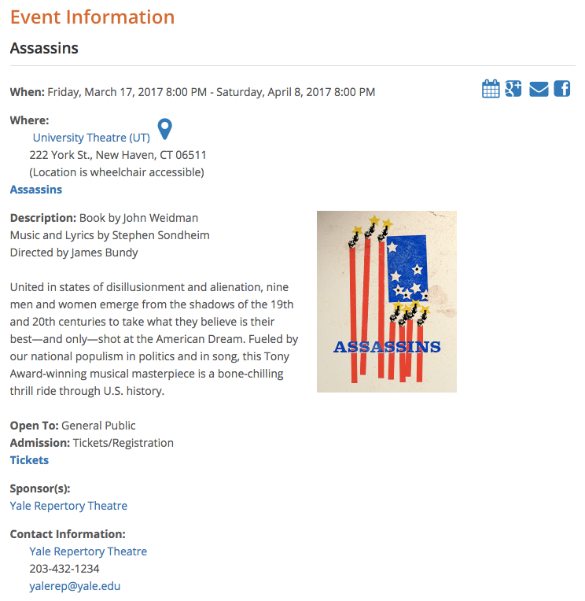
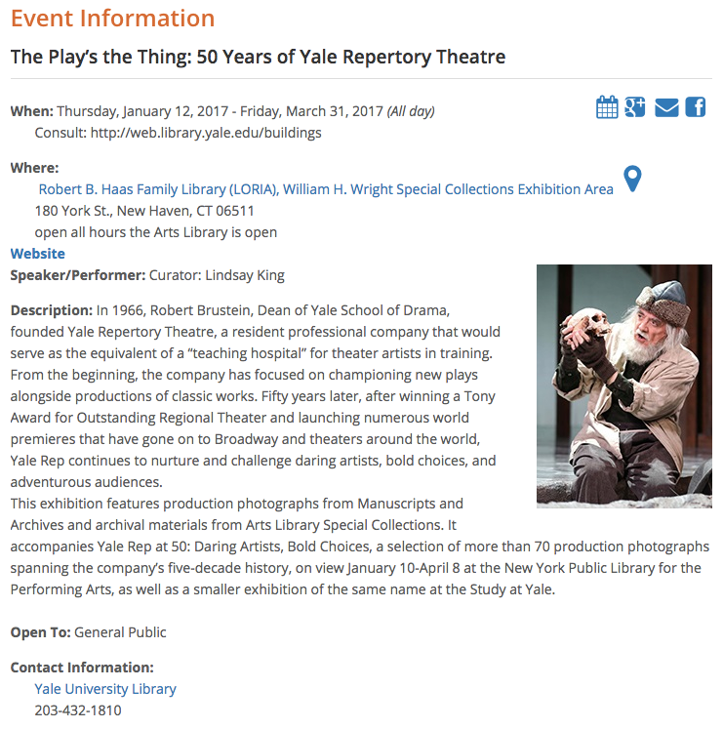
Bedework
Primary Yale calendar
Event promotion and exposure
Unified view of Yale events
Create, maintain, and manage own events
Event submission and approval
Anyone with a NetID can be an administrator or submitter
Tagging for categorization and filtering
Cross-tagging of events
Event consumption via API
Notes:
One Calendar:
Improved event exposure
Broader audience
Users can go to one place to see everything that’s taking place on campus.
Family, visiting guests/speakers/performers, general public, Yale community
Unified Event Hub, all events in one place
Improving experience for the Yale Community, Facilities, Public Safety, and General Public (and certainly others as well)
Improved user-experience
One place for people to go.
Unfamiliar/new users don’t have to know which specific calendar or website holds related events.
Unified University:
University calendar will move us in the direction of the vision and provide a unified hub for events at Yale (own it)
President Salovey has said on multiple occasions that one of our goals is to be a more unified, more innovative, more accessible, and generally more excellent Yale.
A unified calendar allows both the Yale community and community at large to view all events occurring on campus in a single location.
A unified calendar can also provide a unified hub for facilities and public safety where they may have one place to go to know everything taking place on campus.
Global Tagging Structure:
Moving to a tagging structure that can be shared globally throughout the system.
Hopefully, tags better understood by a typical user.
Each calendar group will have their own filter.
Users can choose to view events from a single calendar group.
Easier Sharing/Cross-Publishing:
Essentially will become cross calendar tagging, so an event will be displayed for both calendars.
OPAC:
Public facing outlet of the university
Style, or look-and-feel, of the new public view will be designed and maintained by OPAC.

Slide 4
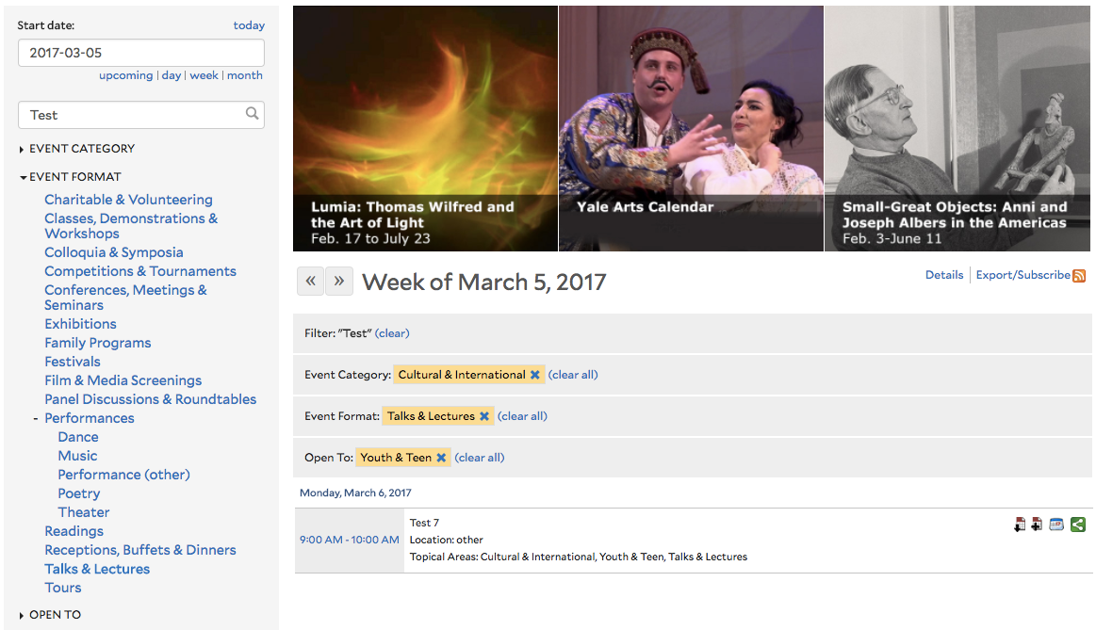
Bedework Upgrade
Improved search and filtering
Introducing filtering by calendar group
Free-event registration and waitlist capabilities
One public calendar aggregating all events
Look and feel to be managed by OPAC
Distinct calendar views will go away
Improved performance, stability, and availability
Designing to facilitate future upgrades
Notes:
Filtering and Search:
Each calendar group will have their own filter.
Users can choose to view events from a single calendar group.
With buildable filters and a search filter, makes for a very robust user experience.
Search acts as a filter, further refining the event list.
Registration:
The Shared Application Services/Calendar and Event Management team has often fielded requests about registration software for free events.
Following the upgrade, Bedework will allow for configuring an event to require registration.
Allows for setting a max number of registrations.
Users create an account to manage their registrations.
Waitlist capabilities allows for dropped registrations.
One Public Calendar
Public facing outlet of the university
Style, or look-and-feel, of the new public view will be designed and maintained by OPAC.
As implied by a unified calendar, individual calendar views / lists / pages / websites (i.e., calendar.yale.edu/cal/…) are going away.
For those interested in maintaining a custom calendar ‘skin’, who also have a YaleSites website, a calendar can be customized to match your theme and consume calendar events from Bedework.

Slide 5
API for Event Consumption
X
API (application programming interface)
A set of methods for communication between software components
Largely phasing out direct feed consumption and associated support
New YaleSites module for Bedework integration
(Still under development – additional details to follow)
Notes:
API:
Mentioned this API quite a bit.
Definition
Basically, in our case, it’s a specific set of commands that allows an application to request data or information.
i.e., a filtered list of events and their fields, a list of calendar tags, a list of calendar groups, etc.
Feed Consumption:
Within Central IT, there is a movement towards making data available through similar mechanisms and programmatical calls.
Allows for better support, improved data structure, and consumption metrics.
PeopleHub
YaleSites Module:
Developing a new YaleSites module that will be similar to the existing Bedework module.
From the administrative perspective, module interaction will remain largely the same.
API key?

Slide 6
Questions and Comments

Slide 7
Cvent
Event management and logistics
Design sessions and tracks
Create event websites
Send invitations and emails
Track activity and generate reports
Securely collect payments
Generate task lists, calendars, name badges and mailing labels
Housing and travel management integration
Cvent OnSite Support

Slide 8
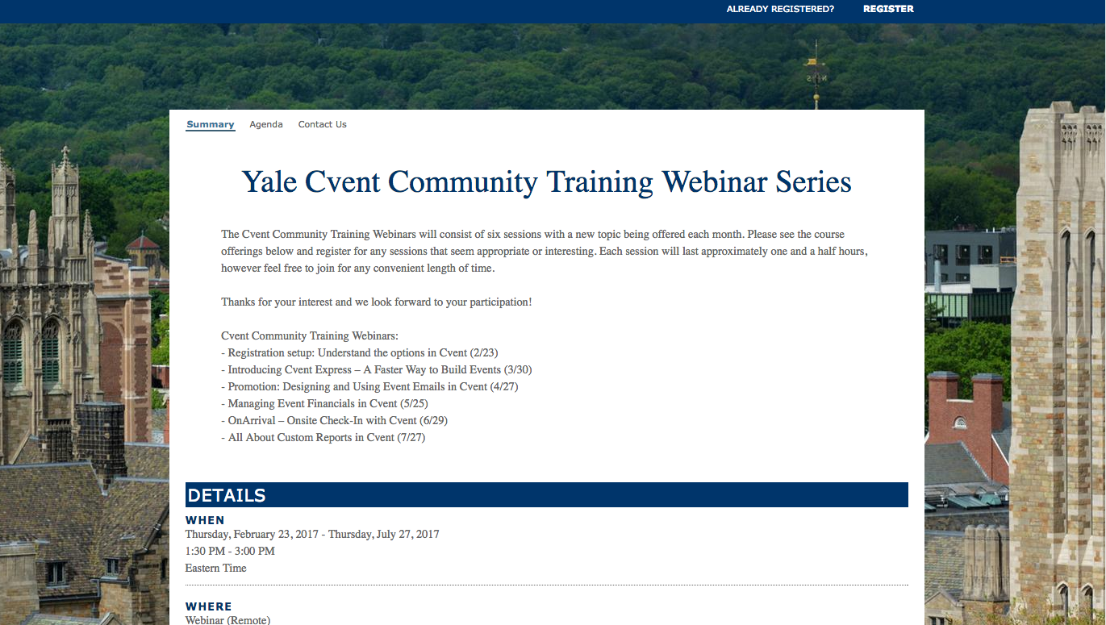
Cvent
Event management and logistics
Design sessions and tracks
Create event websites
Send invitations and emails
Track activity and generate reports
Securely collect payments
Generate task lists, calendars, name badges and mailing labels
Housing and travel management integration

Slide 9
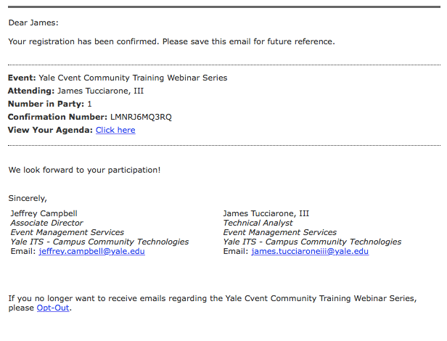
Cvent
Event management and logistics
Design sessions and tracks
Create event websites
Send invitations and emails
Track activity and generate reports
Securely collect payments
Generate task lists, calendars, name badges and mailing labels
Housing and travel management integration

Slide 10
CrowdCompass
Mobile event management
Specific or broad events
Added to existing Yale app (i.e. Yale Events)
iOS, Android, and HTML5
Session pages
Notifications, attendee messaging, and social integration
Maps / Interactive maps
Instant updates
Cvent integration

Slide 11
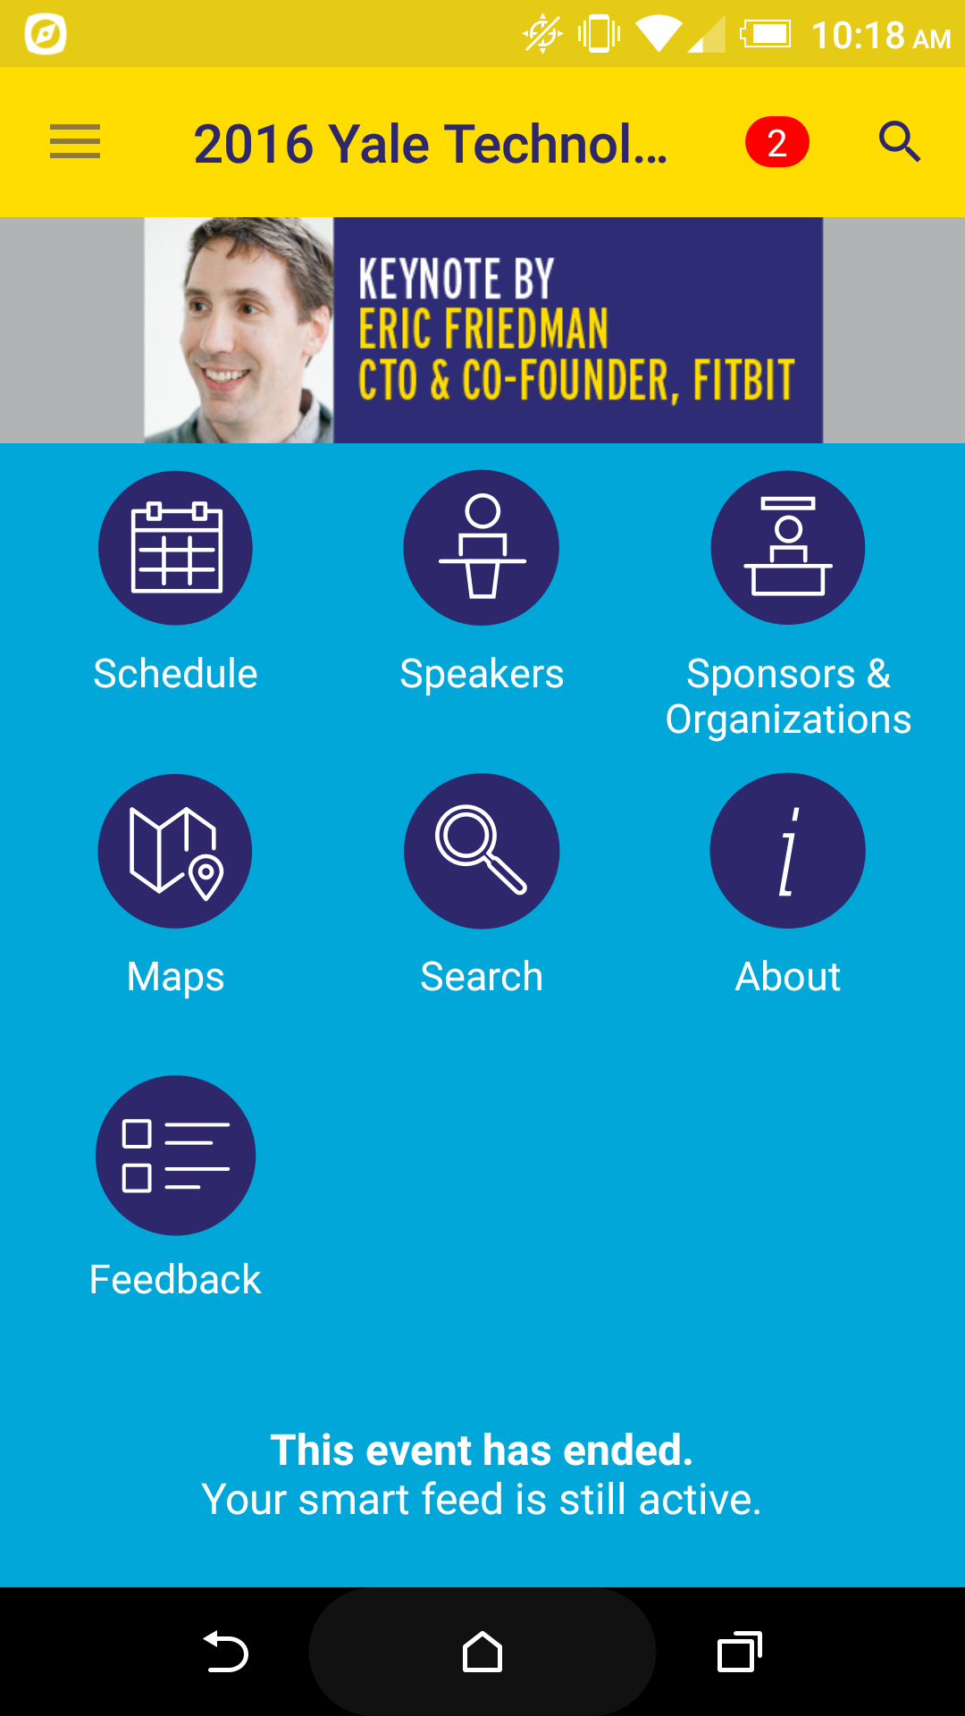
CrowdCompass

Slide 12
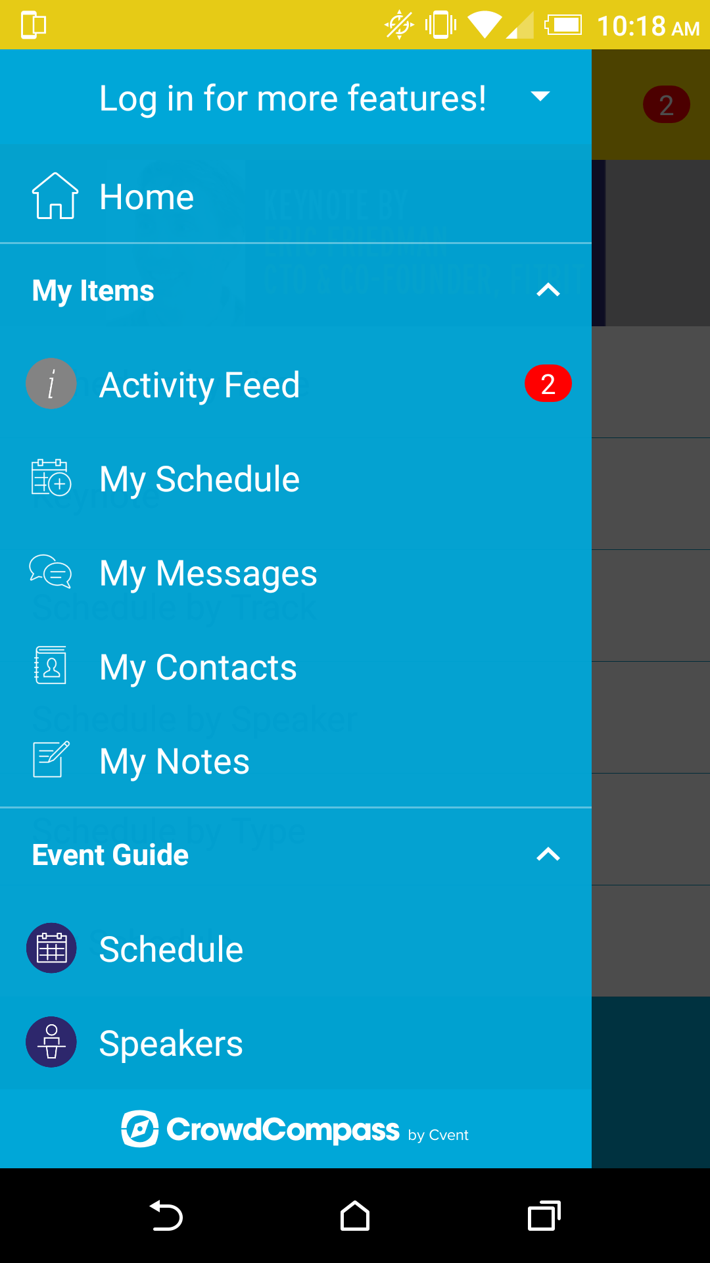
CrowdCompass

Slide 13
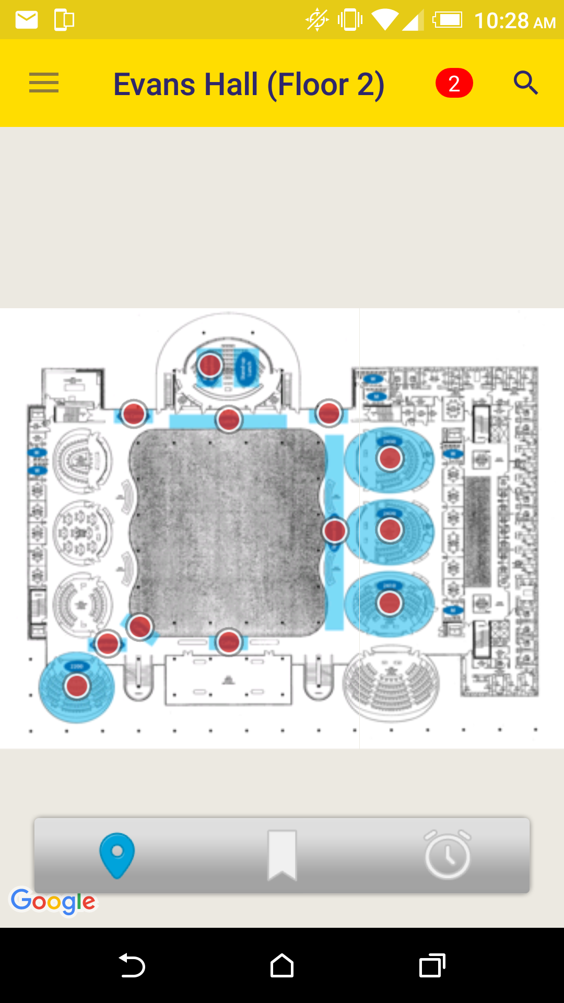
CrowdCompass

Slide 14
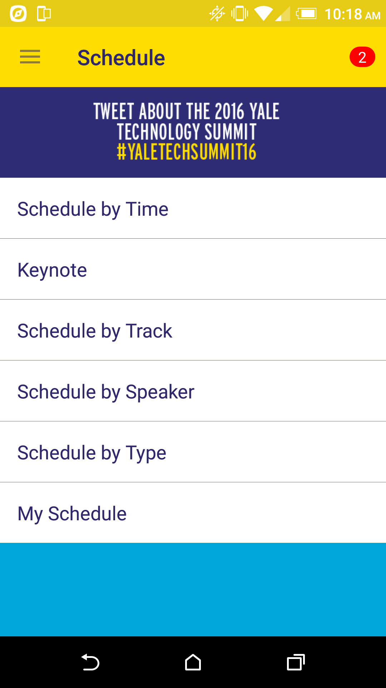
CrowdCompass
Notes:
Service Improvement:
Unified Event Hub, all events in one place
Improving experience for the Yale Community, Facilities, Public Safety, and General Public (and certainly others as well)
Improved user-experience
One place for people to go.
Unfamiliar/new users don’t have to know which specific calendar or website holds related events.
Improved event exposure
Broader audience
Users can go to one place to see everything that’s taking place on campus.
Family, visiting guests/speakers/performers, general public, Yale community
Easier Sharing/Cross-Publishing:
Essentially will become cross calendar tagging, so an event will be displayed for both calendars.
Registration:
The Shared Application Services/Calendar and Event Management team has often fielded requests about registration software for free events.
Following the upgrade, Bedework will allow for configuring an event to require registration.
Allows for setting a max number of registrations.
Users create an account to manage their registrations.
Waitlist capabilities allows for dropped registrations.
Search and Filtering:
Search actually works!
Historically, search has not been very robust or even functional.
Two of the most powerful improvements:
Search
Robust search mechanism that actually return appropriate events.
Content can be used to improve search findability.
Filtering
Allows for selecting multiple filters or tags.
Can be used to refine and dig down into events.

Slide 15
Questions and Comments

Slide 16
Room Reservation System
Space and resource reserving
Configure space details, seating configurations, capacities, room features, availabilities, and costs
Granular access control
Email notifications and confirmations
Custom reporting
Banner synchronization
Exchange integration
Digital room signage and check-in

Slide 17
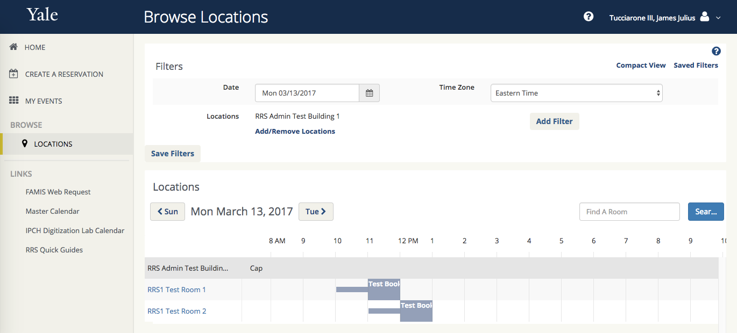
Room Reservation System

Slide 18
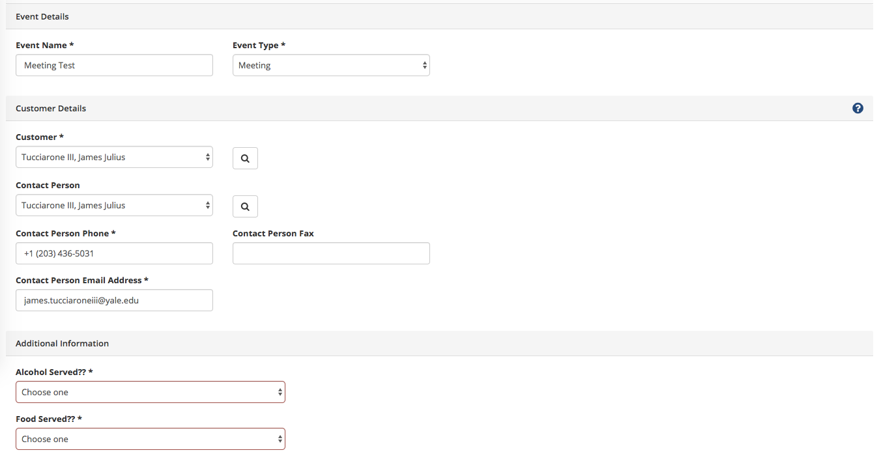
Room Reservation System

Slide 19
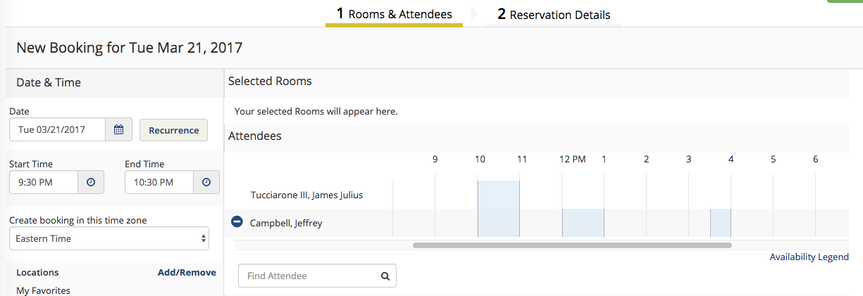
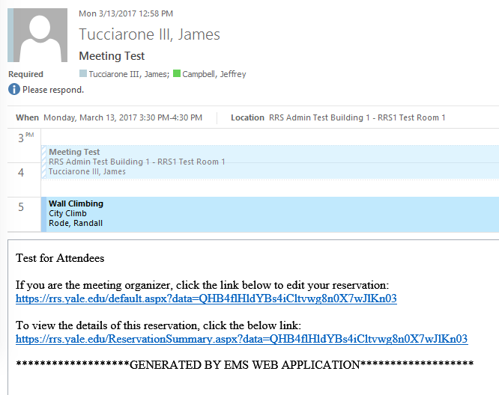
Room Reservation System

Slide 20
Questions and Comments

