Slide 1
Yale Digital Conference 2019
Jenn Nolte
User Experience Research Librarian

Slide 2
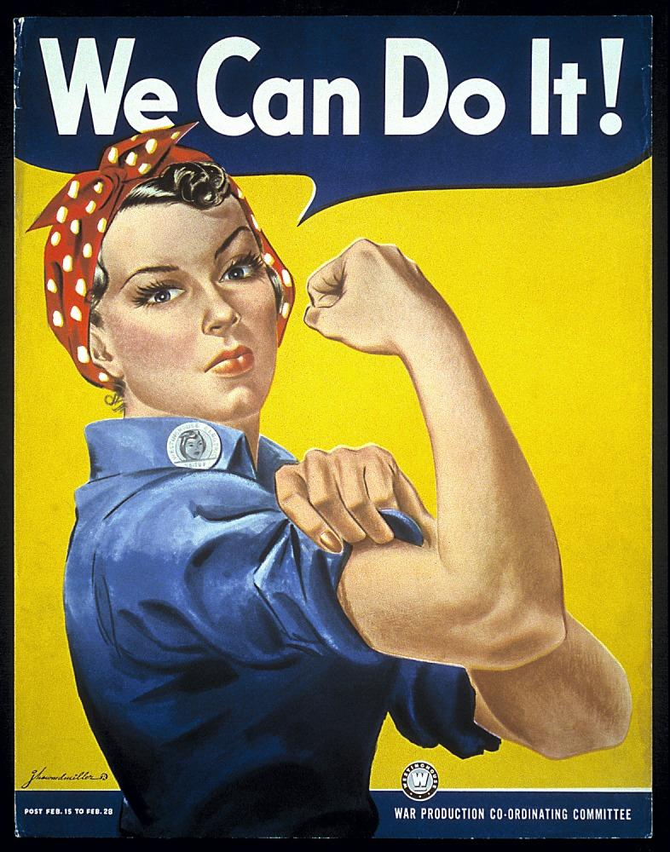
You Can Do It!
Remote Unmoderated User Testing on a Budget
Jenn Nolte
User Experience Research Librarian

Slide 3
What are we talking about today?
The part-time, solitary UX researcher
Addressing constraints
The method
What went well, what didn’t go so well
Variations on the method

Slide 4
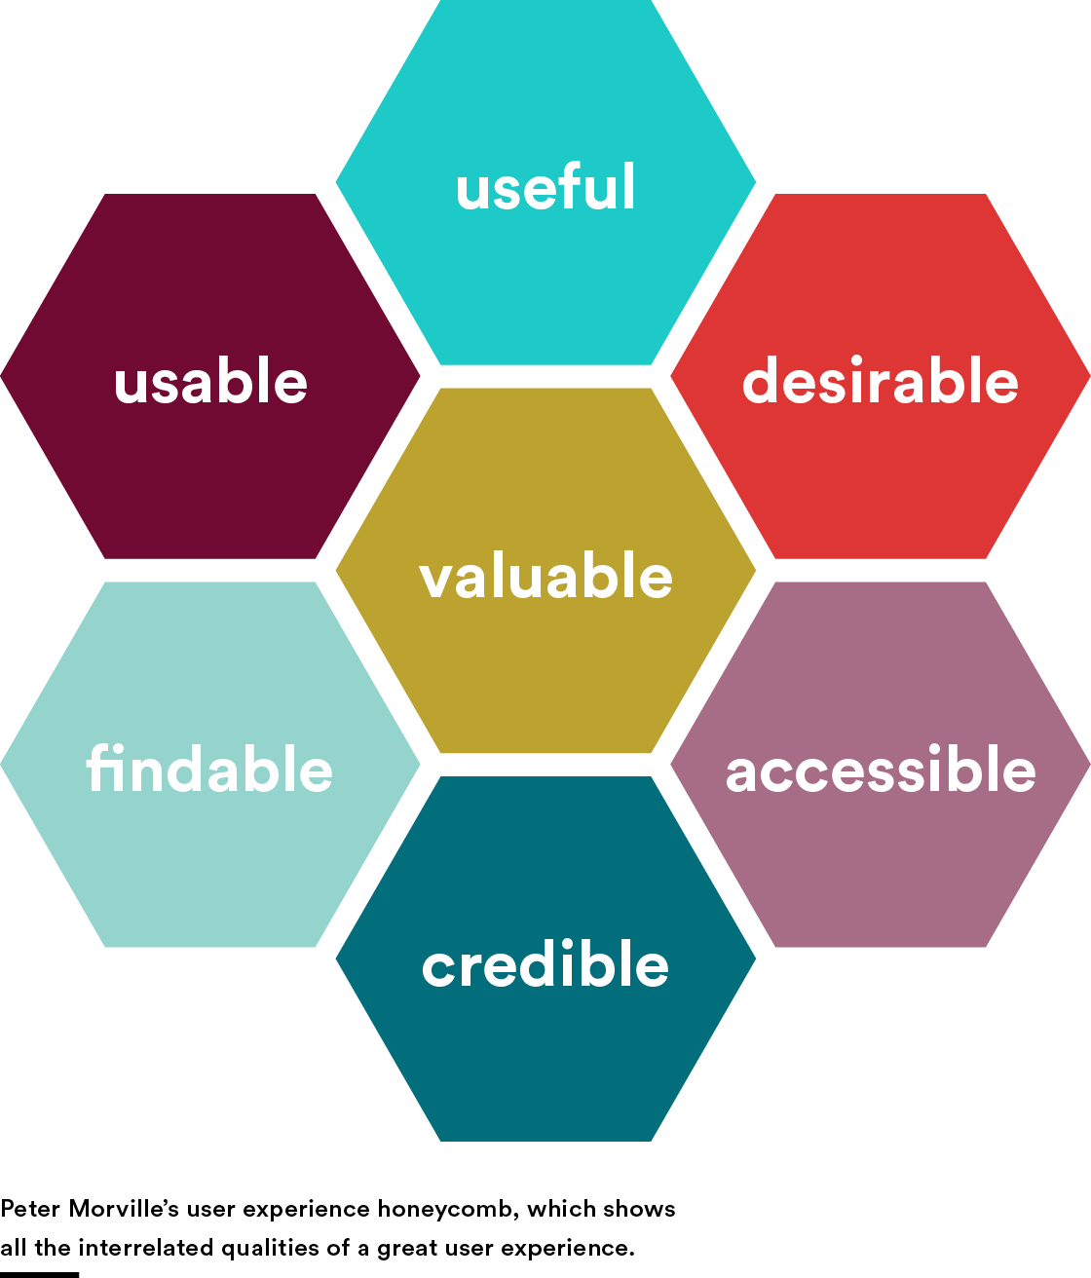
The part-time, solitary UX researcher
Assessment & UX Research at Yale University Library
Usage statistics
Data visualization
Dashboards
Usability testing
More soon!
Notes:
My name is Jenn Nolte, and I’m the UX Research Librarian at Yale University Library. I’ve been at the Library since 2004, but transitioned into my new role this past January as a part of a new department: Assessment & UX Research. This department’s services represent an expansion of the services offered by our department head, Assessment Librarian Sarah Tudesco. With the addition of a Library Business Analyst, Meng Tang, AUXR offers usage statistics collection and reporting, data visualization, dashboards, usability testing as its core services, with more to come in the next several months. It’s exciting!

Slide 5
The part-time, solitary UX researcher
User Experience Group
Assisted UX Librarian in organizing team usability testing
Group testing
My other stuff didn’t go away!
2014
2016
2013
2015
UX Librarian departure
Assumed responsibility for usability testing activities
Exploration
Began investigation into gaining efficiency with usability testing
Notes:
So before this, as I mentioned, I had been working in Library’s IT office when I had the opportunity to join the User Experience group in that department. Once there, I began assisting the UX Librarian in organizing team guerrilla usability testing and collecting and analyzing the results. [Explain process a bit] When the UX Librarian moved on in 2014 I assumed responsibility for the Library’s usability testing activities. HOWEVER, my other stuff didn’t go away! I really wanted to continue and grow our usability testing program, so I began exploring ways to get this work done as a part-time, solitary UX researcher.

Slide 6
Addressing constraints
Time spent | Team testing model | Individual testing model
Organizing, scheduling staff | ✔️
Training staff | ✔️
Debriefing staff | ✔️
Transcription, collation of test notes | ✔️ | ✔️
Recruiting |  | ✔️
Moderating tests |  | ✔️
Notes:
I began to realize that if I continued the team testing model as the basis of our program, I would invest a lot of time in [list].
But, running all the tests myself was also not much better- recruitment is always difficult and even more so with one person.

Slide 7
Addressing constraints
Time spent | Team testing model | Individual testing model
Organizing, scheduling staff | ✔️
Training staff | ✔️
Debriefing staff | ✔️
Transcription, collation of test notes | ✔️ | ✔️
Recruiting |  | ✔️
Moderating tests |  | ✔️
Notes:
Any way you slice it, the processing and analysis of usability testing data will always take up a significant amount of time. But maybe there are ways to expedite this a bit as well?

Slide 8
Addressing constraints
Goal:
Conduct routine usability tests while minimizing time spent moderating and recruiting
Notes:
So these are some of the problems I was seeking to address:

Slide 9
Addressing constraints
Goal:
Collect quantitative data automatically from test participants during the test
Notes:
From conversations with colleagues, I knew that they would value tests done with Yale community members over tests done with random people. I needed to be able to control who actually takes these tests.

Slide 10
Addressing constraints
Goal:
Collect quantitative data automatically from test participants during the test
Notes:
As mentioned before, the data process and analysis of test content is time-consuming- to be able to pull out statistical data from the tests quickly would really expedite the process and allow me to focus on deeper analysis.

Slide 11
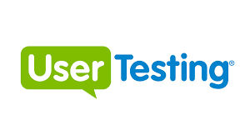
Addressing constraints
Enterprise web usability testing platform
Facilitates remote unmoderated user testing
Maintains a wide roster of on-call test participants
In-test analytics
On-staff review panels
Pay-per-test or license.

Slide 12
Addressing constraints
Expensive!
Would not sign a license agreement
Concern about exposing Yale community members to an outside company

Slide 13
Addressing constraints
Another enterprise web usability testing platform
Maintains a wide roster of on-call test participants
In-test analytics
Analysis from on-staff review panels

Slide 14
Addressing constraints
Not as expensive… but still expensive
Willing to sign license agreements
Had to move on from enterprise solutions

Slide 15
Could I recreate the user testing platform experience…
myself?

Slide 16
The method
Automatic recording
Cloud storage
Join before host
Easy, fast download, install
Mobile testing
Verification of settings

Slide 17
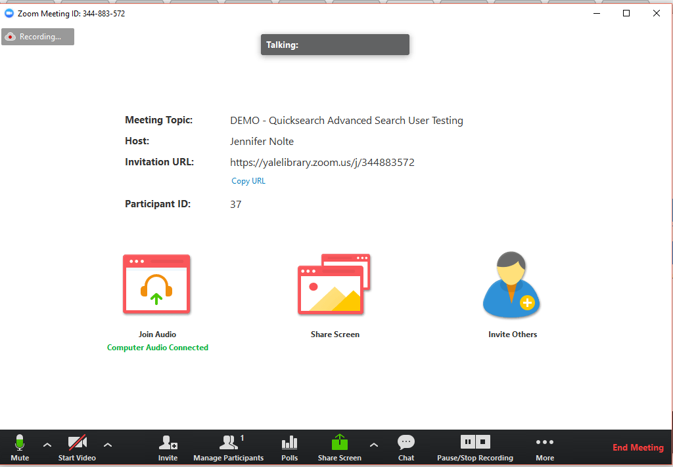
The method
Clearly identifiable settings in session window make unmoderated testing possible

Slide 18
How do you get test participants into the recording session?
Notes:
But… how to do you get participants in the session? How do you make sure it’s set up correctly? Participants aren’t going to know how to use Zoom from the jump.

Slide 19
The method
Qualtrics survey leads test participants into Zoom session
Guides testers through brief set up
Collect participant consent
Collect quantitative data simultaneously
Notes:
Follows the model used by UserTesting and UserZoom

Slide 20
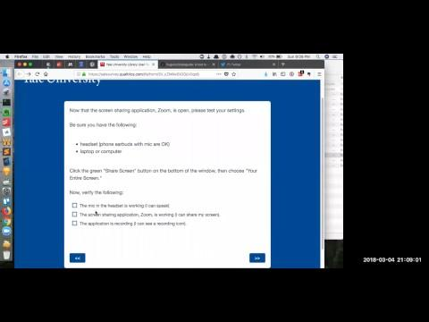
The method

Slide 21
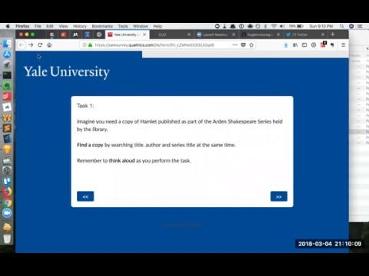
The method
Notes:
https://yalesurvey.qualtrics.com/jfe/form/SV_cZMNs5X2GjUGqsB

Slide 22
What went well, what didn’t go so well
Notes:
The maiden voyage of this method began with a comparison test of three different institutions’ advanced search feature in their Blacklight discovery interface. The results of this test were used to develop a “best of breed” advanced search- driven by student preferences. Show survey: https://drive.google.com/file/d/1fk6RkTe_MTY87mghsXpuFA0ieh1KPyrG/view?usp=sharing

Slide 23
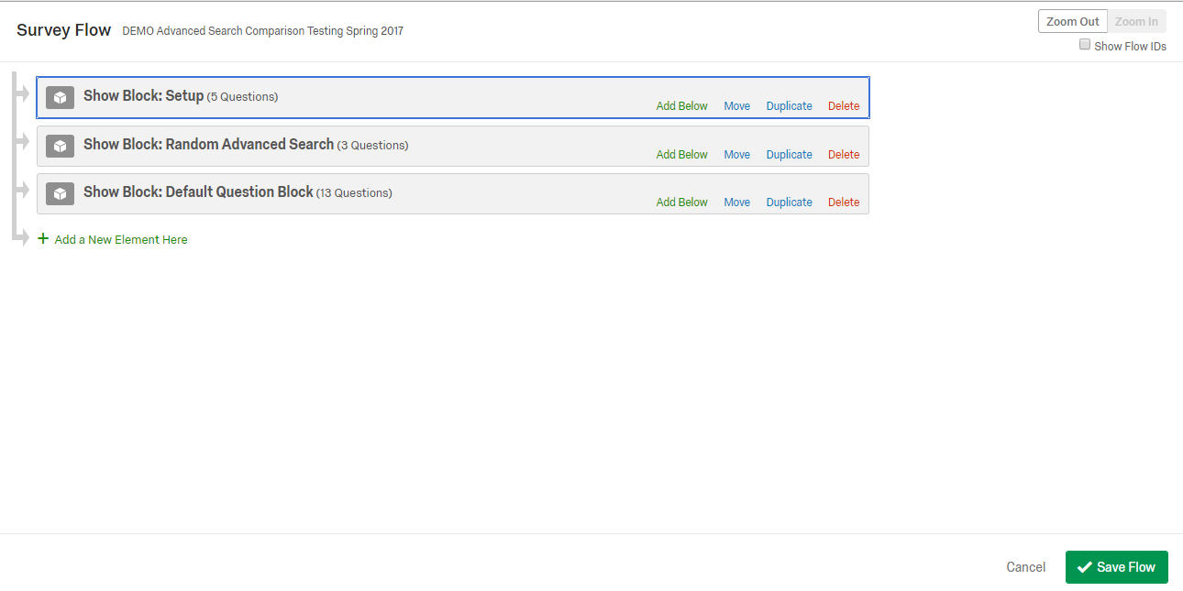
What went well, what didn’t go so well

Slide 24
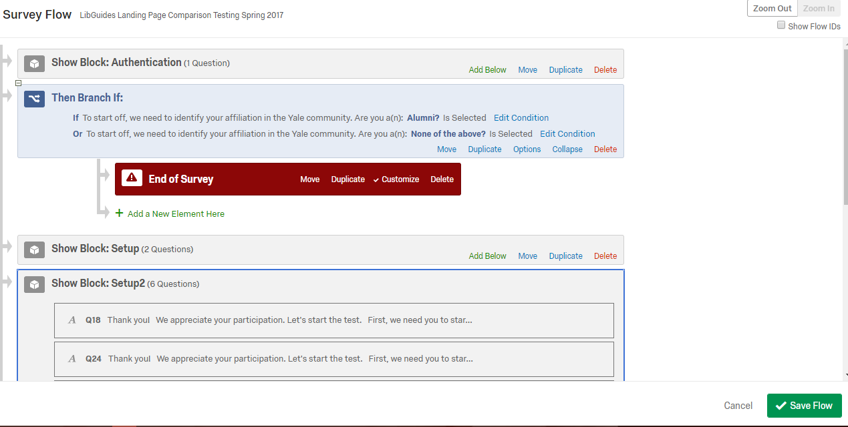
What went well, what didn’t go so well

Slide 25
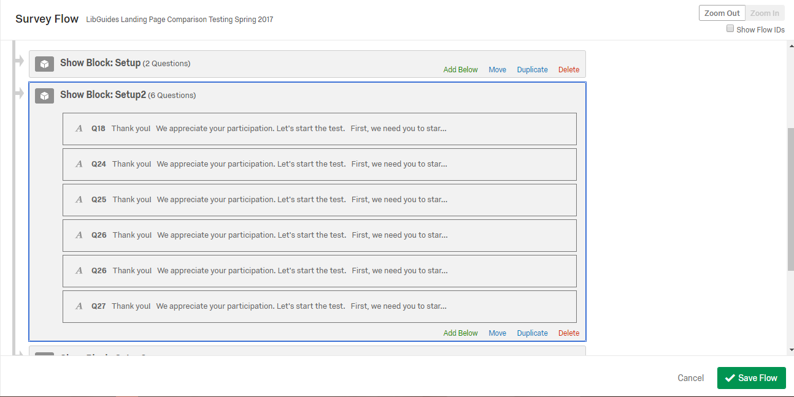
What went well, what didn’t go so well

Slide 26
What went well, what didn’t go so well
Still the most laborious part of testing
Needed to optimize this as much as possible as well
Used Optimal Workshop’s Reframer tool
Each test session transcribed and tagged
Notes:
https://www.optimalworkshop.com/a/yale/reframer/projects/7692/themes/49465
Observations from each session transcribed into OW.
Each observation is tagged with something, like confusion, delight, task 1, task 2, student, faculty, interface 1, etc. I started as a catalog assistant so I love this so much.
The tags can then be used to pull different insights together quickly. For instance, of the students who tested interface 1, how many expressed confusion during task 1? What did each of those moments have in common?

Slide 27
What went well, what didn’t go so well
Sending test out through social media
High bounce rate for tests
Technical setup still a hurdle
Sending test to outside researchers didn’t work
No opportunity to clarify statements from participants or to ask follow up questions

Slide 28
What went well, what didn’t go so well
One complaint about Amazon gift cards
Had to create multiple Zoom meetings for the same test to load balance participant traffic
Sooo much data!
Sometimes hard to hear if participants were using their laptop mic
Not an accessible process

Slide 29
Variations on the method
Variation:
Remote & moderated
Notes:
ArchivesSpace

Slide 30
Variations on the method
Variation:
In-person, moderated & scheduled
Notes:
ArchivesSpace

Slide 31
Variations on the method
Variation:
Card sorting or first click tests instead of survey questions
Notes:
https://www.optimalworkshop.com/a/yale/optimalsort/results/1f1ef149-3724-4aab-a696-32d4d33c6ba5#/t/overview

Slide 32
Variations on the method
Haven’t tried:
Screen annotation
Notes:
Zoom also has a cool feature where you can draw on the screen; this could be useful in a couple of ways.

Slide 33
Variations on the method
Notes:
Only applicable when sharing screens. Other participants can annotate too.

Slide 34
Variations on the method
Haven’t tried:
Other video conferencing solutions
Notes:
Webex, Citrix, Adobe Connect. Remember, what works with Zoom is the auto-recording to the cloud, the easier technical set up indicators, and the join before host setting.

Slide 35
Variations on the method
Haven’t tried:
Other surveying tools
Notes:
Survey Monkey, Google Forms, etc. Switching the test platform would probably be easy- I chose Qualtrics because it’s powerful, we have a negotiated site license so I feel more comfortable having participant data stored there, and it has built-in Yale branding. It is NOT super intuitive to use.

Slide 36
Tomorrow!
Attend a presentation on the new UX Research Lab at Yale!
2pm in Room 319 Kroon Hall
http://uxresearchlab.yale.edu

Slide 37
UX Community of Practice
Join our community of practice - open to all community members interested or currently practicing UX
This includes faculty and students!
Monthly lunchtime meetings
ux.cop@yale.edu
Notes:
http://schedule.yale.edu/calendar/UXRL/?cid=10042&t=d&d=0000-00-00&cal=10042&ct=44410

Slide 38
Thank you!
Jenn Nolte
User Experience Research Librarian
jennifer.nolte@yale.edu

