Slide 1
Wrangling the [Biblio] Module
[author_first]
[permalink]
[ISSN]
[issue]
[DOI]
[pages]
[volume]
[ISBN]
[title]
[editor]
[date]
[accession]
[year]
[publication_type]
[filetype]
[original_publication]
[conference_name]
Nick Allen
Research Assistant
Forestry School
YaleSites DrupalCamp
11 March 2014
[chapter_title]
[abstract]
[author]
[call number]
[keywords]
[section]
[image]
[location]
[edition]
[publisher]
[short_title]
[author_last]
Notes:
Here because you or a loved one need your cite to flexibly manage publications.
Introduce self
YaleSites Publications feature
YaleSites faculty publications is a good start, but doesn’t work play well with varied publication types. Biblio is a YaleSites-enabled module that can help us get there.

Slide 2
Rundown
Problems in publication handling (<10 min)
Biblio advantages (5 min)
Demo (10 min)
Talkback/Troubleshooting (balance of time)

Slide 3
Why Publication Handling?
Active maintenance & research funding
Scholarly impact
Prospective student interest
Journal requirements
Notes:
Why should Drupal developers and admins in higher ed care about publication handling? Same reasons why faculty and researchers care about them.
For these reasons, up-to-date publications lists are probably the most important feature for lab websites and faculty websites. Many funders and collaborators come to these websites specifically to look at recent publications.
However, labs rarely have time or funding to hire web developers. To gain widespread adoption of YaleSites among labs and scholars, a flexible, easily managed publications module must be a core feature.

Slide 4
A Basic Citation
Tomlinson T. 2010. Enabling interactive capabilities. In: Beginning Drupal 7. 1st ed. New York: Springer. p. 97-117. Available from: http://link.springer.com/chapter/10.1007/978-1-4302-2860-8_9.
Tomlinson T. 2010. Enabling interactive capabilities. In: Beginning Drupal 7. 1st ed. New York: Springer. p. 97-117. Available from: http://link.springer.com/chapter/10.1007/978-1-4302-2860-8_9.
Author
.
Publication_year
.
Chapter_title
. In:
Book_title
.
Edition
.
Location
:
Publisher
. p.
Pages
. Available from:
URL
.
Notes:
So let’s look at a basic citation to see what we’re dealing with. On its face a simple text string.

Slide 5
Problem: Publication Variety
NODE: Book Chapter
NODE: Journal Article
Common
Analogous
Distinct
Author(s)
Year
Title
DOI
URL
Attachment
Book Title
Secondary Title
Journal Title
ISBN (13-digit)
Object ID
ISSN (8-digit)
Edition
Editor(s)
Publisher
Volume
Issue
Short Title
Notes:
Consider two fairly similar publication types.

Slide 6
Problem: Citation Styles
Council of Science Editors (name–year): Sciences
Tomlinson T. 2010. Enabling interactive capabilities. In: Beginning Drupal 7. 1st ed. New York: Springer. p. 97-117. Available from: http://link.springer.com/chapter/10.1007/978-1-4302-2860-8_9.
Chicago: Social Sciences
Todd Tomlinson. “Enabling Interactive Capabilities,” in Beginning Drupal 7
(New York: Springer, 2010), 97-117, accessed March 11, 2014, http://link.springer.com/chapter/10.1007/978-1-4302-2860-8_9.
Modern Language Association: Humanities
Tomlinson, Todd. “Enabling Interactive Capabilities.” Beginning Drupal 7. 1st ed. New York: Springer, 2010. 97-117. Web. 11 Mar. 14.<http://link.springer.com/chapter/10.1007/978-1-4302-2860-8_9>.
Notes:
Syntactical differences are pervasive, exacting, and extremely pedantic.
Note differences in:
Field order
Punctuation & capitalization
Bad news: YaleSites Faculty Publications doesn’t
Good news: Problem is widely recognized and lots of brave developers dealing with the tedium. Lots of Open Source applications that are dealing with this. Zotero (online citation management), BibTex (reference management software for LaTeX).

Slide 7
Biblio: Flexible for Developers
Maintained by Harvard OpenScholar
CiteProc compatible
Easily integrated with Views
Robust entity references
API access

Slide 8
Biblio: Easy on Admins
Autopopulation from unique IDs
Export capabilities
User pages linked to Biblio authors

Slide 9
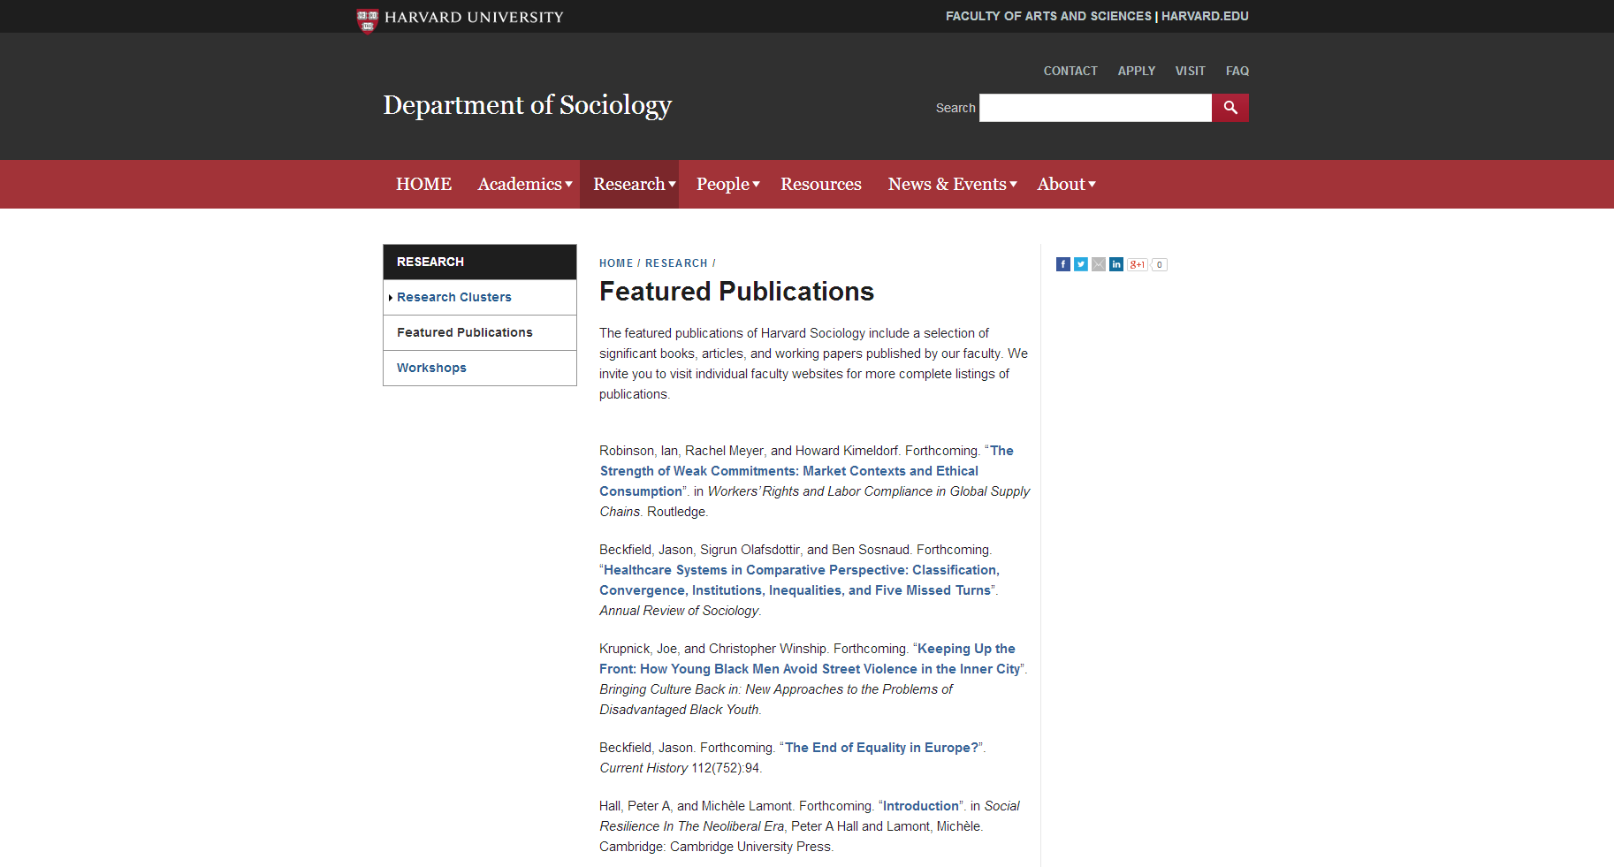
Department Page
Image fields can be appended
Title links to publication node
Abstract expands on click
Pagination

Slide 10
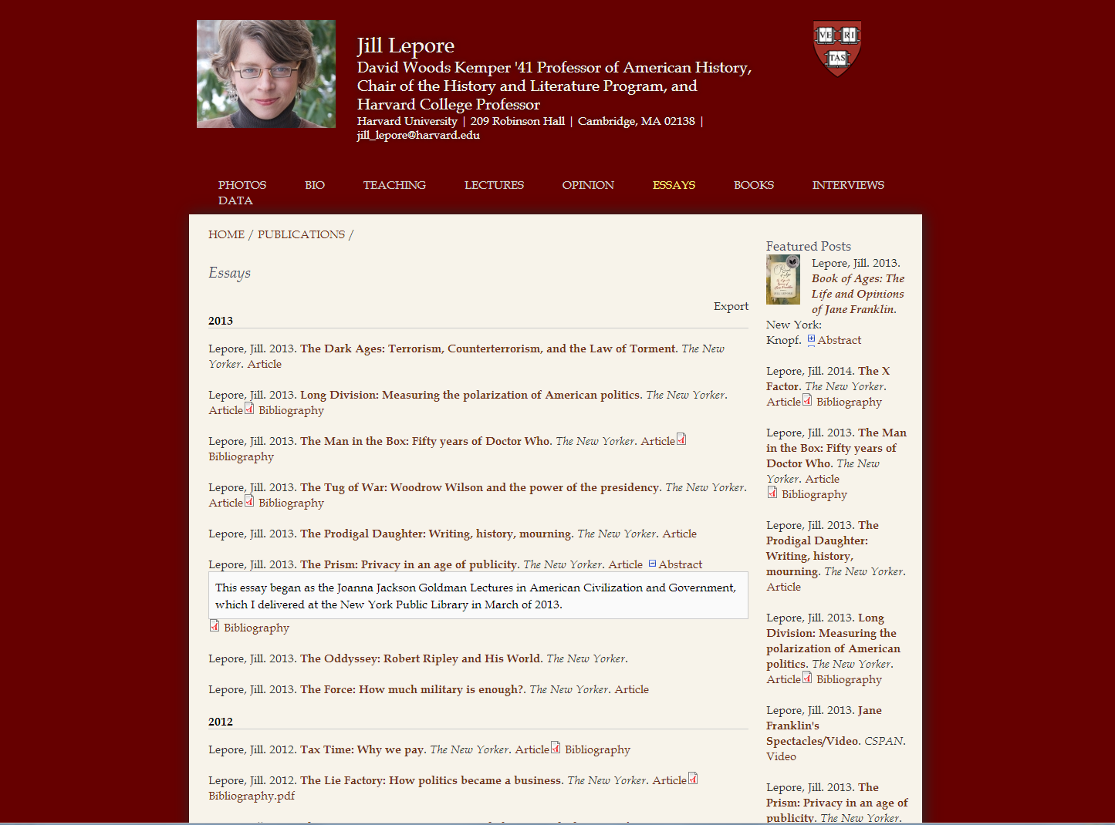
Faculty Page
All recent publications in sidebar
Filtered by Publication Type
Metadata export for bibliography software
External link and PDF download
Sorted by Year

Slide 11
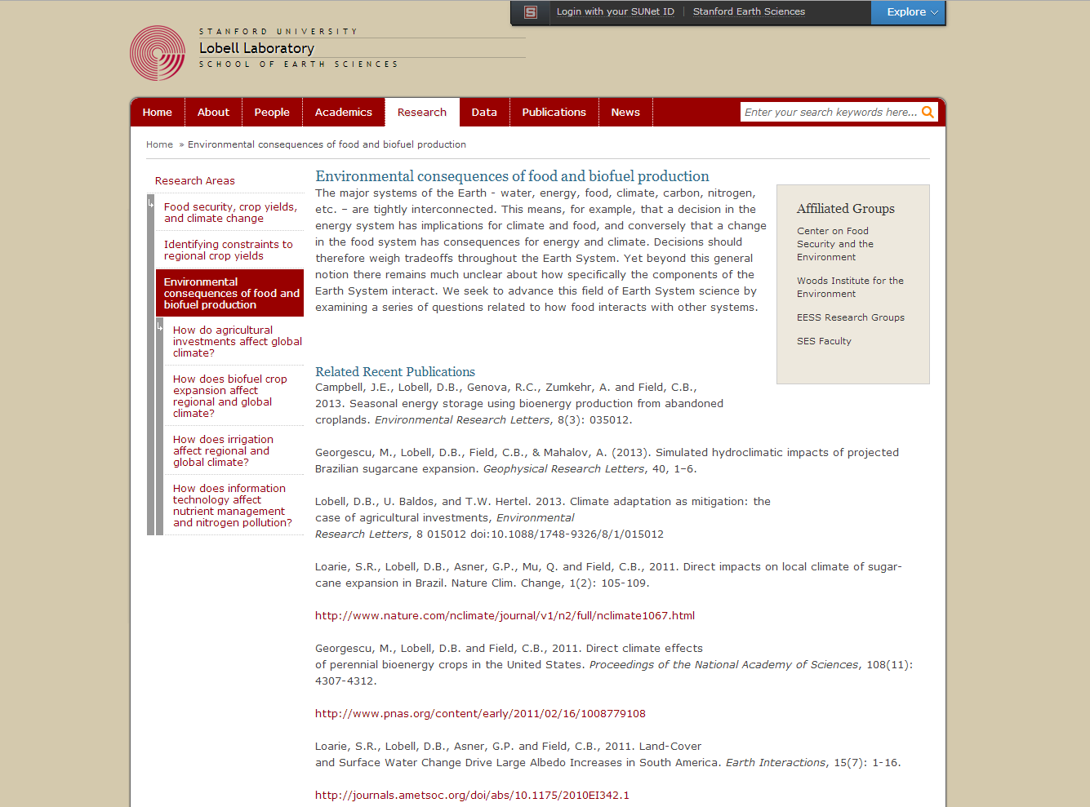
Lab Page
Subset of full publications list
Sorted by research theme

Slide 12
Demo: urban.yale.edu/publications
Notes:
Demo steps:
Poke around urban.yale.edu/biblio
Demonstrate publication upload
Browse Biblio settings
Move to urban.yale.edu/publications
Move to research themes
Show views accordion and sorting

