Slide 1
Take Your Best Shot
The importance of a good photo
Prepared by:
Chris Mongillo, Web Producer (Drupal front end developer), Information Technology
Kimberly Pasko, Website Manager, Internal Communications
Attila Tobias, Associate Communications Officer, Internal Communications

Slide 2
Take Your Best Shot
Tips for taking a good photo
SLR camera or camera on phone
good portraits and overall good practices
Cropping an image for YaleSites
cropping photos for consistency
demo
The It’s Your Yale home page image
challenges with a large image
challenges with choosing an image

Slide 3
Tips for taking a good portrait
Move subject(s) away from background/wall approximately 4 feet.
Keep the background of the image lower or equal lighting as your subject. If background is brighter than subject - exposure compensation needs to happen.
Keep subject(s) out of harsh/bright light.
Look at background, watch for color, contrast, people/things in background/foreground.
Use environment to add interest to portrait.
Take several images. This will help to get one good image. Keep in mind; posture, eyes, mouth, and overall facial expression all need to be in sync in one image.
Pay attention to crop. Try to keep head sizes consistent so the eye doesn’t jump.
If subject wears glasses tilt their head down a tad. Chin down slightly.
Stop before taking the photo and look at the subject; adjust ties, necklaces….

Slide 4
Tips for taking good photos
Open shade is a great light to use. (portraits as well) - overcast.
Try different perspectives.
Make use of foreground and background space.
Look at background, scan frame. Get subject set but look at entire frame.
Move subject from the middle of the frame.
Office lighting can cause a tint on the subject pending the color temperature of the light source.
If you know the crop…. photograph for the crop and then some.
Pay attention to crop.
Take several images, even if one subject. Take several images to tell the story.
Keep the original image, make a working copy and don’t continuously save a jpg, save the psd. The image will break down. Alvin Lucier - I’m Sitting in a Room.
https://www.youtube.com/watch?v=fAxHlLK3Oyk
https://www.moma.org/explore/inside_out/2015/01/20/collecting-alvin-luciers-i-am-sitting-in-a-room/
Notes:
See campusphotos.yale.edu

Slide 5
Adding images to your site
Use captions with images when applicable.
Use Alt field for accessibility.
Use consistent sizes.
Don’t clutter.
Edit, if there is an abundance of quality images you can change them out. Less is more.
Give photo credit and pay attention to copyright.

Slide 6
Cropping images
Cropping an image for YaleSites
cropping photos for consistency
demo

Slide 7
The It’s Your Yale home page image
your.yale.edu
Challenges with a large image
Challenges with choosing an image
Frequency of image change

Slide 8
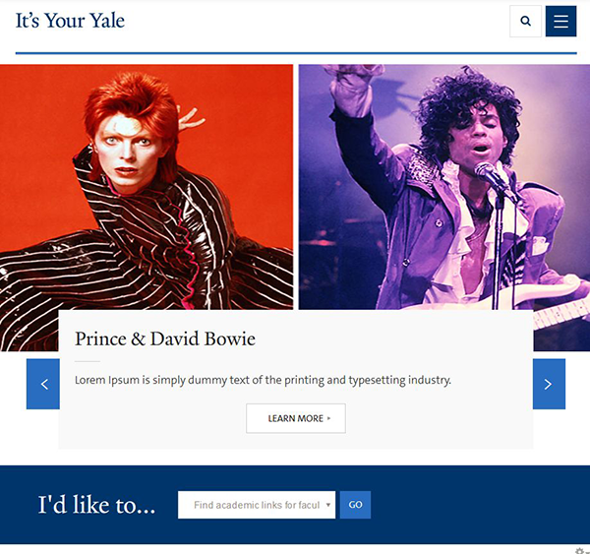
It’s Your Yale - home page image
Basic Information
Dimension: 1175 x 547px
File size:
Type: Photo, Graphics,
Animation
View:
- White box on the left
- White box on the bottom

Slide 9
It’s Your Yale - home page image Challenges – Photo / Graphics
No Animation

Slide 10
It’s Your Yale - home page image Challenges – size/dimension

Slide 11
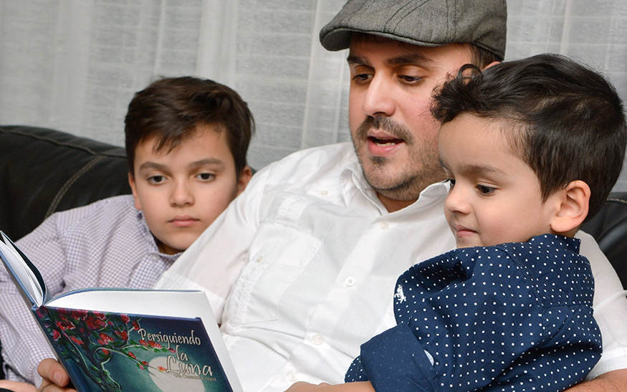
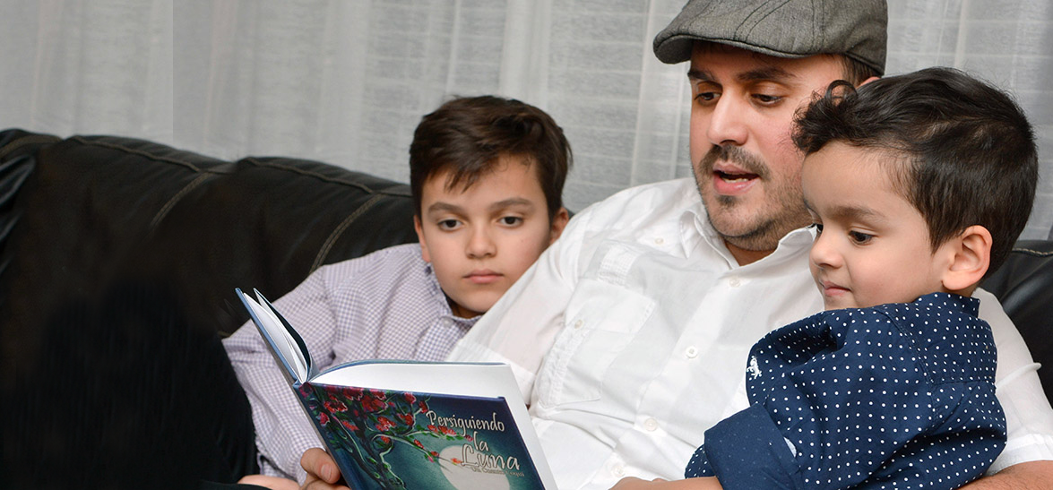
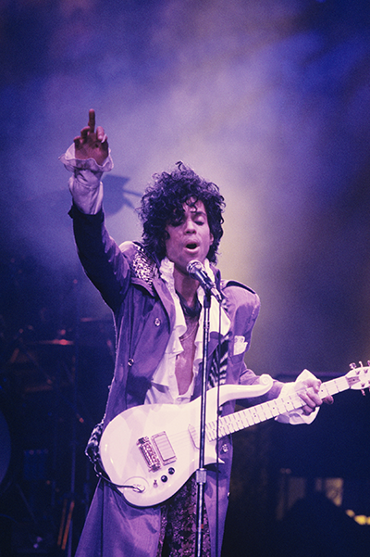
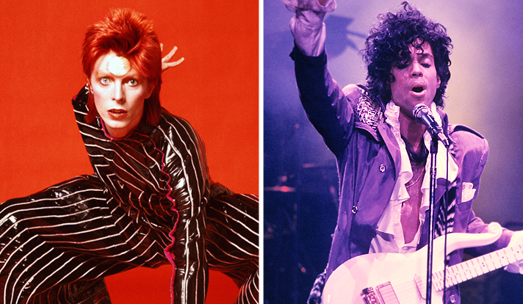
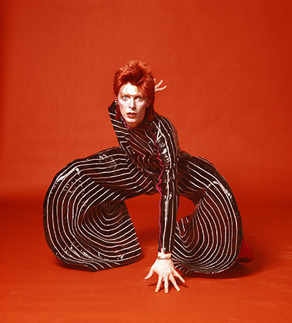
It’s Your Yale - home page image Challenges – size/dimension - photo
Crop, Resize,
Retouch & Draw

Slide 12
It’s Your Yale - home page image Challenges – size/dimension - graphics
Crop, Resize,
Re-type & Draw

Slide 13
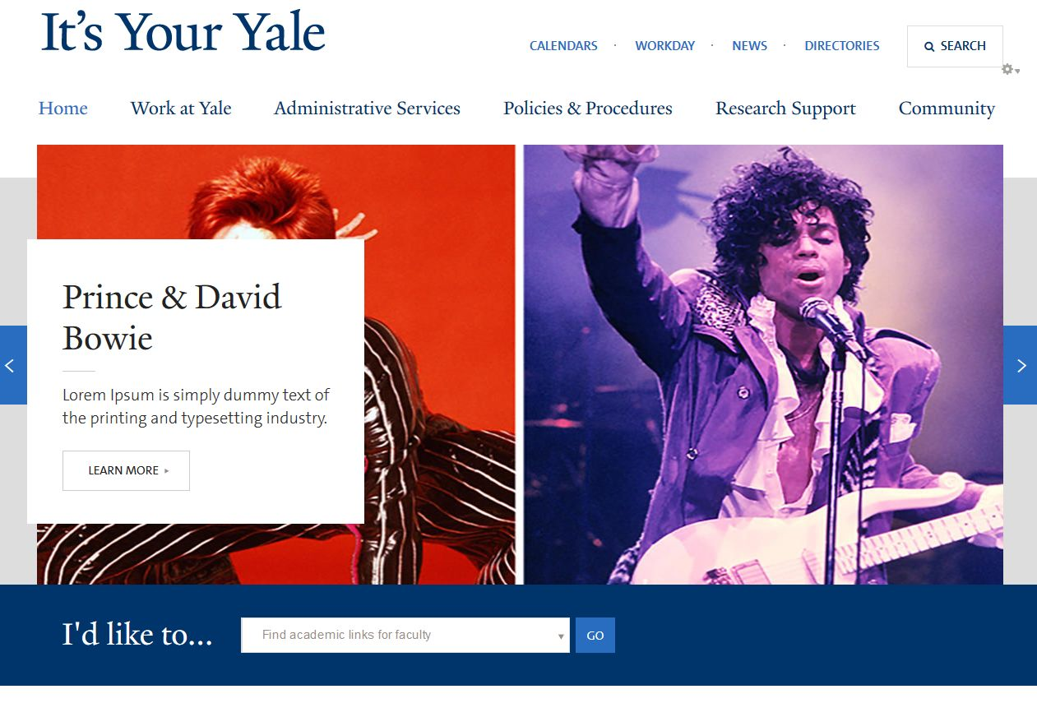
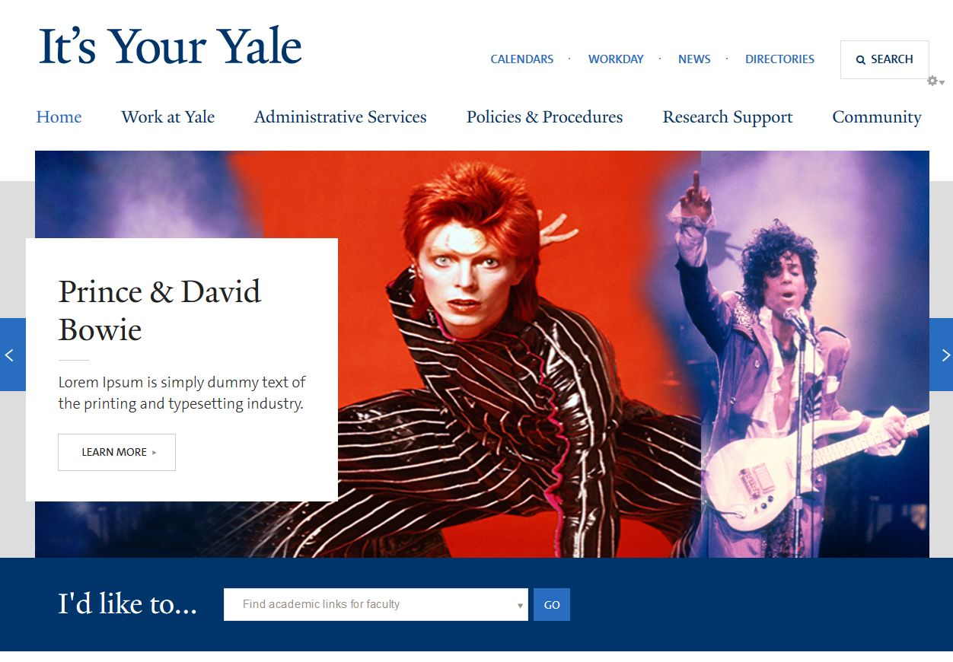
It’s Your Yale - home page image Challenges – White Text Box (1)

Slide 14
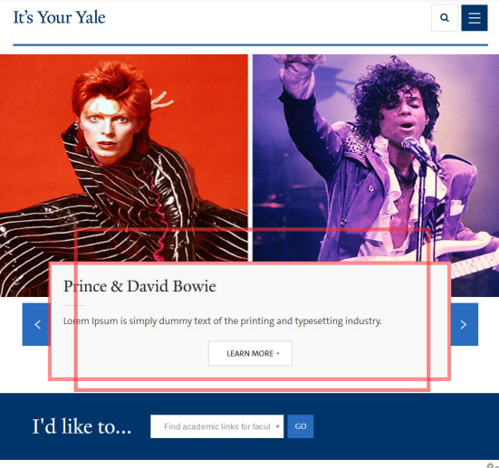
It’s Your Yale - home page image Challenges – White Text Box (2)

Slide 15
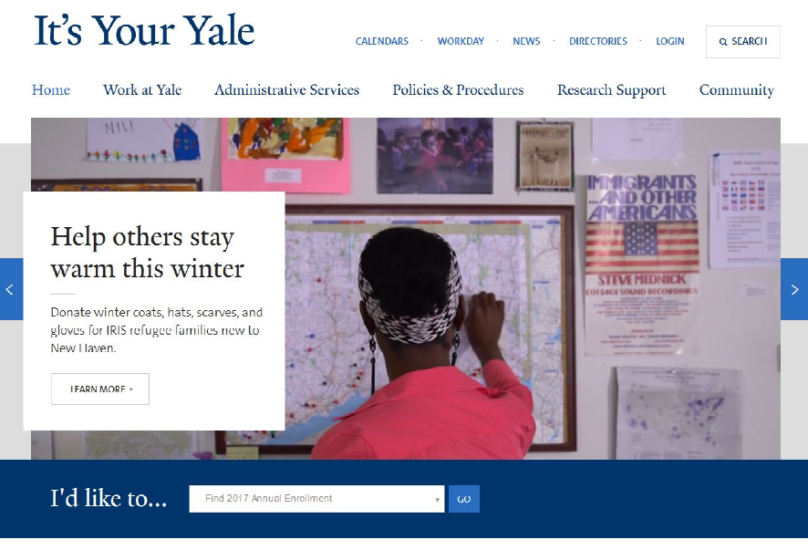
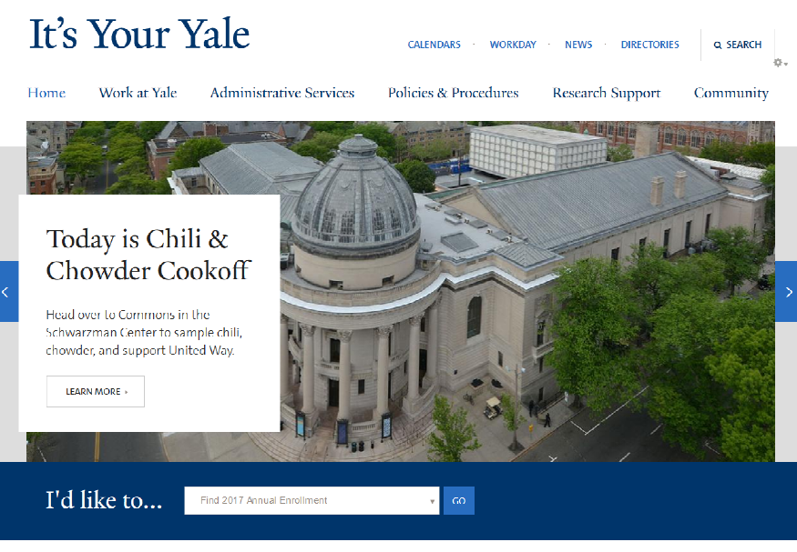
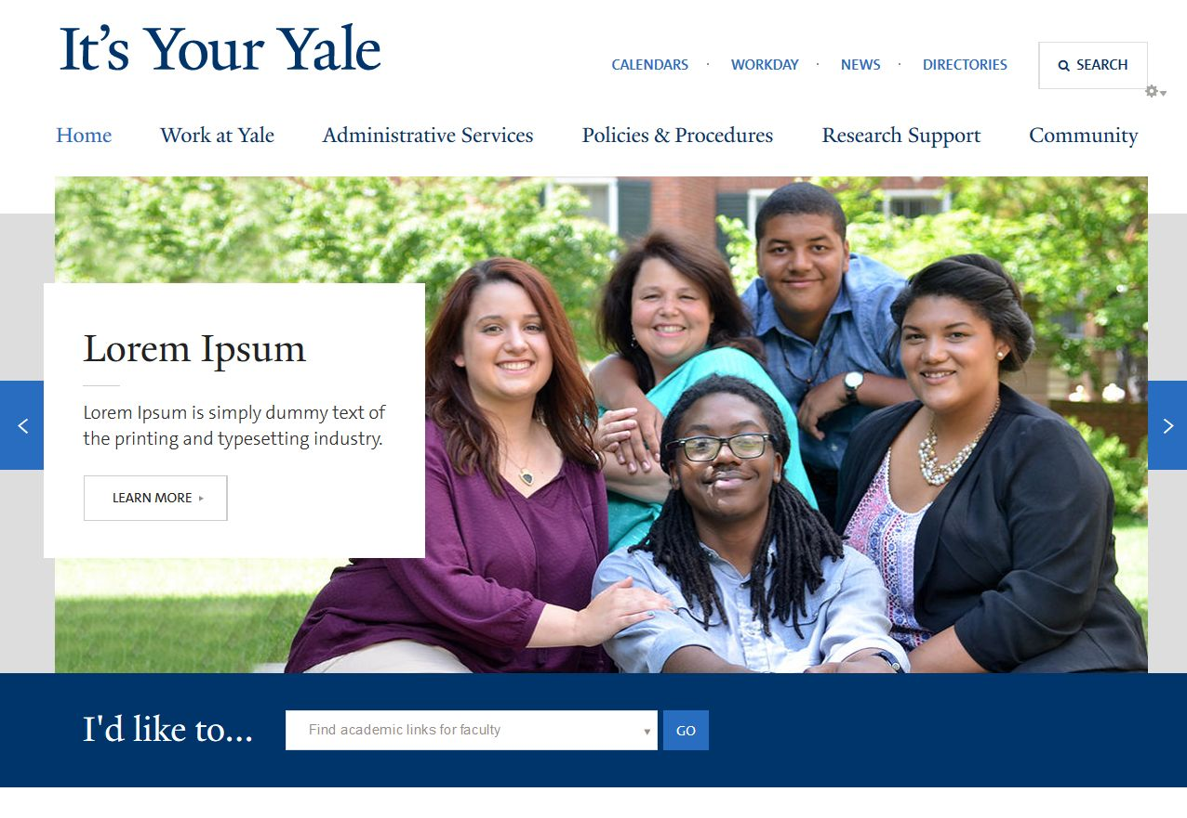
It’s Your Yale - home page image Challenges – White Text Box (3)

Slide 16
It’s Your Yale - home page image Challenges – White on White (1)

Slide 17
It’s Your Yale - home page image Challenges – White on White (2)

Slide 18
It’s Your Yale - home page image Challenges – White on White (3)

Slide 19
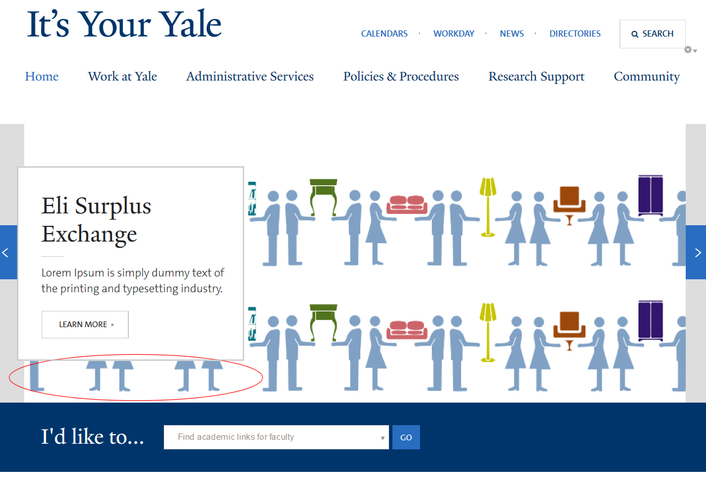
It’s Your Yale - home page image Challenges – White on White (4)

Slide 20
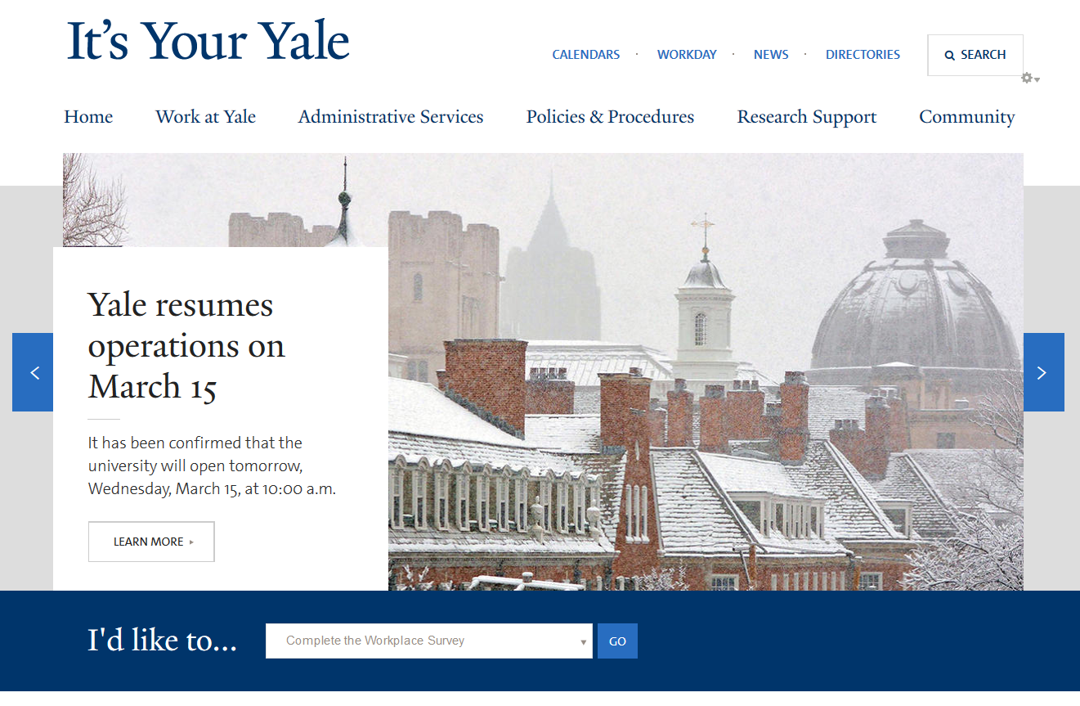
It’s Your Yale - home page image Challenges – Closing words

Slide 21
Thank You
Questions?

