Slide 1
Drupal and Information Architecture
Michael Wayne Harris
Information Architect
User Experience & Web Services

Slide 2
Outline
What is Information Architecture?
Users’ Information-Finding Strategies
Implications for Site Design

Slide 3
What is Information Architecture

Slide 4
What is Information Architecture
The structural design of shared information environments.
The art and science of organizing and labeling websites, intranets, online communities and software to support usability and findability.
An emerging community of practice focused on bringing principles of design and architecture to the digital landscape.
-The Information Architecture Institute

Slide 5
What is Information Architecture
Components of Information Architecture:
Organization and Sorting
Labeling and Classifying
Navigation and Wayfinding
Search

Slide 6


Slide 7


Slide 9
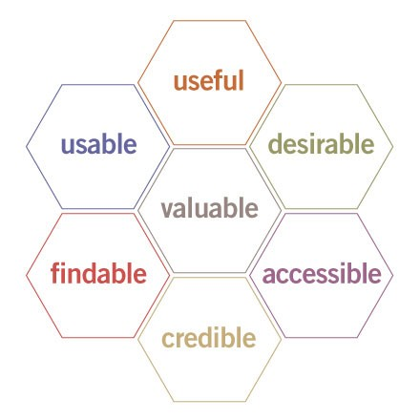

Slide 10
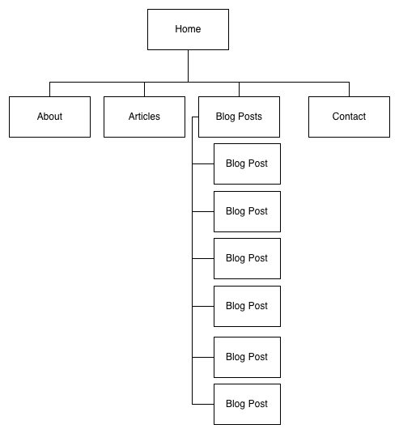

Slide 11
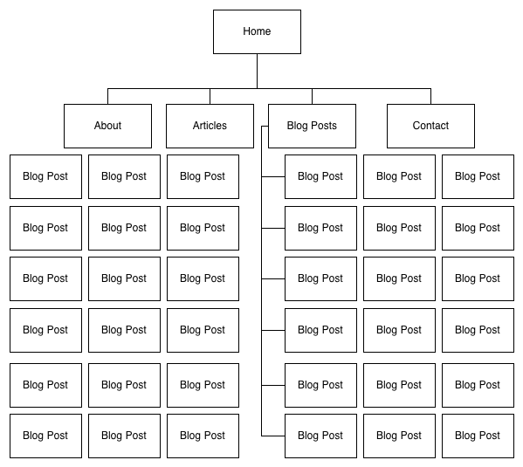

Slide 12
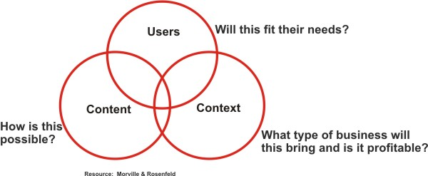

Slide 13
Users’ Information Finding Strategies

Slide 14
Users’ Information Finding Strategies
Known Item Searching
Subject Searching
Attribute Searching
Unknown Need Searching
Exhaustive Searching
Re-Finding

Slide 15


Users’ Information Finding Strategies
Known Item Searching vs Subject Searching
vs

Slide 16
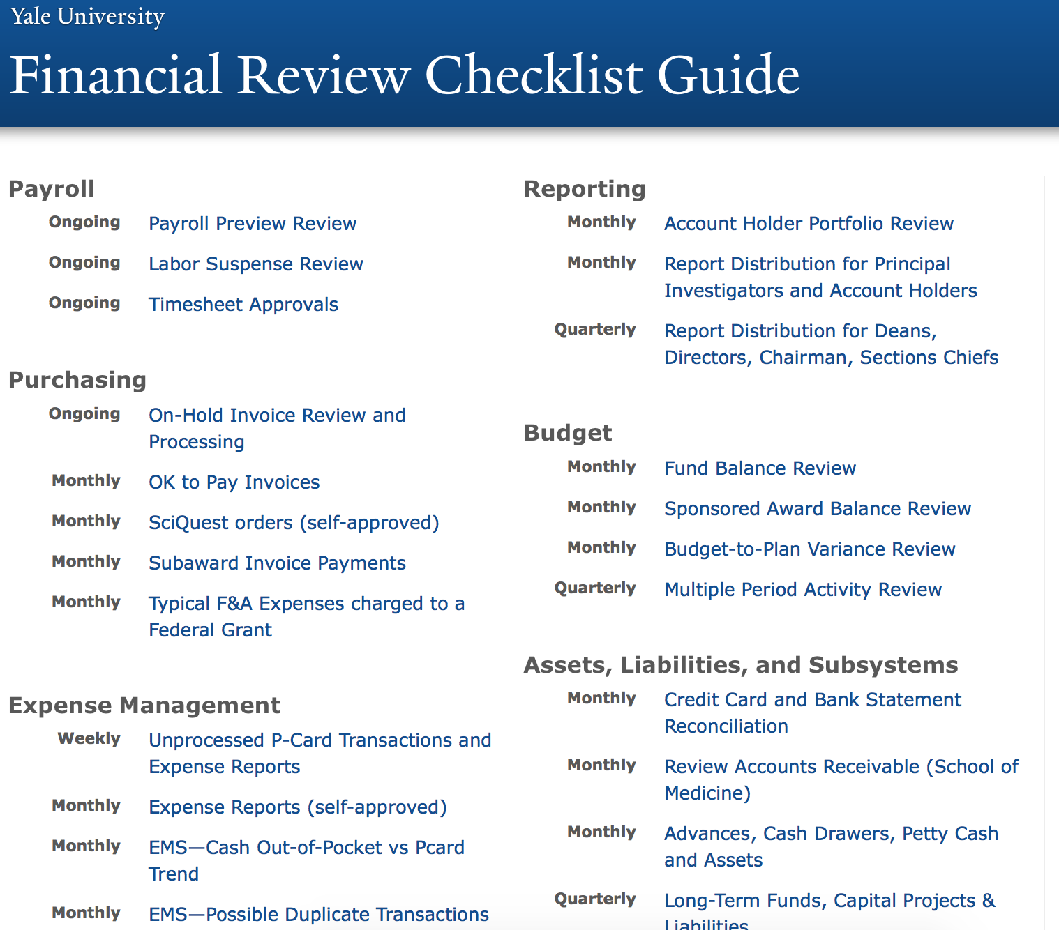
Users’ Information Finding Strategies
Attribute Searching

Slide 17
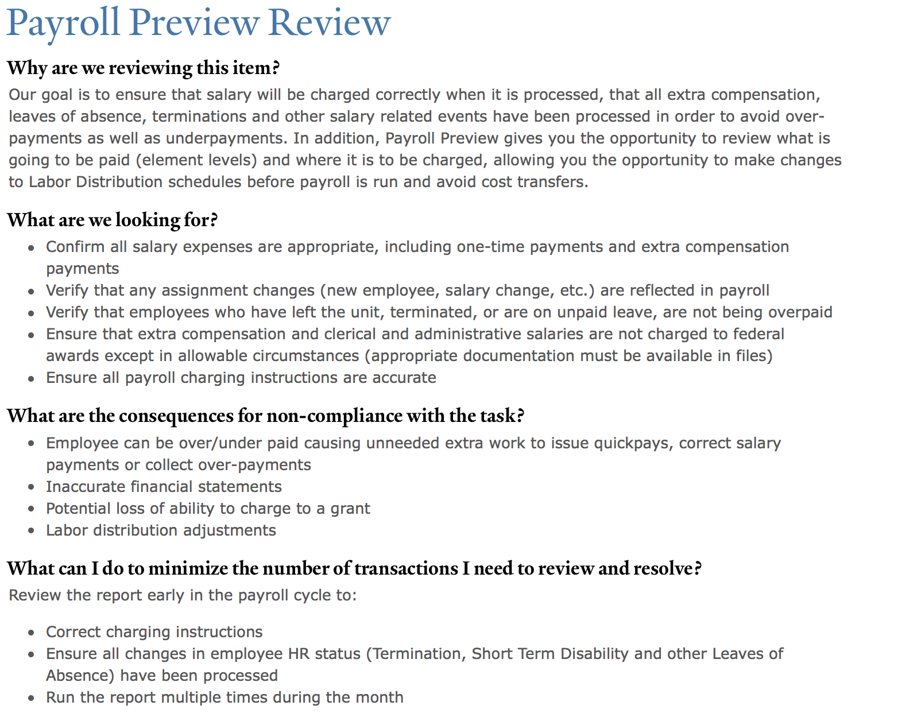
Users’ Information Finding Strategies
Unknown Need Searching

Slide 18
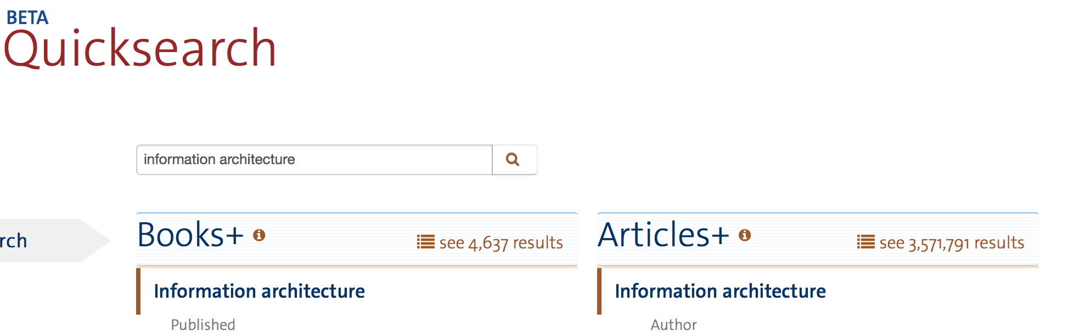
Users’ Information Finding Strategies
Exhaustive Searching

Slide 19


Users’ Information Finding Strategies
Re-Finding

Slide 20
Implications for Site Design

Slide 21
Implications for Site Design
Understand your things before you start thinking about how to put it on a website
  What buckets of things do you have?
  How do people think about your stuff?
    By date
    Alphabetically
    By subject
    By kind of thing
    By audience

Slide 22
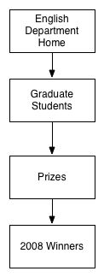
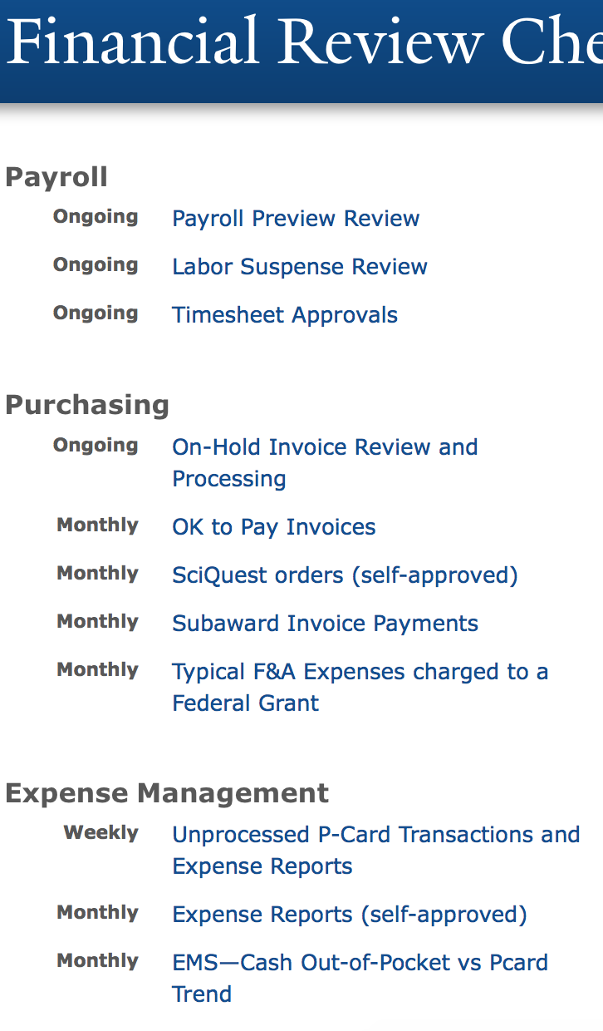
Implications for Site Design
Is your stuff a tree or a spreadsheet?
vs

Slide 23
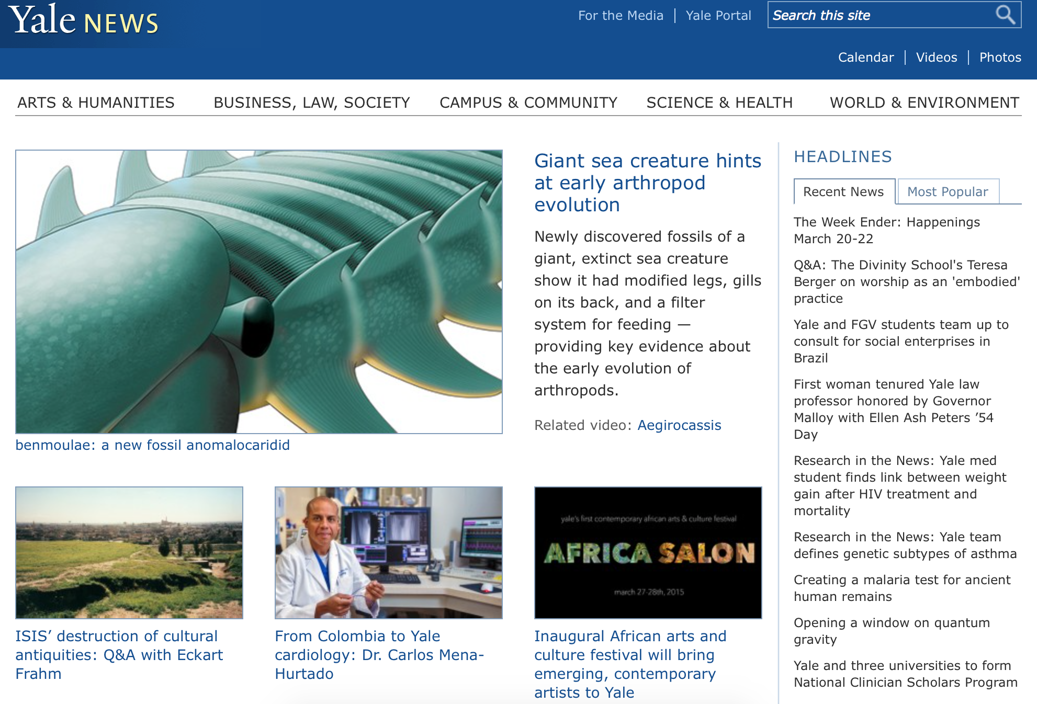
Implications for Site Design
Everything is content or navigation.
Know how users search.

Slide 24
Thanks!

