Slide 1
Optimizing your website for social media interoperability

Slide 2
“Sharing on social media is
Charged with emotions,
bounded by self-image management, and also
by concerns over relationship with others.”
— from “Psychology of Sharing on Social Media: Attention, Emotion and reaction” by Sonya Song http://sonya2song.blogspot.com/2013/11/psychology-of-sharing-on-social-media_14.html

Slide 3
Social media drives website traffic.

Slide 4
Social media drives website traffic.
Facebook*
^
* and Twitter, sometimes

Slide 5
In 2016, Facebook drove 15% of traffic to YaleNews

Slide 6
Sources of traffic to YaleNews in 2016
Email newsletter = 30%
Organic Search = 24%
Social = 20%
Direct = 13%
Referral = 12%

Slide 7
Social traffic to YaleNews in 2016
Facebook = 75%
Twitter = 12%
Other = 13%

Slide 8
Sources of traffic to yale.edu
Organic Search = 54%
Direct = 40%
Referral = 5%
Social = 1%

Slide 9
What do people share on your site?

Slide 10
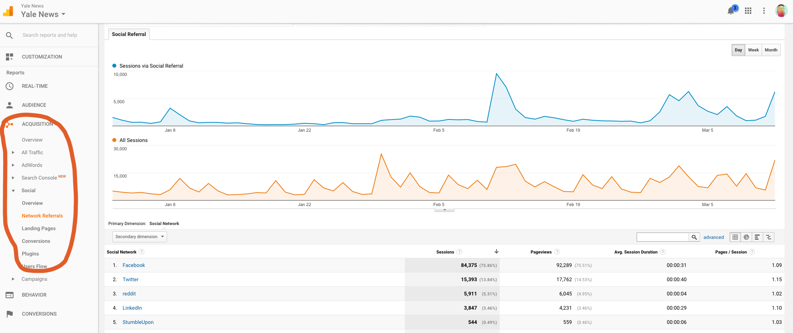

Slide 11
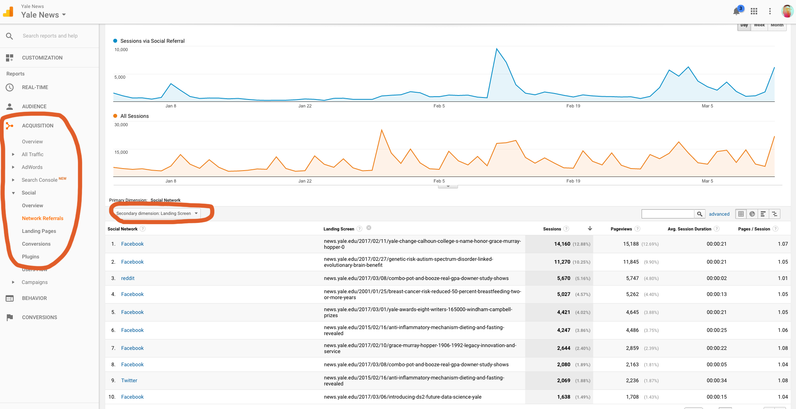

Slide 12
Make sure your news content can be shared easily on social media.

Slide 13
The Open Graph protocol enables any web page to become a rich object in a social graph.

Slide 14
ogp.me
Basic metadata
Structured properties
Object types

Slide 16
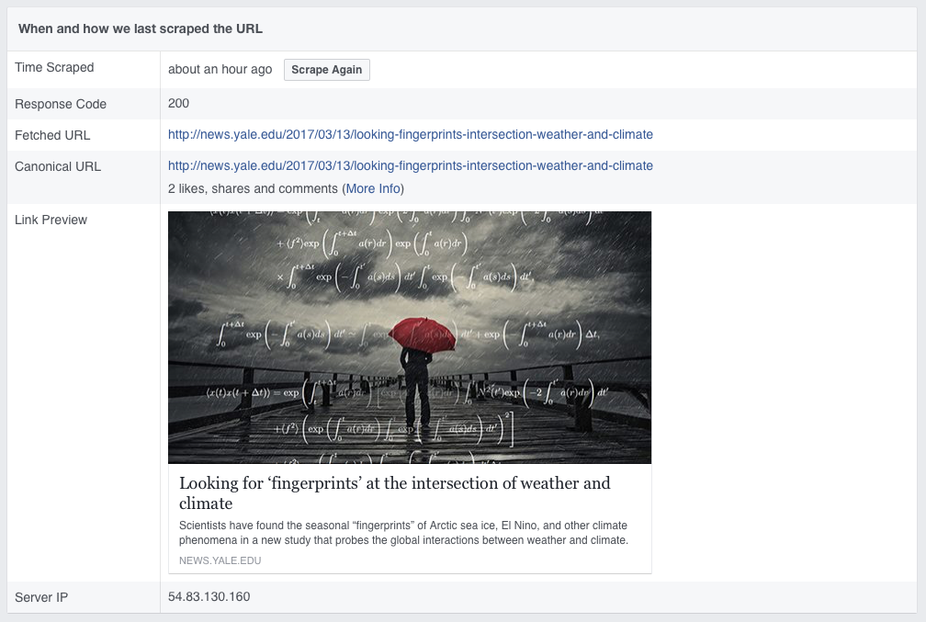
https://developers.facebook.com/tools/debug

Slide 17
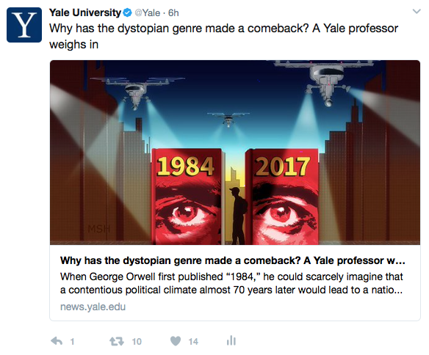
Twitter cards
“With Twitter Cards, you can attach rich photos, videos and media experiences to Tweets, helping to drive traffic to your website.”
https://dev.twitter.com/cards/overview

Slide 19
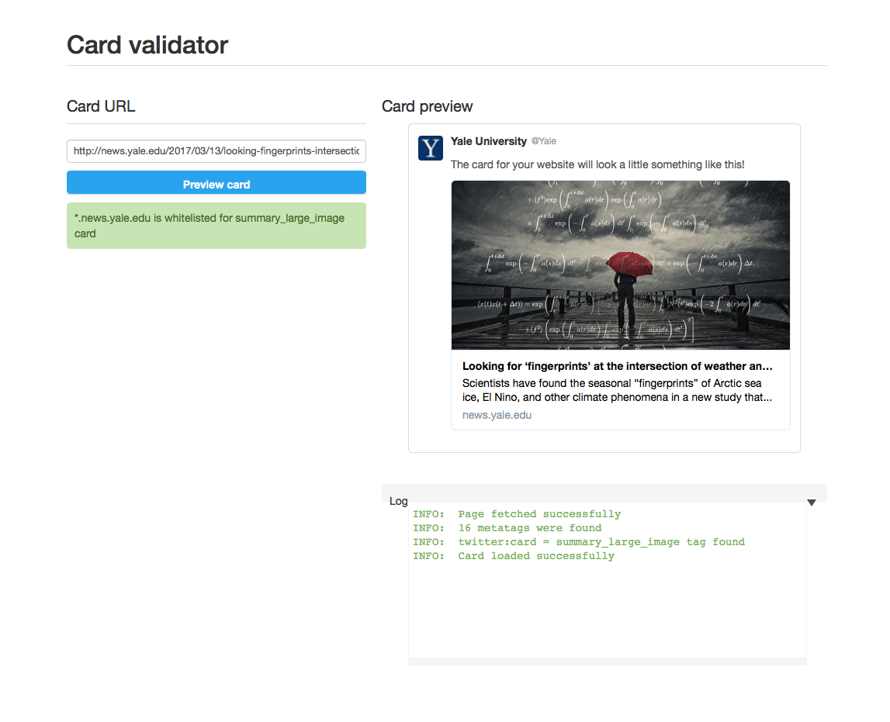
https://cards-dev.twitter.com/validator

Slide 20
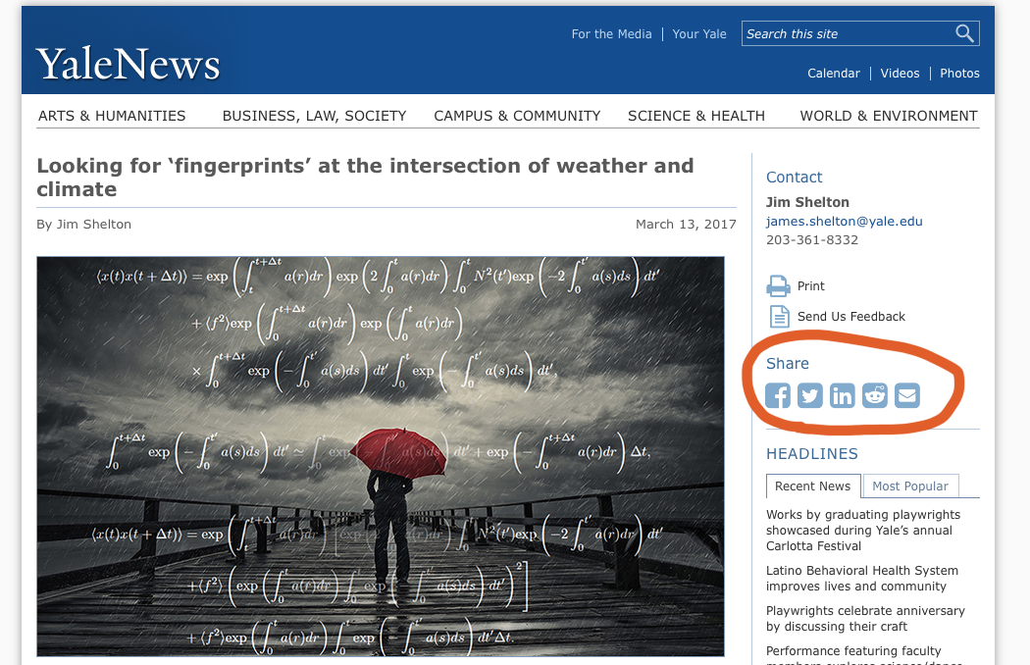
Give people an easy way to share your content.

Slide 21
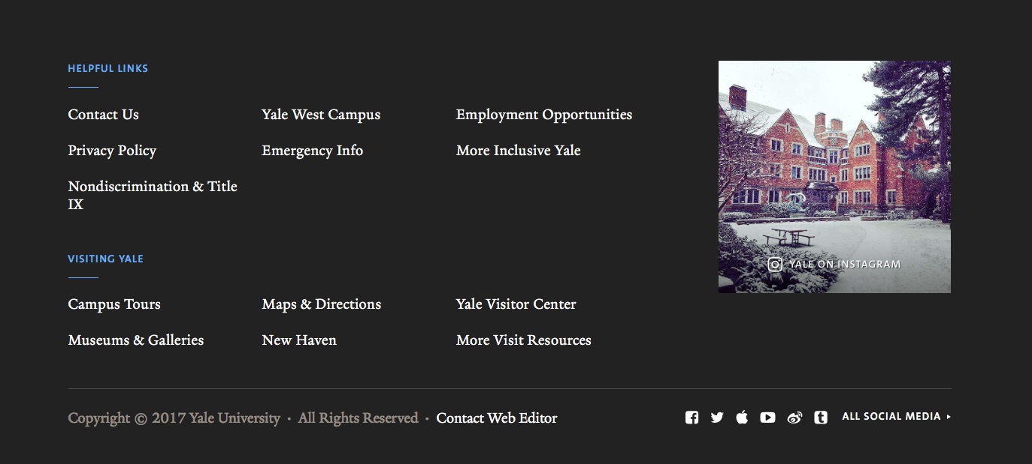
Feature social media content on your site

Slide 22
Feature social media content on your site

Slide 23
Make sure your site works flawlessly on mobile.

Slide 24
Make sure your site
is fast.

Slide 25
Remember:
You own your website.
Don’t give up control
to proprietary “walled gardens.”

