Slide 1
Crash course in Web Design
By Justina Eng
Notes:
Hi everyone, my name is Justina Eng, and I’m the assistant interaction designer for the UX and Web Services team at Yale ITS. My presentation is just going to be a quick “crash course” presentation of design fundamentals and how they can be applied to your website. I just want to emphasize that these are basic concepts that I think everyone should be aware of as they continue to work and iterate on their website layouts.

Slide 2
Why is good site design important?
Build trust
Maintain reputation/brand
Increase visibility
Notes:
Good site design is very important because of the following:
Trust: a well-designed site allows users to develop a sort of “trusting” relationship with it.
Reputation/Brand: Your website is your online/digital presence. Because so many people have access to the internet via computers, mobile phones, tablets, etc. it’s important to have a strong online presence. Having a well-designed site confirms your organization’s legitimacy and can even draw wandering users to it.
Visibility: When your site is well-designed, you draw more overall traffic, and your reputation in the worldwide web improves. Your site may show up more frequently in search engines, and can thusly expand its appeal to more users.

Slide 3
What does good site design entail?
A logical roadmap (well-planned information architecture)
Clear navigation and well-formatted content
Responsive layout – mobile, web, tablet views
Consistent graphics, icons, layouts, color schemes
Cross-browser consistency
Accessible; compliant with ADA, WCAG

Slide 4
Consistency is key
Layout consistency
Icon/graphics consistency
Color consistency
Typographic consistency
Cross-browser consistency

Slide 5
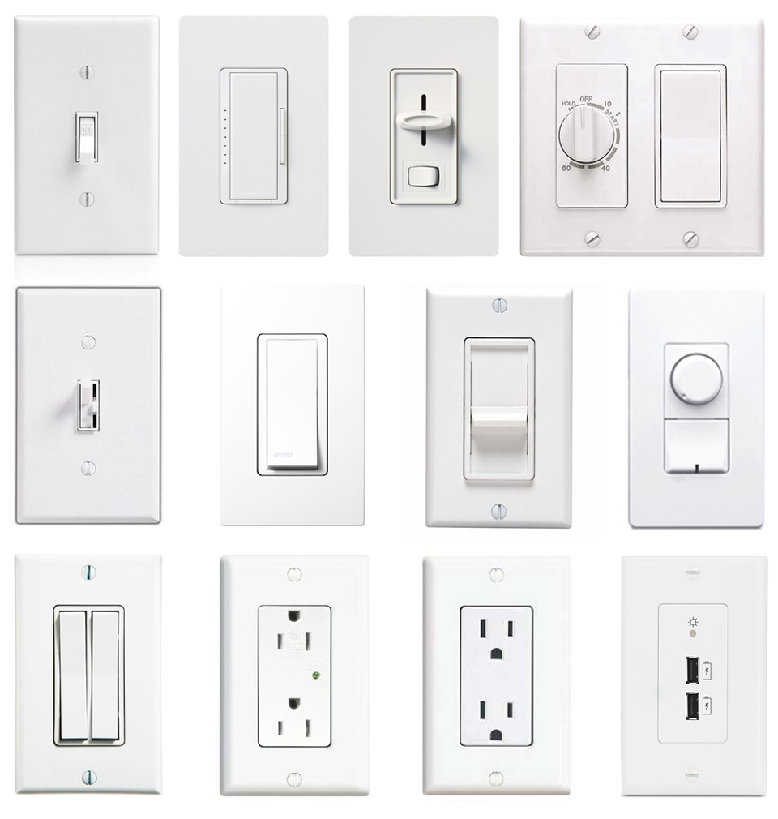
Notes:
One way to think about consistency is this: think about everyday objects that you interact with. Door knobs, light switches, elevator buttons. How do you know what to do with that switch, and how do you know what those buttons do? Isn’t it because these buttons and switches produce the same results in most situations?
Site consistency is comparable to this example. You don’t want to have crazy looking buttons or layouts that are dynamically different from each other. This makes it incredibly difficult for your users to build strong visual associations between different parts of your website.

Slide 6
Think like a designer
Critiques are how artists/designers/illustrators evaluate their work. It allows them to see how they can improve their work, or what steps they can take to push it in their intended artistic direction.
“I think this looks cool” >> subjective statements are hard to understand
“I think the paint strokes convey a sense of aggression/anger”
Notes:
So before we dive into some site examples, I want to try doing critique exercises as we go through the presentation. I think that it’s more important for everyone in this room to point out the visual elements that they find striking. And this is something that I did a lot in art school, and I think this thought process really helps people figure out why something doesn’t work visually. It’s sort of like an artistic “de-bugging” process. So when we look at the website examples I provide, I want people to participate and talk a little bit about why they think the layout does or doesn’t work.

Slide 7
Notes:
Hard to see the org’s name
Meaningless images scattered throughout the site
No real logical flow of information

Slide 9
Layout Consistency
Positioning of…
Text
Headings
Images
Navigation menus
Search box
Sign-up/register buttons
Notes:
So before you even think about color, icons, pictures, logos, or any of the “fun” visual elements, it’s important to think about how you want to lay out your website. Think about your website layout like an architectural blueprint– when you build your house, you don’t want to be picking out your curtains before you figure out what the foundation is and how the rooms are laid out. In that way, I want everyone to really think about the importance of the core elements in their website.

Slide 10
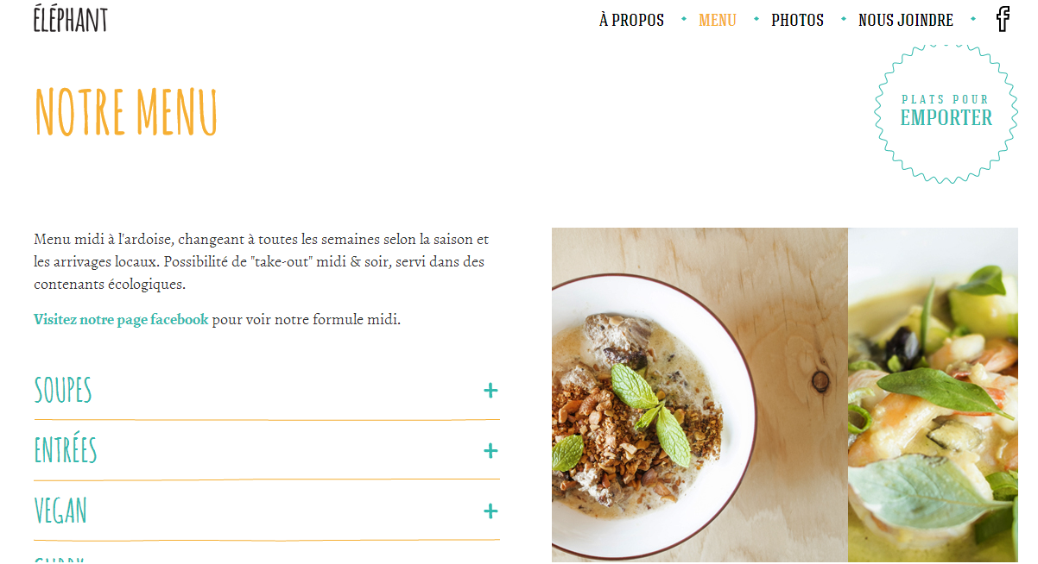
Notes:
What do you like about the site?
Menu in the top right, a common practice for most sites; easy to locate
3 different text colors and no more. Yellow denotes titles/highlighted items, teal denotes hyperlinks
Text/info on left, images on the right

Slide 11
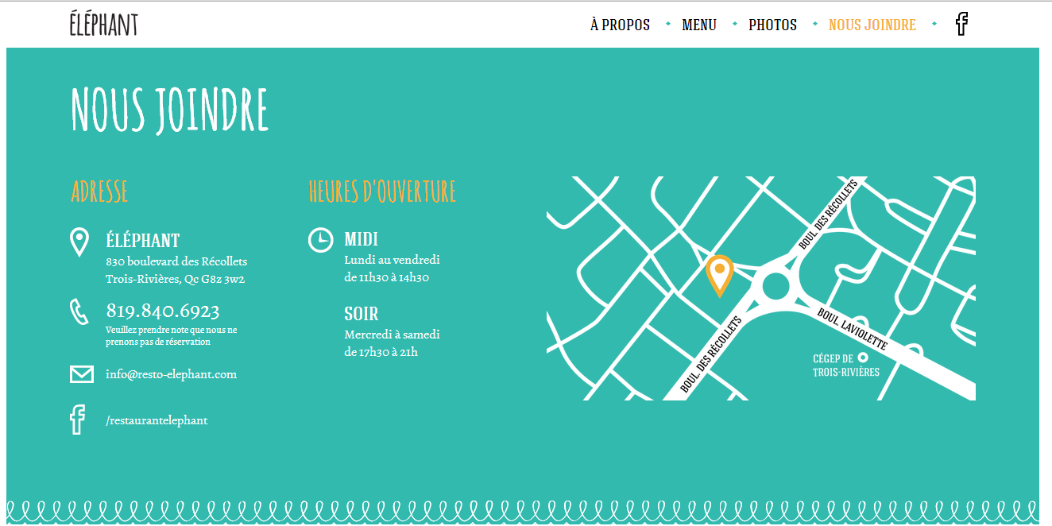
Notes:
Text on left, image on right
Color scheme is the same (white, teal, orange)

Slide 12
Layout Consistency
Plan with wireframes
(Balsamiq, Invision, proto.io, etc.)
Smart organization
Group together similar elements
Establish visual hierarchy

Slide 13
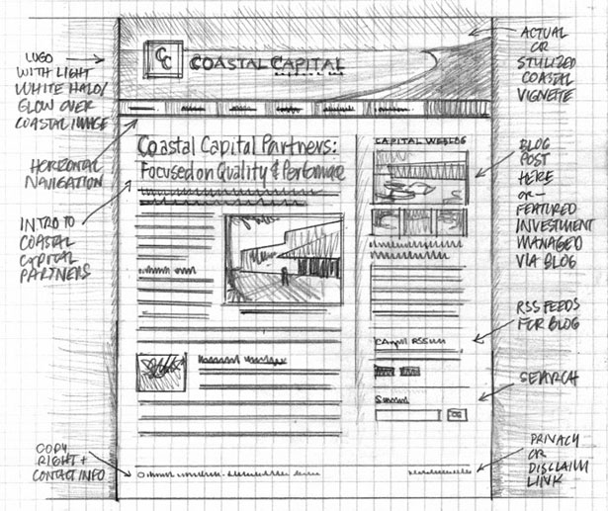
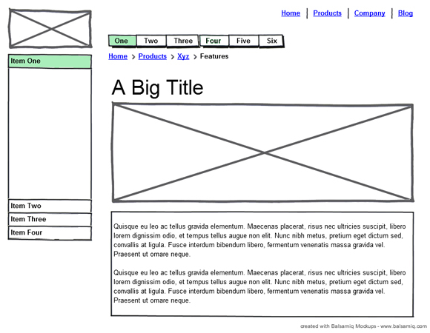
Notes:
These are examples of wireframes. As you can see on the left, designers used to draw out layouts for their website designs. Now, there are a ton of different wireframing tools you can use to achieve a similar effect, and you can share them with your coworkers or clients to continue iterating on the layout possibilities.

Slide 14
Notes:
Wireframing is an excellent way to create layout consistency and hierarchies of information for your website. I would recommend creating wireframes or sketches of your website before you even consider typing a line of code or opening up a CMS platform for it. As you can see here, the wireframe provides a clear “blueprint” of what the creator wants on the page. The navigation scheme, columns, images, and buttons are all mapped out. You can create multiple wireframes to see out one layout can accommodate your information, and if there are maybe a key set of templates you want to stick to when you wireframe your website.

Slide 15
Graphic Consistency
Selection & Use of…
Icons
Images
Buttons
Color scheme

Slide 16
Notes:
Looking at this site, what do you notice about the graphic elements? Is there anything that bothers you?
Too much going on
Inconsistent/not well thought out color scheme
Not enough contrast between all the elements; bright purple vs bright orange vs brightly colored font

Slide 17
Graphic Consistency
Keep the graphics consistent
Rich media (i.e. high resolution photos) should strongly contrast the rest of the site
Icon sets should be similar in style and color scheme; start with monochromatic
Select a color palette
Keep it simple at first (try to stick to 3 colors or less)
Sites: colourlovers.com, coolors.co, paletton.com

Slide 18
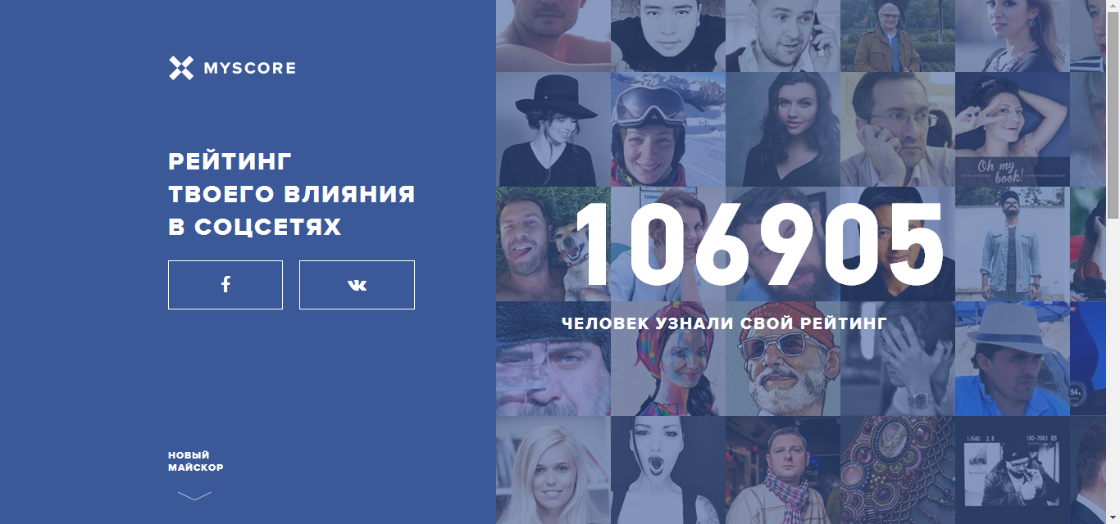

Slide 19
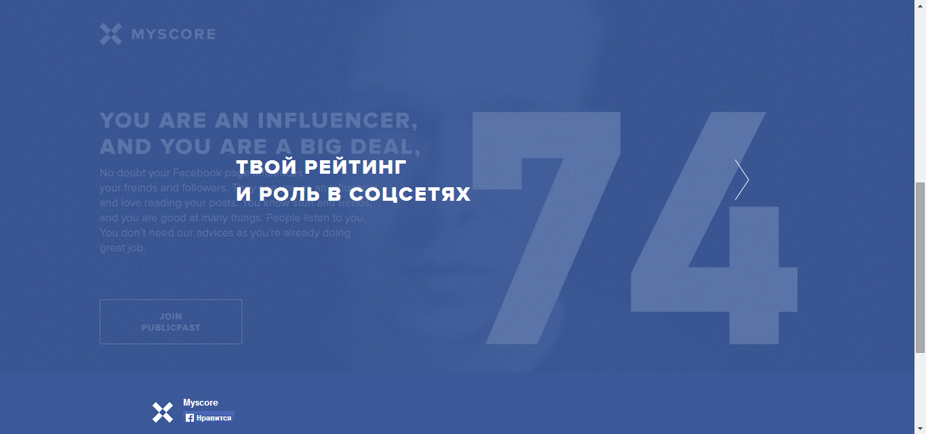

Slide 20
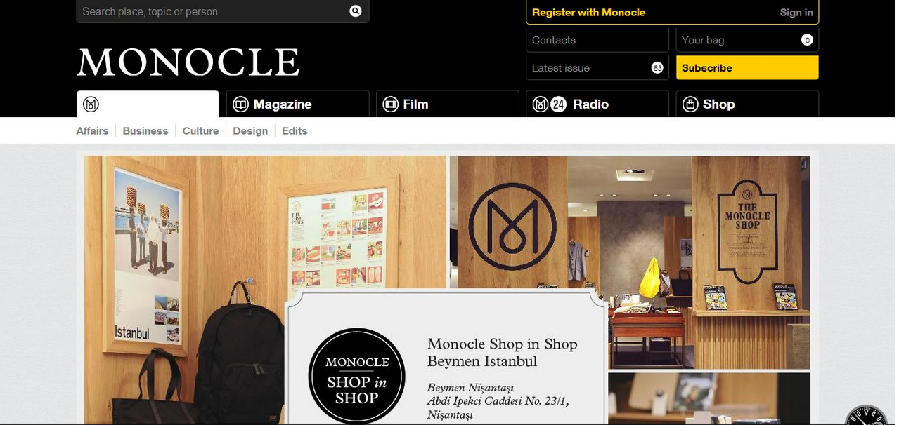

Slide 21
Typographic Consistency
Choose your body text first
White space; ample spacing is important for text
Line height

Slide 22
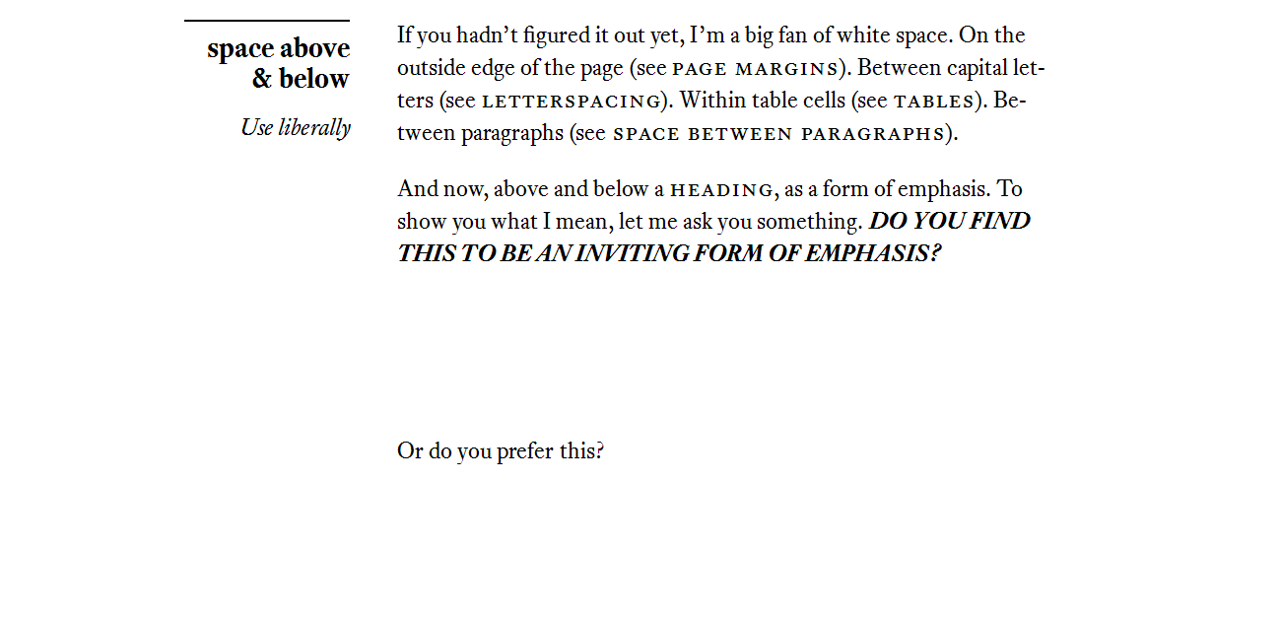
Notes:
Spacing is an incredibly important concept to consider; in some cases, you can use this to emphasize certain words/phrases, establish visual hierarchy i.e logos
Source: practicaltypography.com

Slide 23
Notes:
Line spacing (leading) should be 2-5x the font size.
Ex. 12px font; line height of 16px

Slide 24
Inspiration is key
Wireframes (Layout)
Color palette & graphics
Typography
Moodboard

