Slide 1
Yale Message

Slide 2
Yale Message - Communicating to the right audience
Notes:
Good morning everyone, today our team will be discussing Yale Message and the ability to communicate to the right audience

Slide 3
The Yale Message Team
Presenting today
Michael van Emmenes - Shared Application Services Manager
Venkat Reddy - Senior Software Engineer
Gloria Hoda - Digital Manager
Alejandra Rodriguez - Project Administrator
Kim Zaweski - Platform Analyst
Notes:
Yale Message has a team here to talk to you today
myself, Michael van Emmenes - Shared Application Service Manager
Venkat Reddy - Senior Software Engineer
Gloria Hoda - Digital Manager
Alejandra Rodriguez - Project Administrator
Kim Zaweski - Platform Analyst
Not onstage with us, but supporting the tool are Dave DeMichele and Dan Powell.
Additionally we work very closely with the Yale Community and with OPAC, a special thank you to Andrea MacAdam and Victor Velt for your continued support for YM and the Yale community

Slide 4
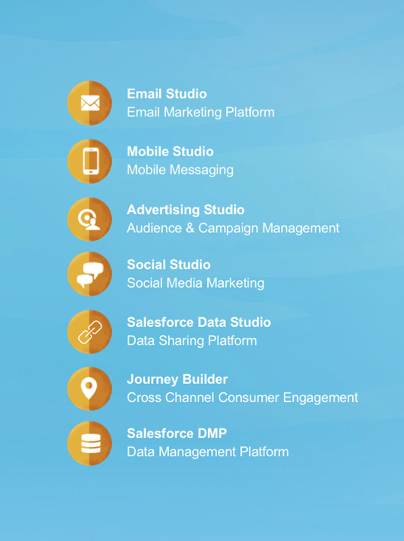
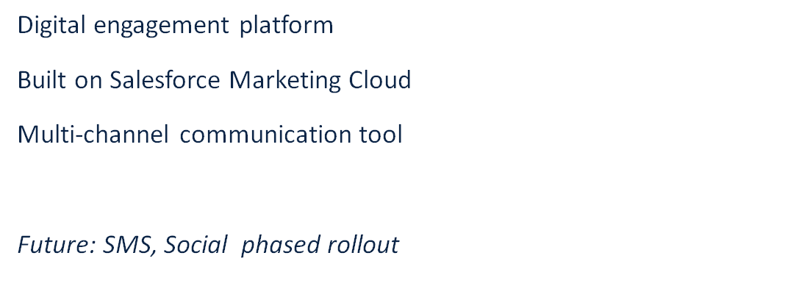
Overview:
Notes:
Yale Message is built on the Salesforce Marketing Cloud and is used as a communication channel. We are currently supporting the email and journey builder tools. There is more utility within Yale Message - including SMS and social - these tools are in our vision and will be rolled out in the future.

Slide 5
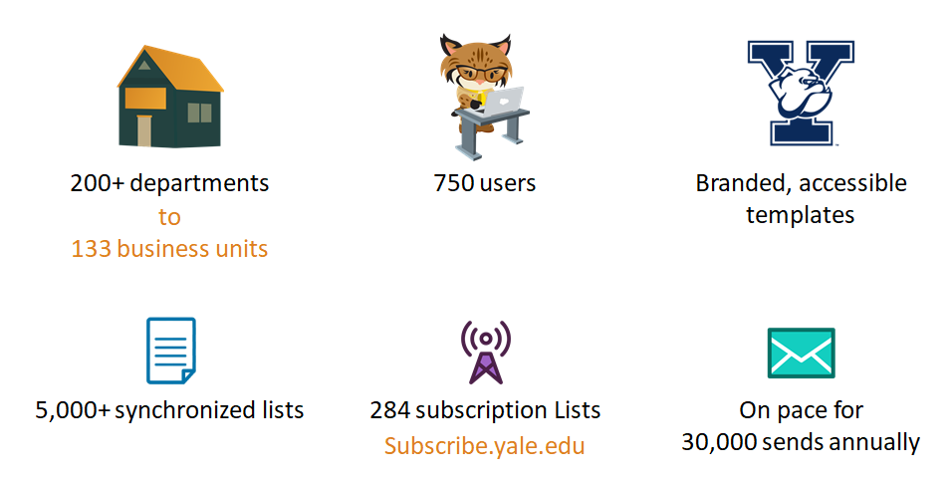
On Campus:
Notes:
In our current footprint of Yale Message we have over 200 departments with 32+ in the pipeline and 750 users.
Year to date, through May, 75,000 messages have been successfully sent reaching over 34 million recipients. An open rate of 40% - which is about 8% higher than our previous tools.
Up next - Venkat will discuss our data sources and integrations

Slide 6
Data Sources and Integration
Yale Community
Peoplehub, Banner, WorkDay, Hopper and other sources
Talend ETL for Integrations
Daily Data Sync to Yale Message
Global Community
Salesforce CRM (subscription center, file upload)
Notes:
Time: 5 min
I would like to talk about our data because it is really the backbone of our audience and email lists.
Our audience can be broadly classified into 2 categories: Yale and global
Yale audience includes students staff faculty, alumni, consultants etc.
The global or non-Yale population is essentially people that have opted for our content and emails using the subscription center and have also been uploaded into the Marketing Cloud using the Custom File Upload.
The Yale audience exists in various data sources both on prem and in the cloud. In order to be able to effectively communicate with every member of the Yale community, we need to get data from these various sources
Using talend ETL tool, I was able to build integrations tp export data from these sources into Yale Message daily.
What does this mean to departments and centers: their constituent data is constantly updated kept current. For ex: Student class and major changes, faculty affiliations, staff job related information such as cost center and job categories etc.

Slide 7
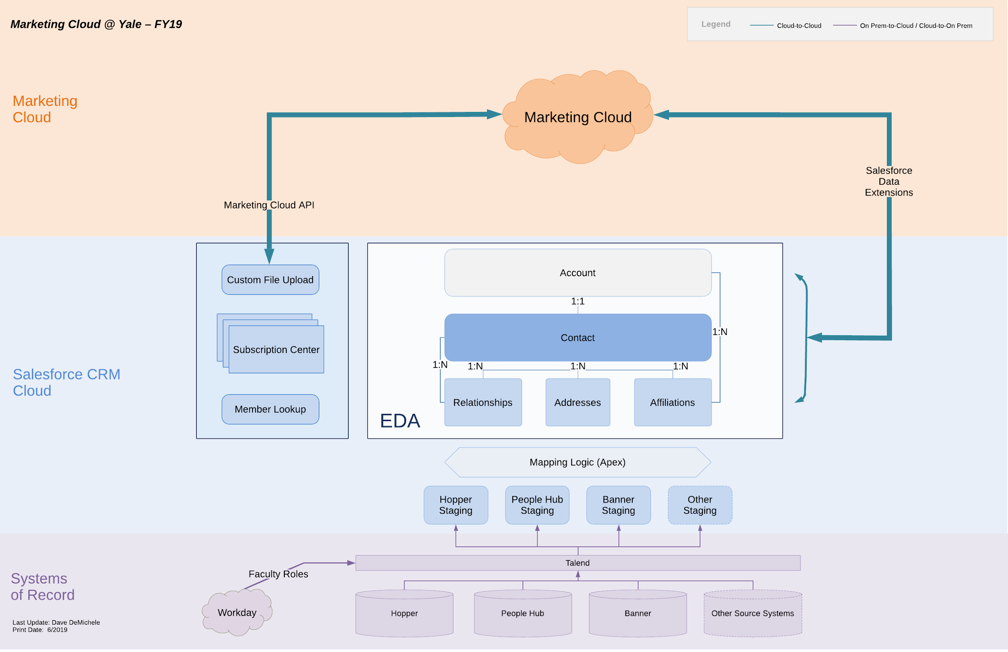
Data Flow
Notes:
The next slide provides an overview the the data flow from these various sources to its final destination: the Marketing Cloud
There are basically 3 layers here:
Data Sources
Salesforce CRM
Marketing Cloud (Yale Message)
Data from various sources is imported into CRM first and then pushed to Marketing Cloud. We need the CRM middle layer to make data import to Yale Message easily and convenioent.
The next step is to organize the data into EDA constructs (accounts, contacts, roles, affiliations and relationships) from these staging tables. This is done using APEX and Mapping logic.
The next step is to sync the data between CRM and MC using the MC connect on a daily basis.
Finally within the Marketing cloud, data is channeled into targeted lists using SQL queries and filtered Data Extensions.

Slide 8
Data Security: Who sees What
Business Units (130 plus)
User Permissions and Roles
Data Sharing between Business Units
Notes:
Business Unit allows a department or school to organize it’s data, For ex: YSM or Law or ITS or SOM.
The first step is to ensure that these departments can only see the data that they are supposed to see. YSM will see only YSM constituents and this is achieved using SQL
Users are then assigned to 1 or more Business Units, hence allowing them access to onlky the data that the BU is provided.
Data sharingf between Business Units allows the same set of data to be accessed between 2 Multiple Business Units

Slide 9
Targeted Lists for Communication
Custom File Upload - for Ad-hoc lists and Non-Institutional data.
5,000+ lists and growing
Subscription Lists - allows members to subscribe and unsubscribe.
250+ lists (subscribe.yale.edu)
System of Record List (SOR) - based on a role/department/school etc.
350+ lists
example: All students, faculty and staff
Combination SOR and Subscription - SQL List with option to unsubscribe
100+ lists
example: YaleNews
Notes:
Time : 5 min
Gloria -
4 types of lists - SQL, ARS, Subscription and File upload
SQL - create a list based on a person’s role, department, school or other criteria - updates nightly
example: All students, faculty and staff
ARS (Auto-refresh subscription) begins with SQL but allows members to unsubscribe. Removes members who are no longer at Yale.
example: YaleNews
Subscription - create your own subscription list that allows members to subscribe and unsubscribe. (question for Venkat - do these lists remove members who are no longer at Yale)
example: members attended a training or event and you want to stay in touch with them.
File upload - ad-hoc list that cannot be generated as a SQL list.

Slide 10
Analytics
Tracking Functionality
Subscribers clicks and opens behavior
Undeliverable messages
Inbox Activity
Notes:
•I will be talking about Analytics - this is great feature to use if you want to have visibility into your messages subscribers activity, such as how many people are opening you email? , is your email being forwarded to others?, which links of your email is receiving the most clicks.
•All these data can help you create a targeted audience based on predictive behavior models.
•The tracking functionality in the Email Studio provides you data details such as:

Slide 11
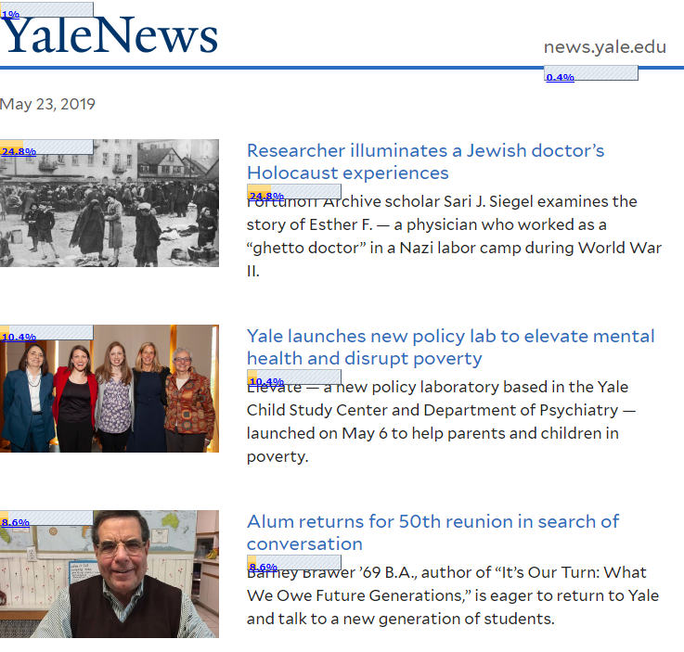
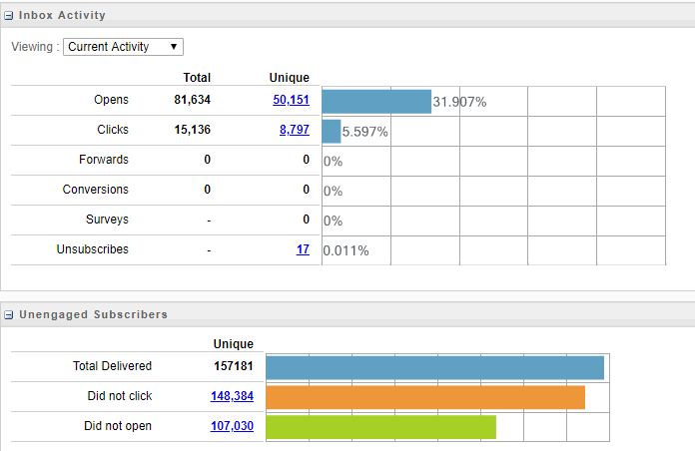
Notes:
Hard Bounce: Yale Message will mark invalid emails and suppress them from receiving future messages.
The number counts are hyperlinked, which gives you the ability to see if any of these emails need to be corrected, due to spelling errors.
Soft Bounce: Yale message retries sending the email to the subscriber every 15 minutes for 72 hours.
Block Bounce: when the email server rejects the email due to Filter issues, such as URL blocks, lack of proper authentication of the domain or IP.
•Yale Message team pays close attention to ensure that the messages are being delivered.
Inbox Activity:
Number count of open messages, clicks, forwards, unsubscribes and unengaged subscribers.
To the right - Email Click Activity
To go more This is an overview of the email, if the email have an urls links, the tool will provide you a clicking activity rate for each hyperlink as you can see in this email.

Slide 12
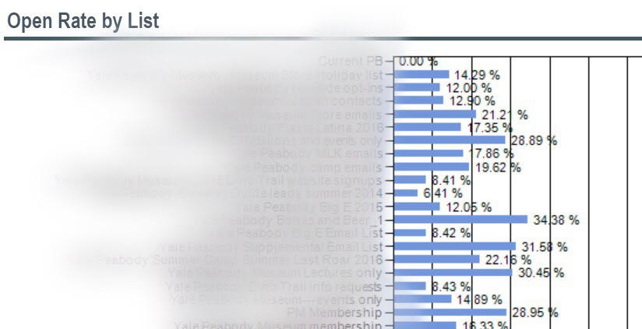
Reports
A variety of reports available to choose from reports catalog
Email Performance by List report
Notes:
Another nice feature is the reports functionality.
•Yale message offers you a catalog of reports available for you to choose from, based on what you need
•This is a quick example of one of the reports we have available which is the Email performance by list Report – this is an email that was sent to 10 different lists, what this report does, it provides you subscribers activity analysis for each of these lists such as the send count, bounce rate, open rate, click through rate and unsubscribe rate
•Thanks for listening and I will pass it to Kim who will be talking about Journey Building.

Slide 13
Journey Builder
Allows you to create personalized ‘journeys’ for your audience
Automated drag and drop customer mapping tool
Use cases: Welcome Journey, Anniversary or Birthday, Abandoned Cart Journey,
Notes:
Now that many of our users have conquered email, we are beginning to roll out a new automation tool called Journey Builder
journey builder Allows you to create personalized ‘journeys’ for your audience
it features an easy to use Automated drag and drop customer mapping tool
A few use cases for Journey Builder are
a welcome journey that you could use for a new employee orientation
an anniversary journey for work milestones
or an abandoned cart journey for when a shopper leaves something behind in their digital cart.
We have a department at Yale that is actively using Journey Builder for communicating lesson plans and reminders to students in their class

Slide 14
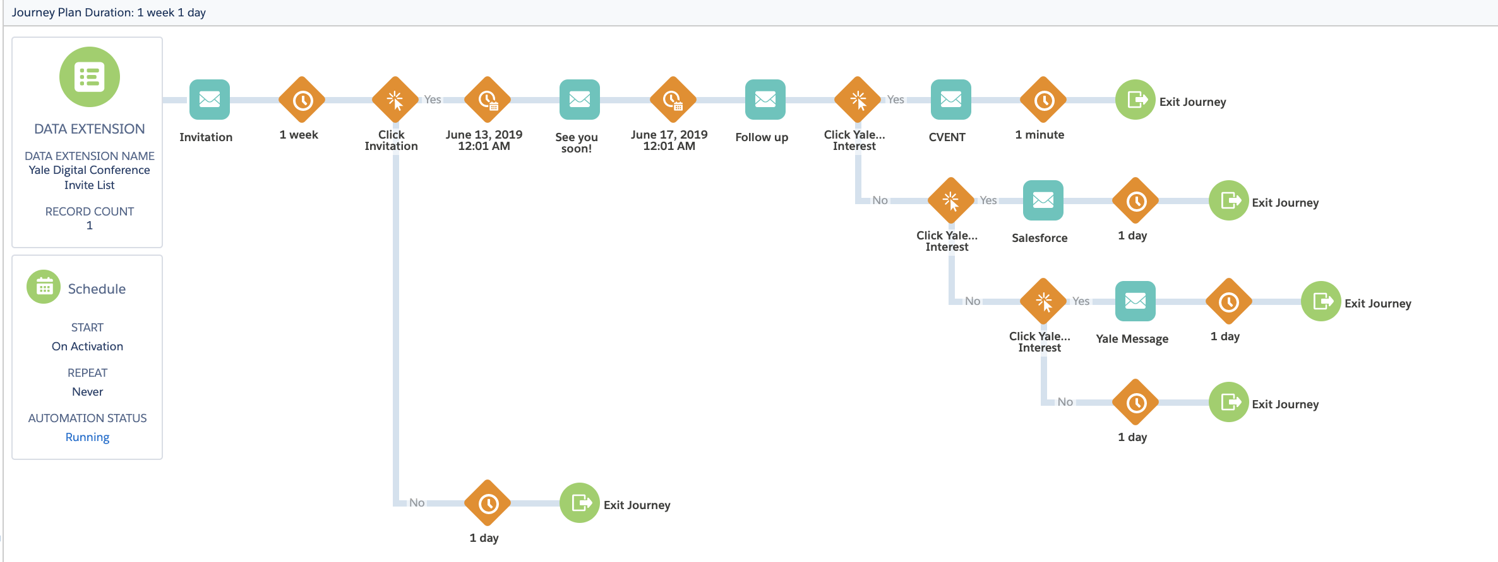
Journey Builder
Notes:
Today I will be showing you how a journey could have been used to send an invite to this conference, send a scheduled reminder, and finally a follow up email. You can set the journey up and it will run itself.
Here is the journey laid out start to finish in that drag and drop interface that I mentioned with emails showing up in blue and our time and engagement based decisions in orange
NEXT SLIDE

Slide 15
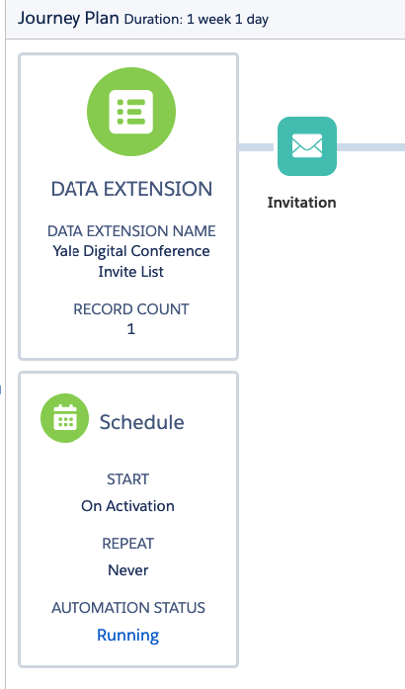
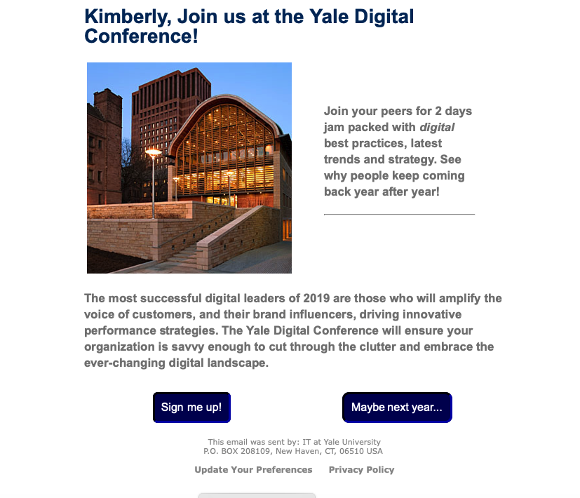
Journey Builder
Notes:
First, we have created a data extension with all of the people we would like to invite to the conference
we will then set a schedule that can be modified to start on a specific date and time or when you press the activate button on the journey
NEXT SLIDE

Slide 16
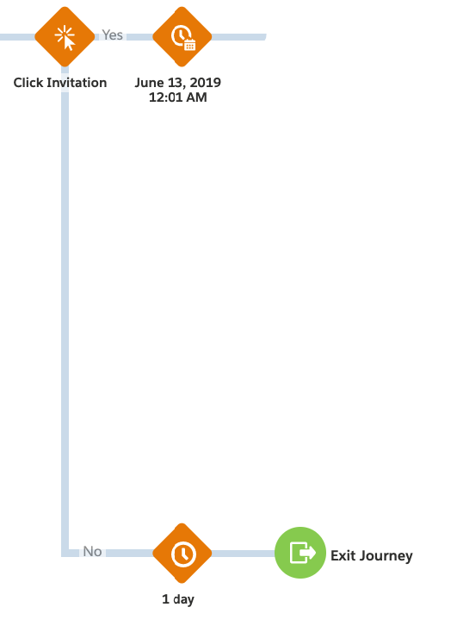
Journey Builder
Notes:
Next, we will hit our first ENGAGEMENT SPLIT
the button you click in this email will push you down one of two paths
If you click sign me up you will remain in the journey and move down the path, if you click maybe next year, you will be exited from the journey.

Slide 17
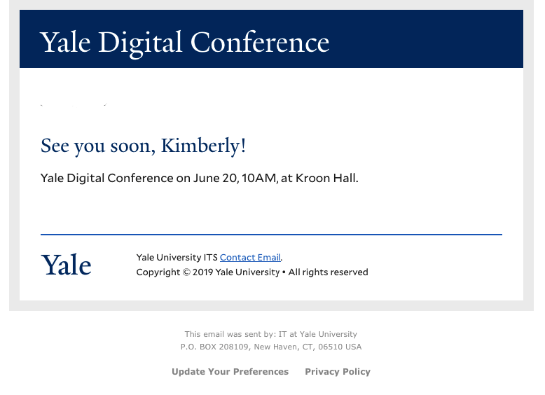
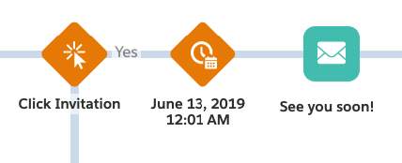
Journey Builder
Notes:
The people that have signed up for the conference are now taken down a path to be reminded the day of the conference with details about the time and location
we have also deployed AMPSCRIPT here which is a way to control content for an individual recipient.
As you see my name has been plugged in here to personalize the message

Slide 18
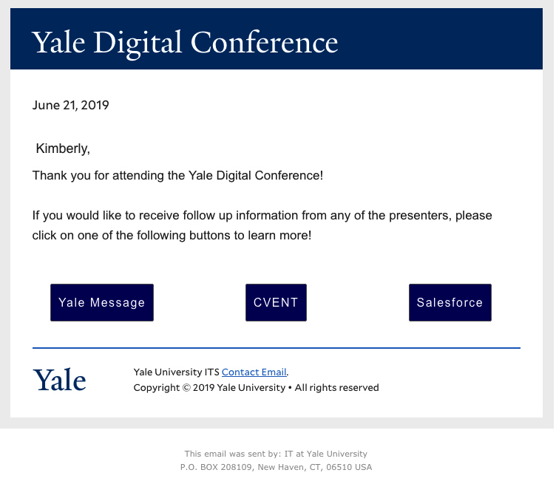
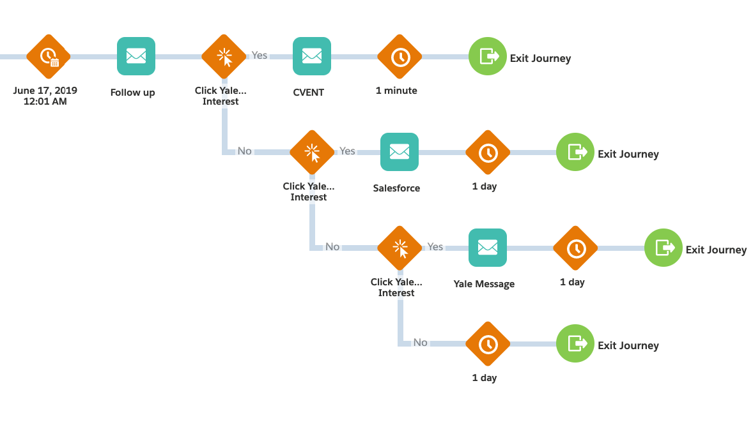
Journey Builder
Notes:
Our next ENGAGEMENT SPLIT will come after the conference when we send a follow up email to attendees inquiring about their interest in the topics they heard.
We have set this email up with three buttons, one for each topic
NEXT SLIDE

Slide 19
Journey Builder
Engagement Split
Notes:
depending on what the recipient clicks, they will be sent down one of three paths and will receive a follow up email from the group that they wanted to learn more from
after this, the journey is completed and all contacts will exit

Slide 20
Q&A

