Slide 1
User management in Drupal
Andy Hickner
Web Services Librarian
Cushing/Whitney Medical Library
andrew.hickner@yale.edu
(203) 785-3969

Slide 2
Today’s agenda
Users
Roles
Permissions
Help/Resources

Slide 3
How many editors do you have on your site?

Slide 4
Users
http://library.medicine.yale.edu/admin/people
Notes:
(demo this)

Slide 5
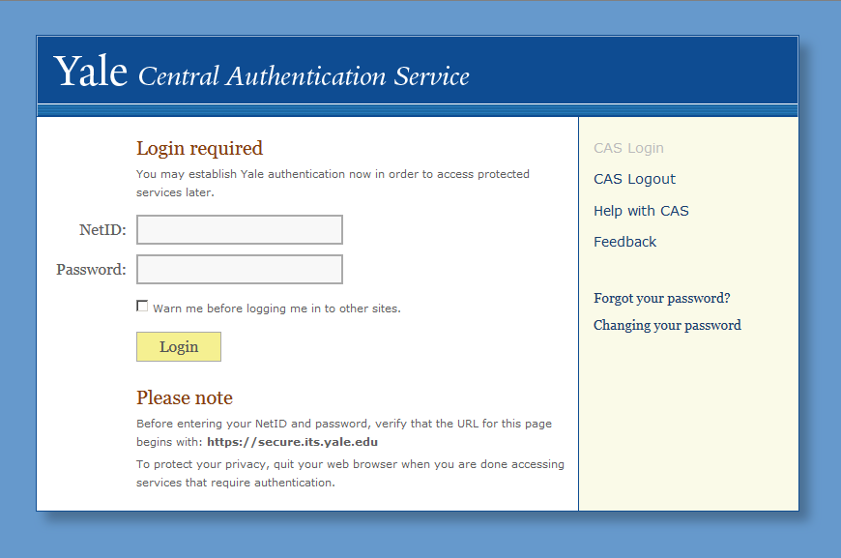
Notes:
CAS is a beautiful thing. I love CAS. You don’t want to be in the business of managing people’s passwords.
I know just enough about web security to know that I know hardly anything about web security, and I am grateful I don’t have to. We are incredibly lucky that we can delegate our user management to CAS.

Slide 6
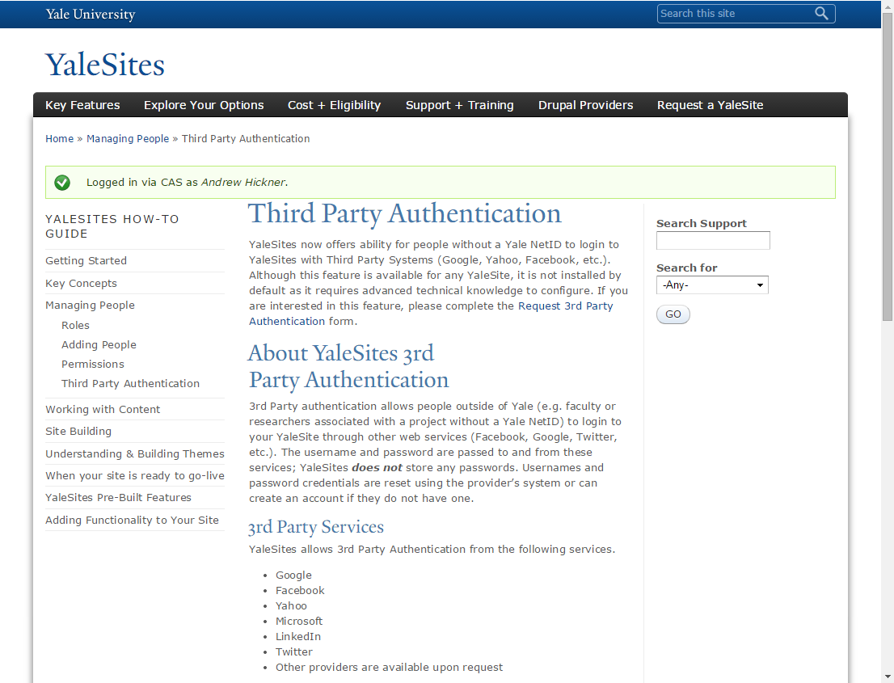
http://yalesites.yale.edu/book/third-party-authentication
Notes:
For non-NetID users

Slide 7
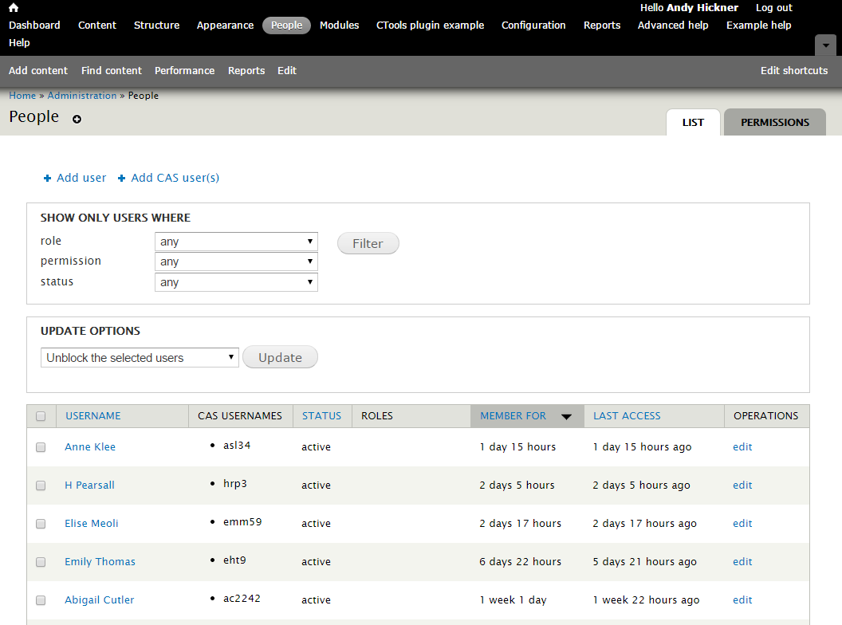
Notes:
What do you notice about this list? (No one has a role. ) Who do you think these users are? (Bots)

Slide 8
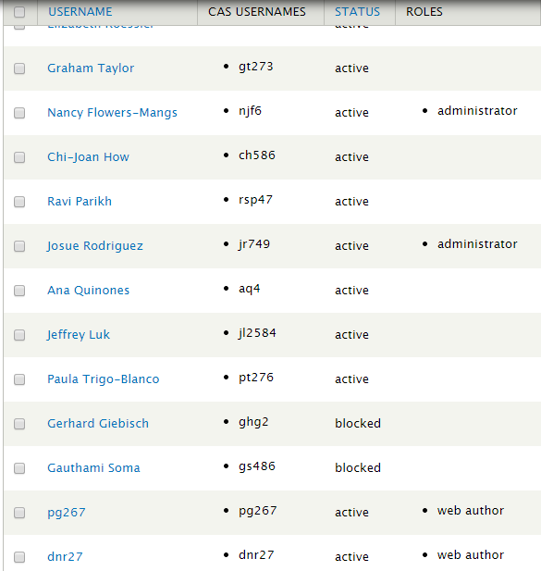
Notes:
What do you notice about THIS list? (some of these users have roles assigned)

Slide 9
Roles
To get to roles, you have to go through…
Notes:
How many roles do you have on your site?
What roles does your site have?
Default roles?
Role = type of user

Slide 10
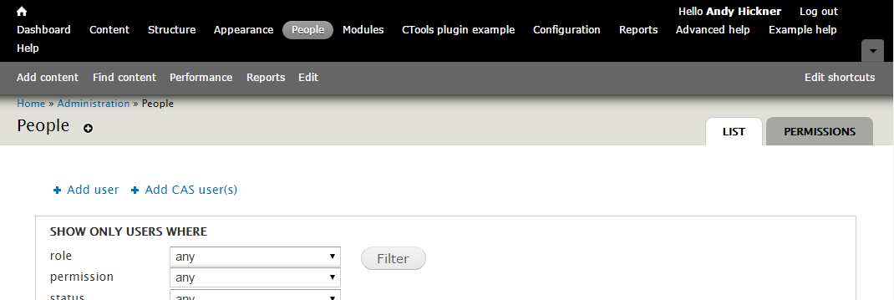
People > Permissions
http://library.medicine.yale.edu/admin/people/permissions
Notes:
If you find yourself not seeing an option or not able to do something – check the permissions!!!

Slide 11
People > Permissions > Roles
http://library.medicine.yale.edu/admin/people/permissions/roles

Slide 12
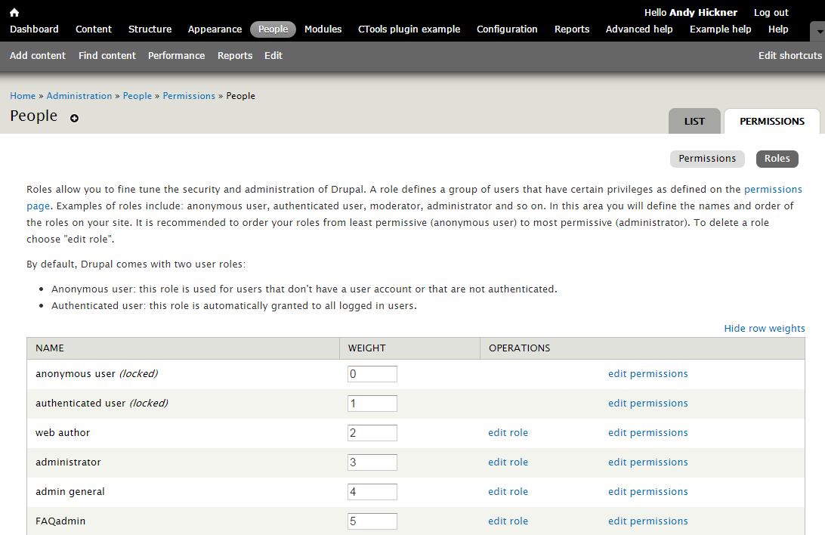
Notes:
You set permissions by role

Slide 13
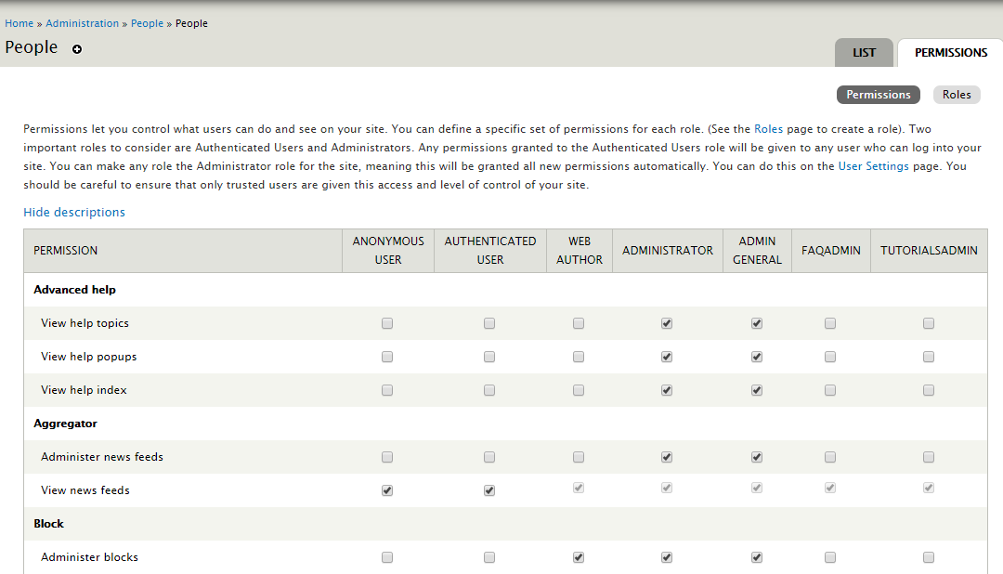
Notes:
The tip of the iceberg – a peek at the dreaded enormous permissions table
If you find this overwhelming, I have good news – you can set permissions individually by role

Slide 14
Notes:
Knowing what we know now, what kind of permissions do we want to grant authenticated users?
A: Ability to view public content. THAT’S IT. Assume authenticated users are malicious intent on using your website for mischief.

Slide 15
Demo
Create a user
Create a role
Assign permissions to the role
Assign user to the role

Slide 16
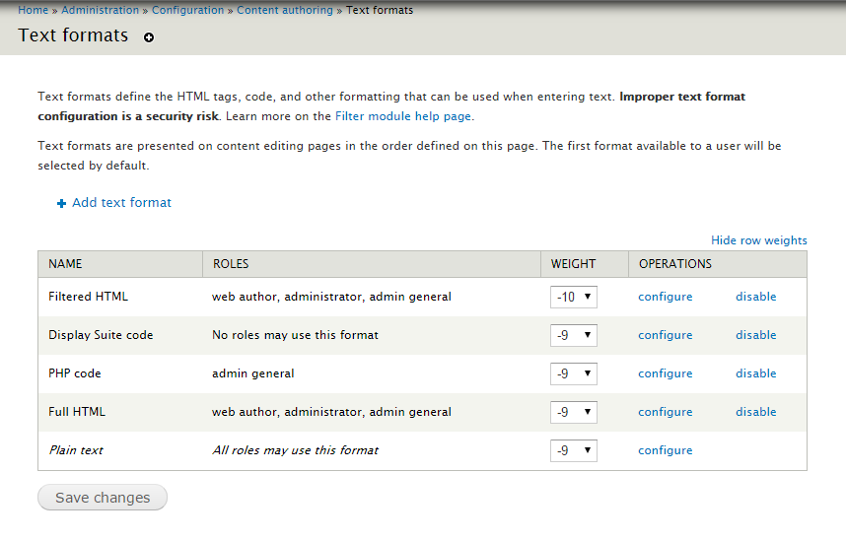
Configuring text formats for roles
http://library.medicine.yale.edu/admin/config/content/formats

Slide 17
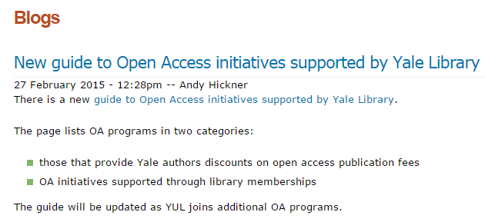
Display names & the Real Name module
Notes:
When you post to the blog, what does it show as your byline?
Default display name when a user authors a piece of content, for example a blog post, is to just show netid as content author. For example, when I started at the Medical Library, I would write a blog post and it would list the author as alh72.
This isn’t really user-friendly, obviously.
Good news is, there’s a way to address this. You can set a display name be enabling the Real name module.

Slide 18
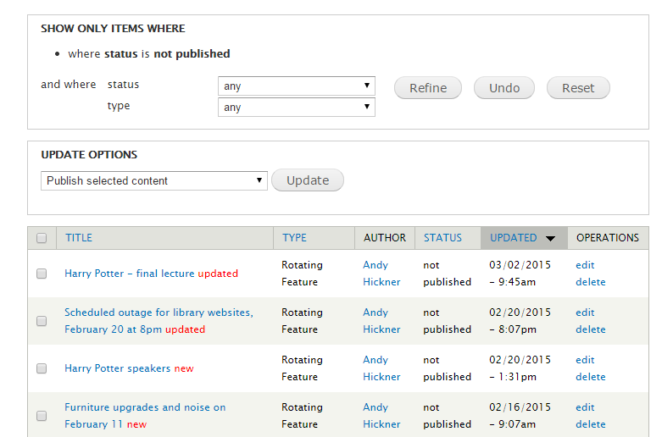
View unpublished
Notes:
A handy module that lets a non-administrator who is logged in view an unpublished node. When might this come in handy?
A: For example if you’re drafting a blog post and you want a colleague to be able to view and edit it before it gets published.

Slide 19
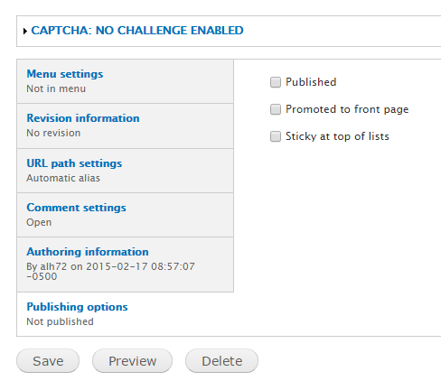
View unpublished
Notes:
With the module enabled, you can scroll down to the bottom of a node you are editing and this new “Publishing options” section will appear.

Slide 20
Implications
What kinds of actions and behavior can you control using roles and permissions?
Notes:
What can you control using permissions?
Views, blocks, modules
Creating, viewing, and editing content

Slide 21
Scenarios
A colleague comes to you complaining that she can’t access a particular page on the website. Where would you start to troubleshoot?
This same pesky colleague notices there is outdated information in a block you created. You tell her to go ahead and make the updates. She comes back to you and says she doesn’t see the “Edit” link on a block she needs to edit. What might be causing the problem?
Notes:
Check user – what role is she assigned? Does this role have access permission for this type of content?
Check user – what role is she assigned? Does this role have permission to edit blocks?

Slide 22
Help/Resources
Yalesites: http://yalesites.yale.edu/book/managing-people
“Managing users,” Drupal.org: https://www.drupal.org/node/627158

Slide 23
Questions?
Notes:
Questions?

Slide 24
Contact:
Andy Hickner
Cushing/Whitney Medical Library
andrew.hickner@yale.edu
(203) 785-3969

