Slide 1

Yale Digital Conference 2019
Louis Tiseo
Sr. Director, Foundational Technologies Services

Slide 2
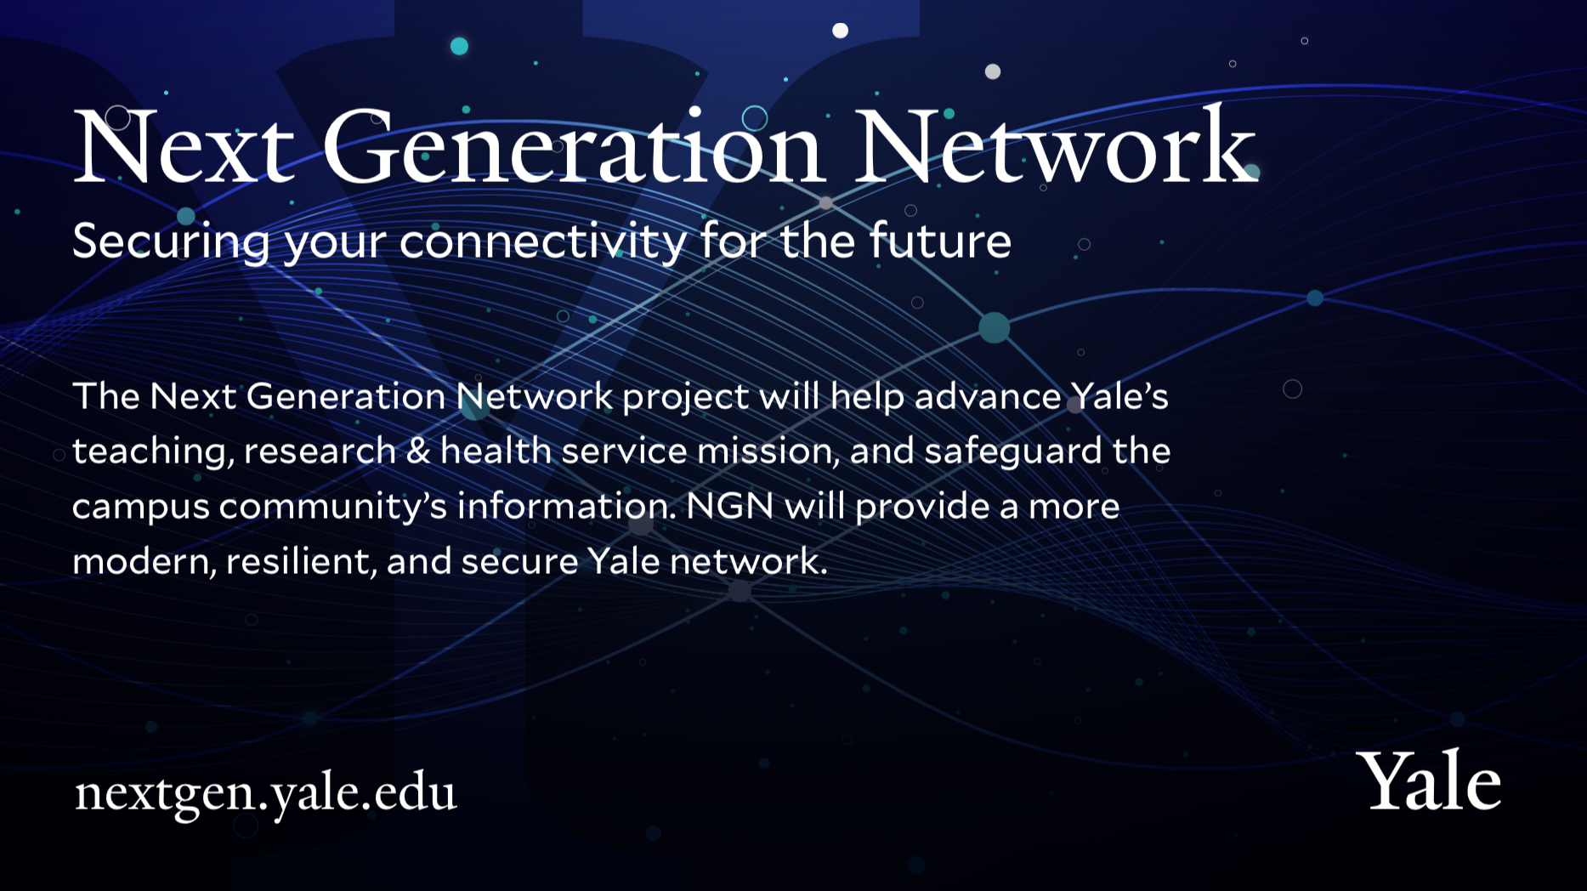

Next Generation Network
Securing your connectivity for the future
IT Knowledge Exchange
March 21, 2019

Slide 3

Next Generation Network: What is driving change in campus networks? networks?
Security - increased complexity of securing data and enabling research and collaboration
Increasing numbers of devices on the network (IOT, BYOD)
Converged Networking (Voice, data, AV, IOT)
Applications and data moving to the Cloud
Requirements for high speed research networks (100G+)
Need for collaboration across institutions for research
Increased global presence for large campuses
Move towards BYOD and desire for seamless wifi
Technical debt for schools who have not invested enough in network upkeep

Slide 4


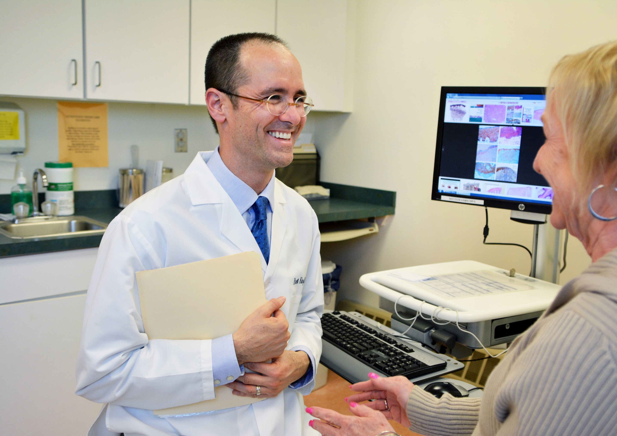

Next Generation Network : Growing Dependencies
Academic Delivery –
With everything from learning management systems to library resources online, we are dependent on the network for executing our education mission.
Research –
The network is foundational to accessing research clusters and instrumentation as well as working across peer institutions.
Clinical Care –
The information doctors use in patient interaction is almost entirely system based, accessed through the network.
Cultural Heritage –
Making Yale’s collection accessible to patrons and scholars worldwide is dependent on a robust network.

Slide 5
Next Generation Network : Goals and Drivers
Next Generation Network (NGN) will help advance Yale’s teaching, research & health service mission, and safeguard the campus community’s information. NGN will provide a more modern, resilient and secure Yale network.
Goal:
Comprehensive replacement of the network infrastructure of Yale
Provide a differentiated security risk model which fits the complex needs of Yale
Drivers:
Improve reliability and performance of the network
Improve our cybersecurity posture
Position Yale for an ever more digital world

Slide 6
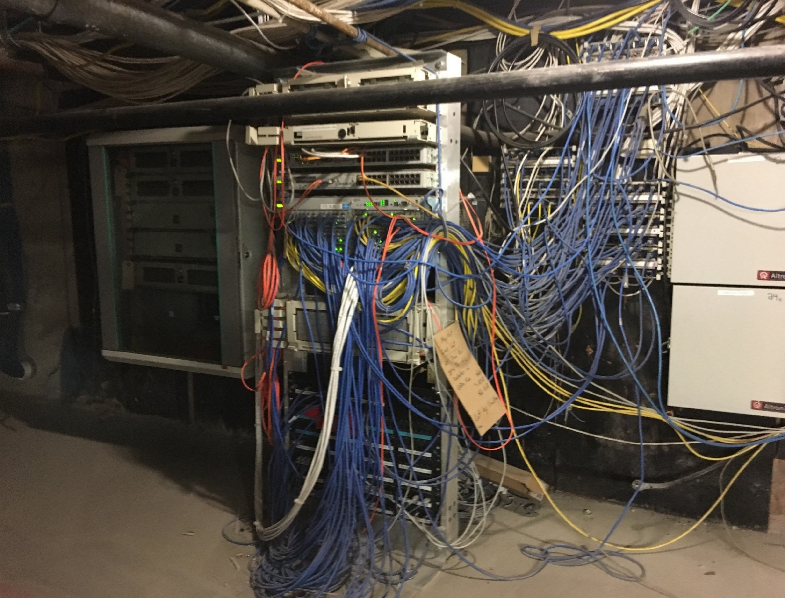
Next Generation Network: Current State
Currently, Yale experiences eight building-level network disruptions per week
55% of equipment beyond recommended service age
Limited segmentation and network visibility is a significant security concern
Inconsistent enforcement of standards makes management and repair very challenging

Slide 7
Next Generation Network : Key Deliverables
Key Deliverables:
Comprehensive update of network equipment to modern standard
Implement differentiated risk model
Establish cybersecurity detection and response capabilities
Converge separate networks and increase capacity
Establish appropriate redundant network pathways
In-building facilities (closets) addressed separately through facilities planning.
REMEDIATE
1450 Data Closets
REPLACE
8950 Network Switches
CONSOLIDATE
5 Networks into 1
DEVELOP
Role-based Access
AUTOMATE
Cybersecurity Response

Slide 8

Next Generation Network : What will be different……
Current User Experience
Next Generation Network User Experience
Disruptive User Experience
Professor who is also a Clinician is required to have separate logon to Yale Campus Network to YNNHS network.
Seamless User Experience
Professor who is also a Clinician will need to logon only once to access both Campus Network and YNNHS networks.
Slow Network Speed
Researcher (and all users) experience significantly oversubscribed bandwidth that can impact large data transfers
Faster Network Speed
All Users will experience 10-40X faster than current network speed
Frequent Network Disruptions
All Users experience frequent network disruptions
Fewer Network Disruptions
All Users will experience fewer network disruptions
Human Speed Detection of Security Breach
More Users impacted by a security breach because of human speed detection
Machine Speed Detection of Security Breach
Fewer Users impacted by a security breach because of machine speed detection

Slide 9
Next Generation Network: High Level Timeline

Slide 10


Next Generation Network : Releases
Foundational Release
    Software Defined Access (SDA) hardware will be rolled-out to ALL buildings with the base security model so that the network benefits of the technology will be realized much more quickly and earlier by all users.
Network
Higher Availability & Performance
Replace antiquated network equipment
Increased Efficiency in Management
Security
Increased Network Security Visibility
Auto-alerting on malicious network attacks
Authentication
Advanced Security Release(s)
Implement more advanced security features including (but not limited to) Guest Network, Device Posturing, Automated Security/Quarantine, and advanced Macro/Micro Segmentation
Security
Micro/Nano-Segmentation
Posture Checking/Network Access Control or Change of Authorization
Role Based Access Control
Location Based Access Control
Yale-YNHHS Network Integration
  Provide seamless authorized network
Security
Data Closets
Networks
Switches and Wifi

Slide 11
Next Generation Network : Timeline, where are we…
FY19 | FY20 | FY21 | FY22 | FY23 | FY24+
Initiation & Planning
IAM & Security Supporting
Phase 1: Analysis,
Design, Rollout Planning
Phase 1
Pilot (3 Buildings)
Foundational Release
Campus-wide Rollout
Advanced Security Release Analysis/Design, Rollout Planning
Advanced Security Release Campus-wide Rollout
Operational
Where we are
Partnering with Cisco for network analysis/SDA design (80% complete) and Presidio (VAR) for Implementation/design support
Readying for SDA implementation 2 Data Centers (Commons and West Campus), 3 pilot buildings (25 Science Park, 221 Whitney, Med Campus Building TBD).
Standing up our SDA Lab, refreshing network closets (wiring, fiber, power)
Preparing Authentication use cases and Lab (IAM) and User acceptance plan
Communication & Change Management work: NGN Website, NGN One-Pager, communications targeted for building / rollout communications
Building out operational plans and procedures
What’s Next
Complete SDA Design, Migration Plan and Implementation Plan
Begin installation of new network equipment (including switches and core distribution gear) in the 2 Data Centers: West Campus, Commons
Begin migration to SDA fabric of 1st pilot buildings 25 Science Park
Development of our migration plan (past West Campus) and aligning to a quarter by quarter Roadmap. This will be based on criteria such as; Use Cases, Building H/W criticality and outcome of the pilot
Development of further informed Program Roadmap to support our Foundational and Advanced Security Release (s)

Slide 12
Next Generation Network:
Questions
Security
Data Closets
Networks
Switches and Wifi

Slide 13


