Slide 1
Yale Digital Conference 2019
Michael Harris
Accessibility Engineer

Slide 2
Introducing the Yale UI Component Library
Michael Harris
Accessibility Engineer

Slide 3
Extra Special Thanks!
Sarah Lynch, Accessibility Engineer
Chris Mongillo, Digital Accessibility Coordinator
Adomous Wright, ITS, Early Career Development Intern

Slide 4
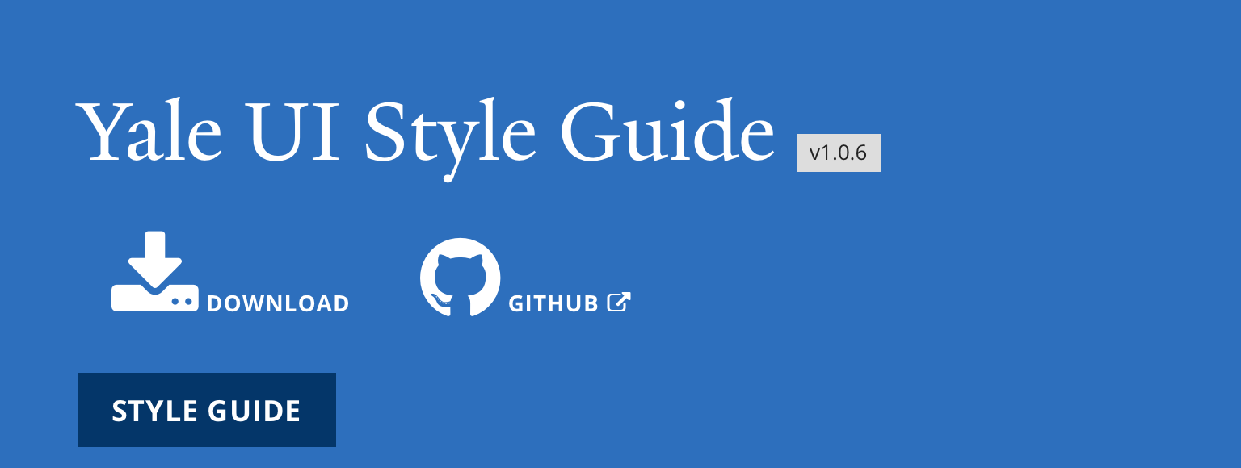
History

Slide 5
Motivation
A high quality, consistent, accessible User Experience throughout Yale
Consistent, up-to-date Yale branding
Speed up development time for custom projects

Slide 6
Current Milestones
Begin the project (early 2019)
Get the UI Component Library to a stable version (Jun 2019)
Get community feedback and engagement (Summer 2019)
Launch V1.0.0 (2nd Half 2019)

Slide 7
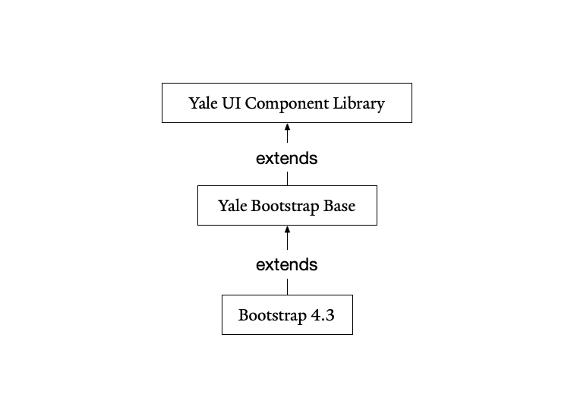
Architecture

Slide 8
Yale Bootstrap Base
Extends Bootstrap 4.3
Fixes and re-implementations to Bootstrap
Force accessible color contrast
No particular Yale branding
Can be used as the basis for any Bootstrap project

Slide 9
Yale UI Component Library
Extends Yale Bootstrap Base
Adds Yale-specific styling, colors, fonts, etc to Bootstrap
Inherits accessible Color Contrast
Can be used as the base of a Yale-branded project

Slide 10
Accessibility Wins: Color Contrast
Bootstrap by default does not have accessible color contrast
Developers can set custom colors that may not be accessible

Slide 11
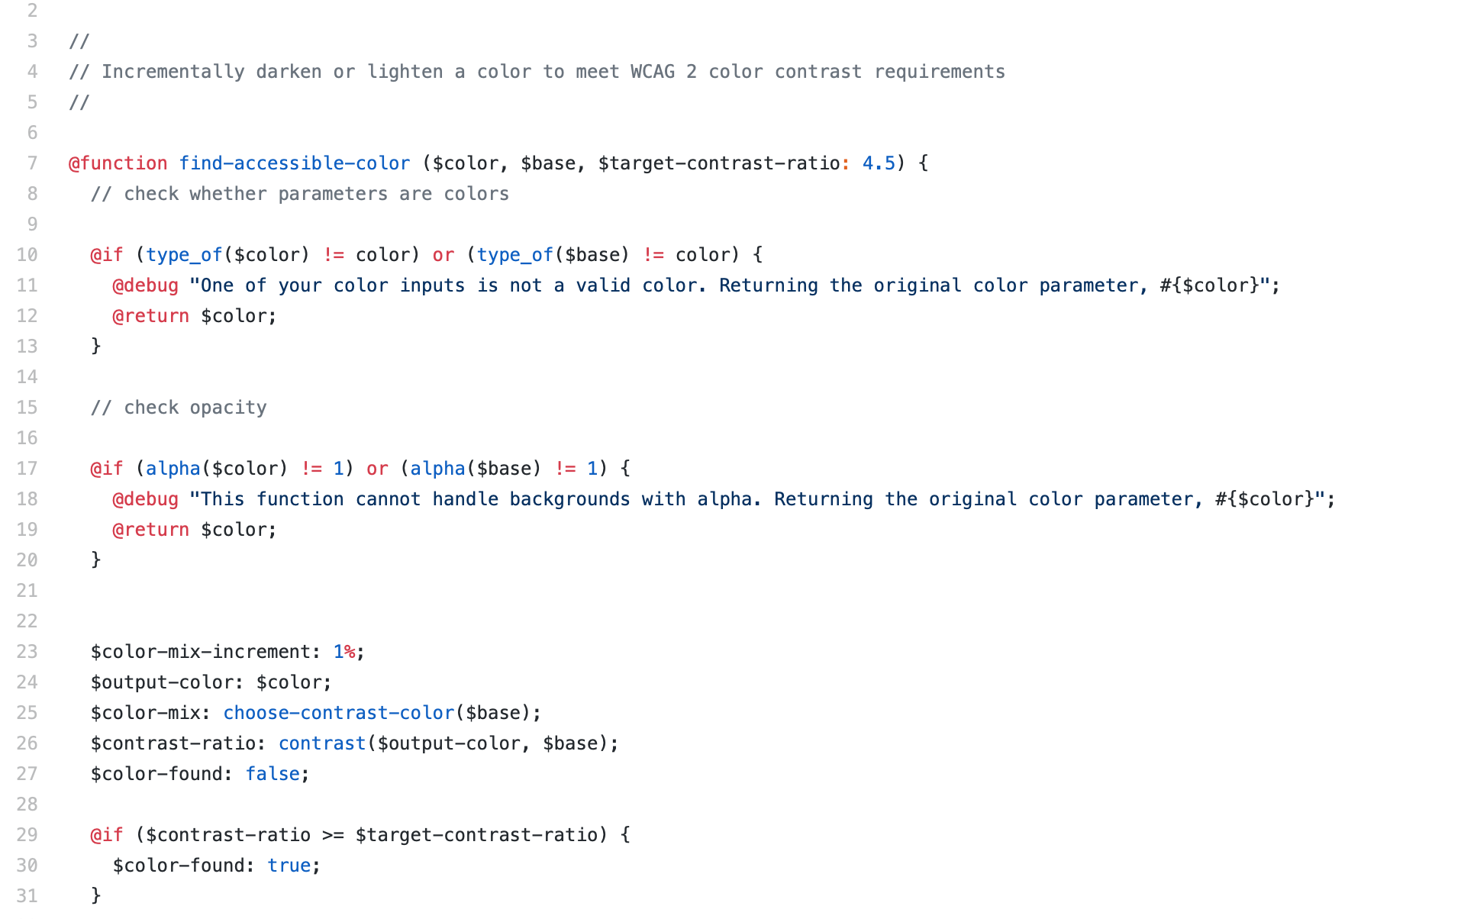
Accessibility Wins: Color Contrast
We implemented SASS color contrast functions to automatically calculate color contrast, and lighten or darken colors until they meet WCAG 2 requirements

Slide 12
Let’s have a look!
https://git.yale.edu/pages/yale-ui/ui-component-library/

Slide 13
Using the Library
There are two ways to use the Yale UI Component Library
Drop it into a project
Provide custom variables and recompile it

Slide 14
Get involved!
Check out the Git repo: https://git.yale.edu/yale-ui/ui-component-library
Email us to collaborate: accessibility@yale.edu

