Slide 1
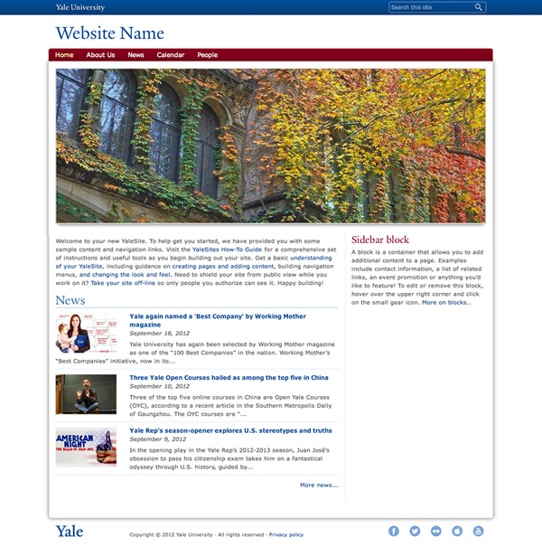
YaleSites Templates A Powerful Foundation for your Custom Theme
Victor Velt
Design & Theming
Andrea MacAdam
Information Architecture
Nancy Flowers-Mangs,
JoAnn Piscitelli
Content Types & Views
Vincent Massaro
Custom Development

Slide 2
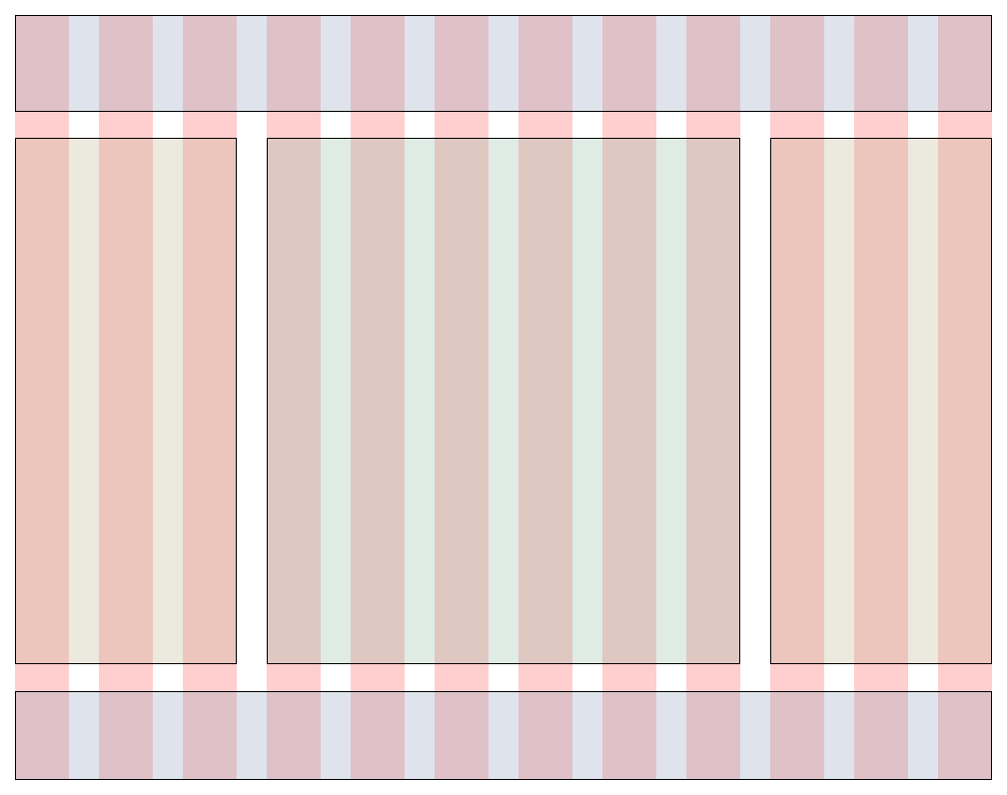
Yale 978 Grid
Omega is based on the 960 grid system
Yale Grid
978 px wide
12 columns
15 px margins
30 px gutters
19 regions

Slide 3
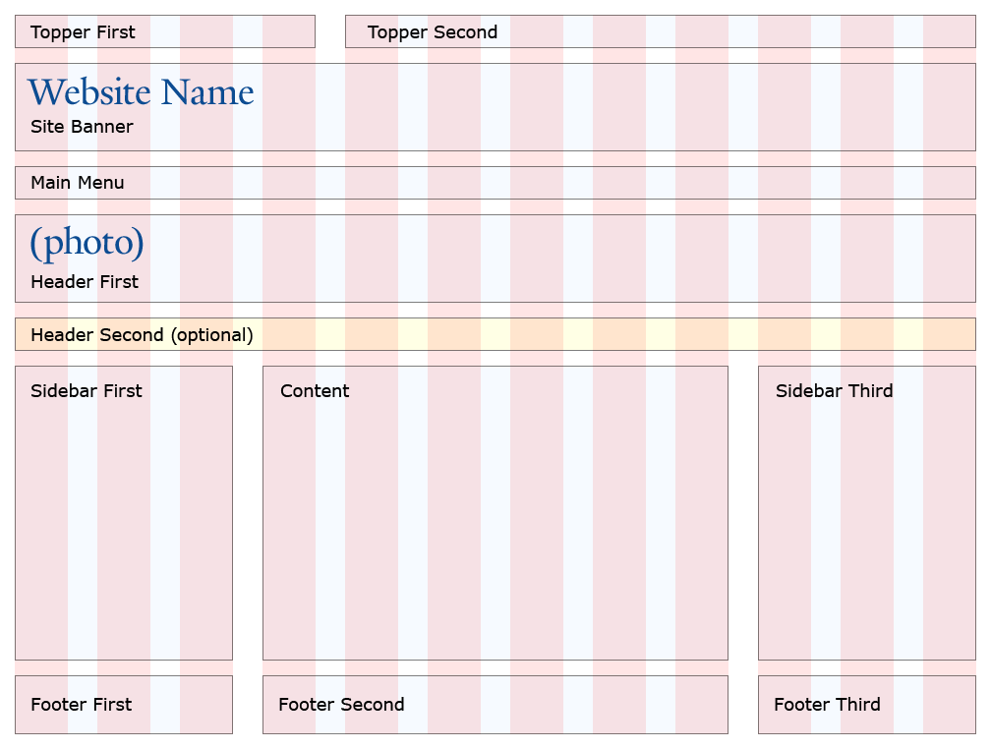
Primary Regions

Slide 4
Sections • Zones • Regions
Header Section
Topper Zone
Banner Zone
Menu Zone
Content Section
Header Zone
Content Zone
Footer Section
Footer Zone

Slide 5
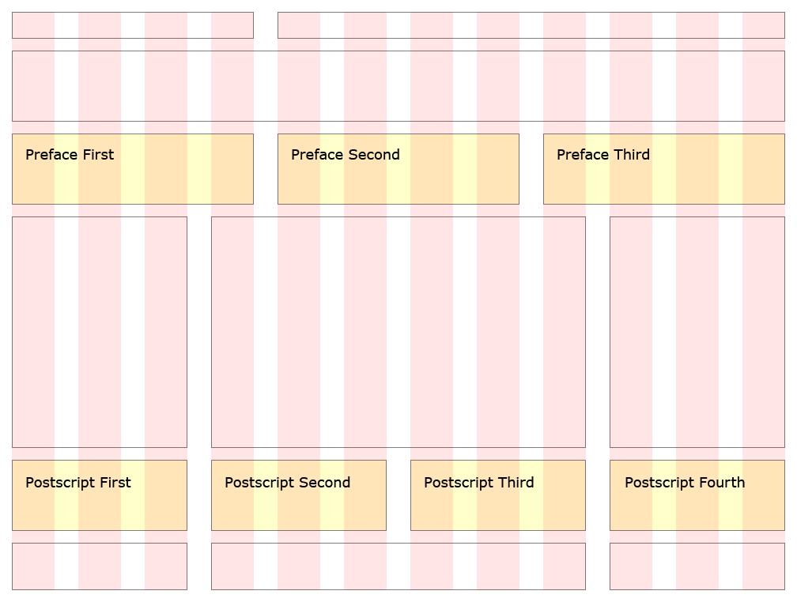
Additional Regions

Slide 6
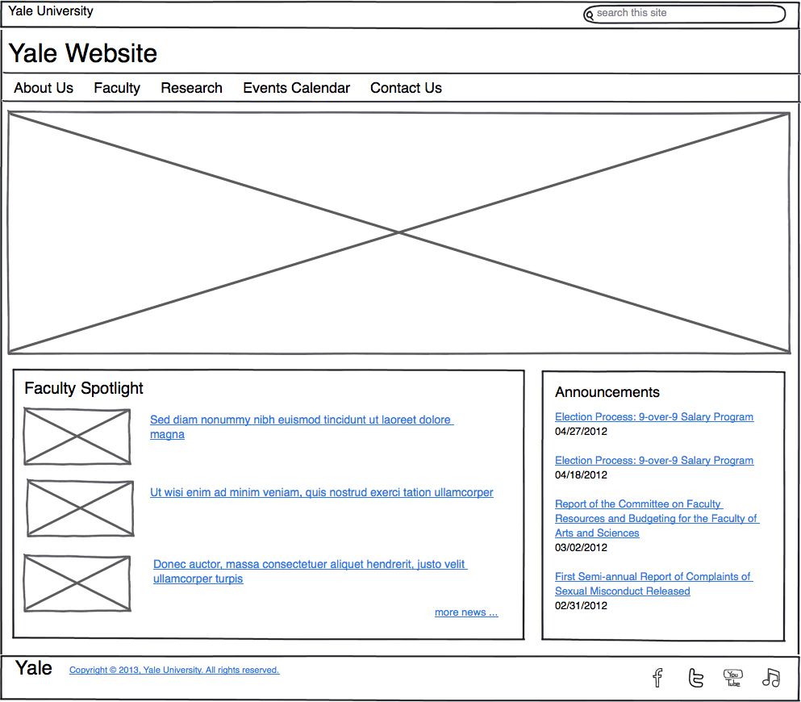
Layout Options

Slide 7
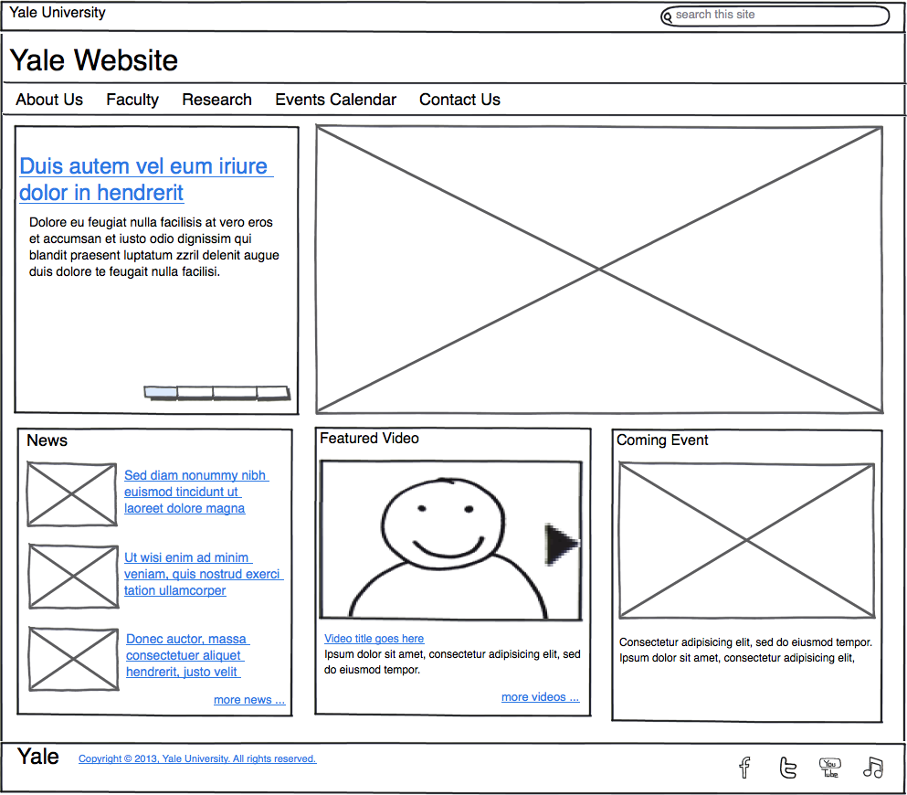
Layout Options

Slide 8
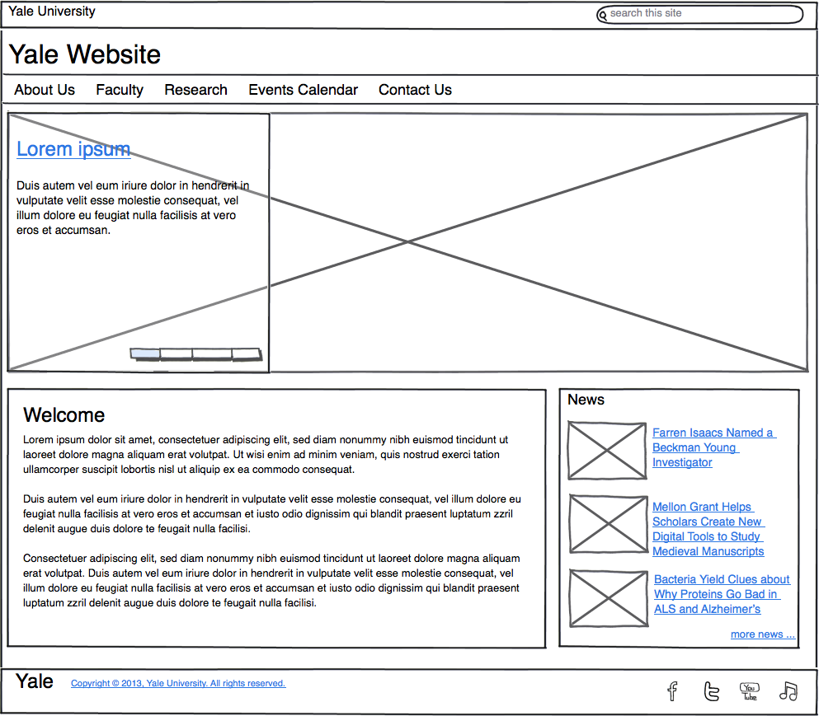
Layout Options

Slide 9
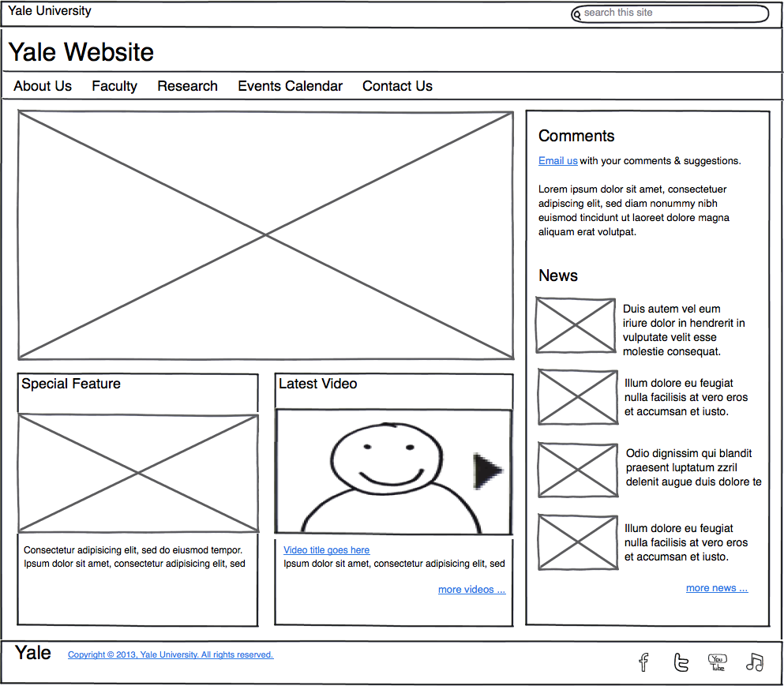
Layout Options

