Slide 1
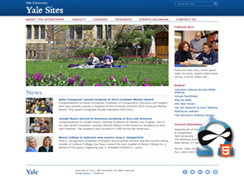
Designing with YaleSites
drupalcamp.yalesites.yale.edu/designing-yalesites
Victor Velt
Office of Public Affairs
and Communications
victor.velt@yale.edu

Slide 2
What makes up YaleSites?
Drupal 7
Omega (base theme)
Yale Omega Base (builds on Omega)
adds the global Yale theme style sheets, images, scripts, features and configurations
Yale Standard
Yale Boxed
Yale Wide

Slide 3
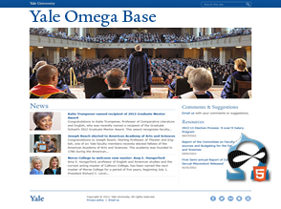
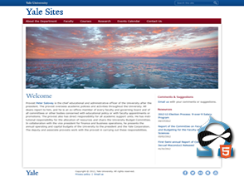
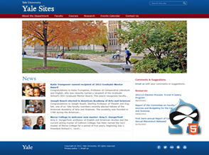

Slide 4
Yale Omega Base
Yale 978 Grid
Based on 960 Grid System
Modular grid layouts
Sections, Zones, Regions
Responsive grid for mobile devices
compresses for medium width screens
fluid grid for small screens
Content first source ordering
Better accessibility, mobile, SEO

Slide 5
Making Changes
Modify any YaleSites theme
CSS Injector
Delta & Context to change key pages
Custom sub-theme
Use any YaleSites theme as starting point, customize as much as needed
Add new CSS, Javascript, images, Drupal template files

Slide 6
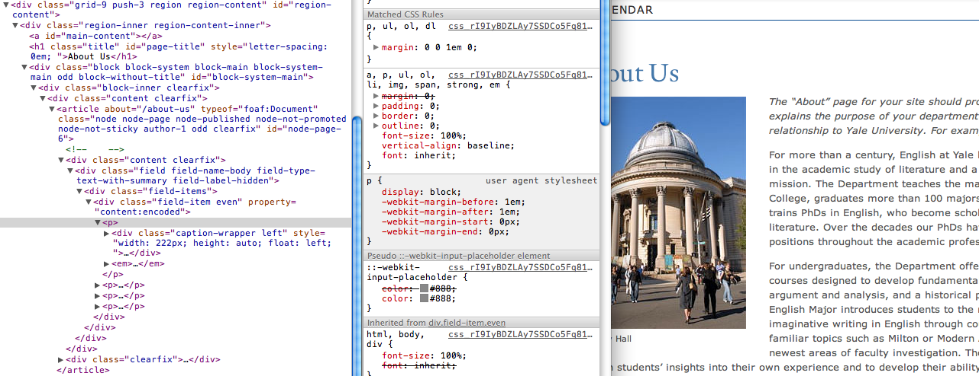
Simple Changes
Change body text to the Yale typeface
Find CSS selectors with browser inspector
Override styles using CSS Injector

Slide 7
.region-content p {
font-family: ‘YaleDesign’, Georgia, “Times New Roman”, Times, serif;
font-size: 16px;
font-size: 1.6rem;
line-height: 1.5em;
}

Slide 8
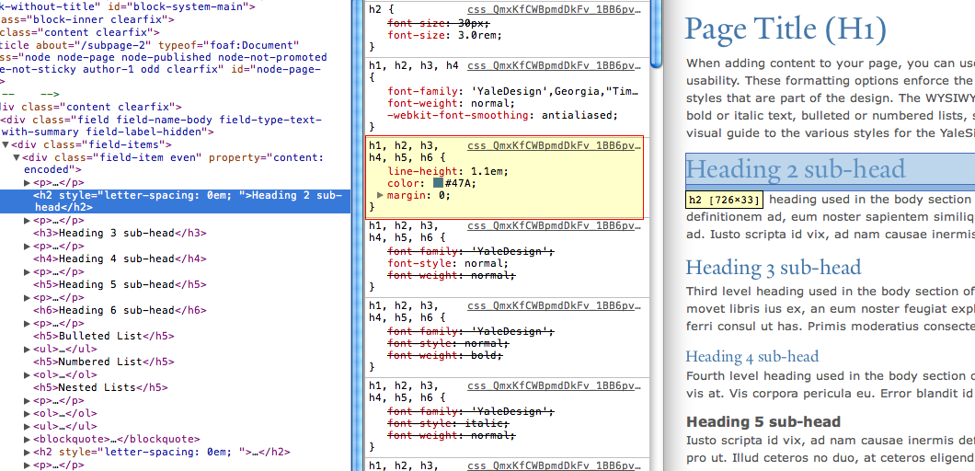
Change Heading Color
Find CSS selectors

Slide 9
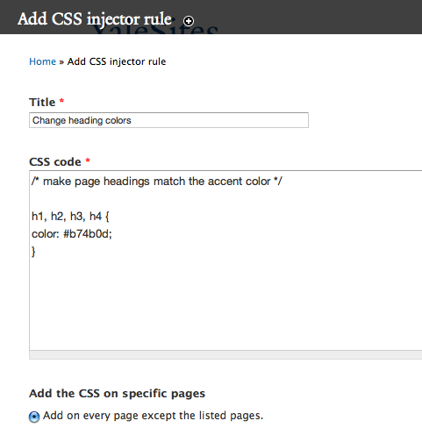
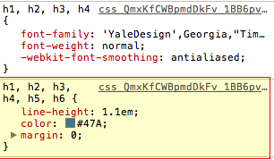
CSS Injector
CSS for headings 1 – 4

Slide 10
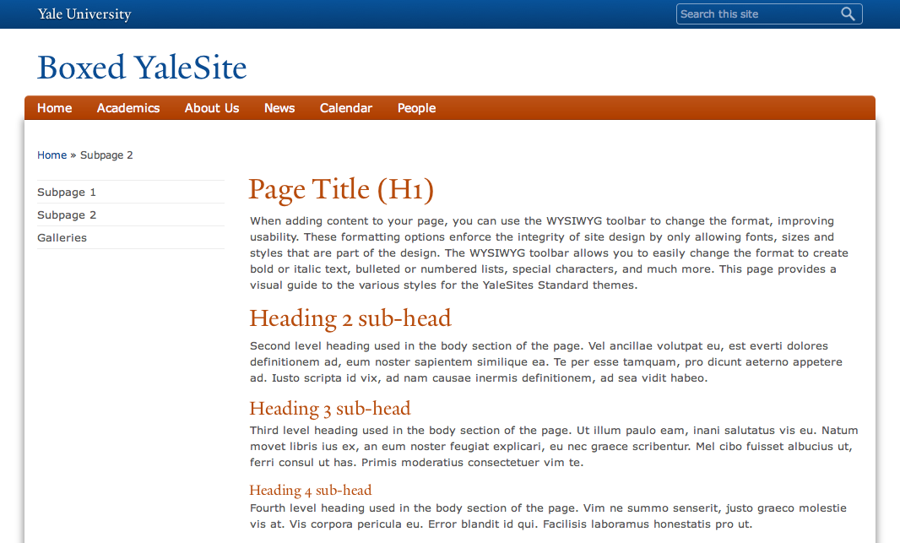
New Heading Color

Slide 11
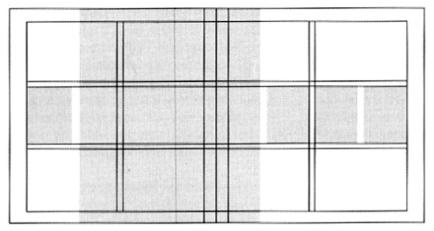
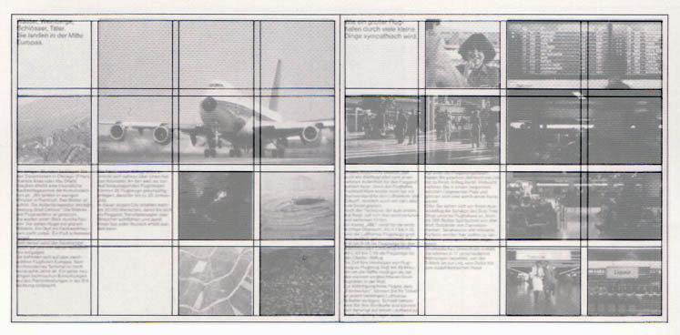
Grids

Slide 12
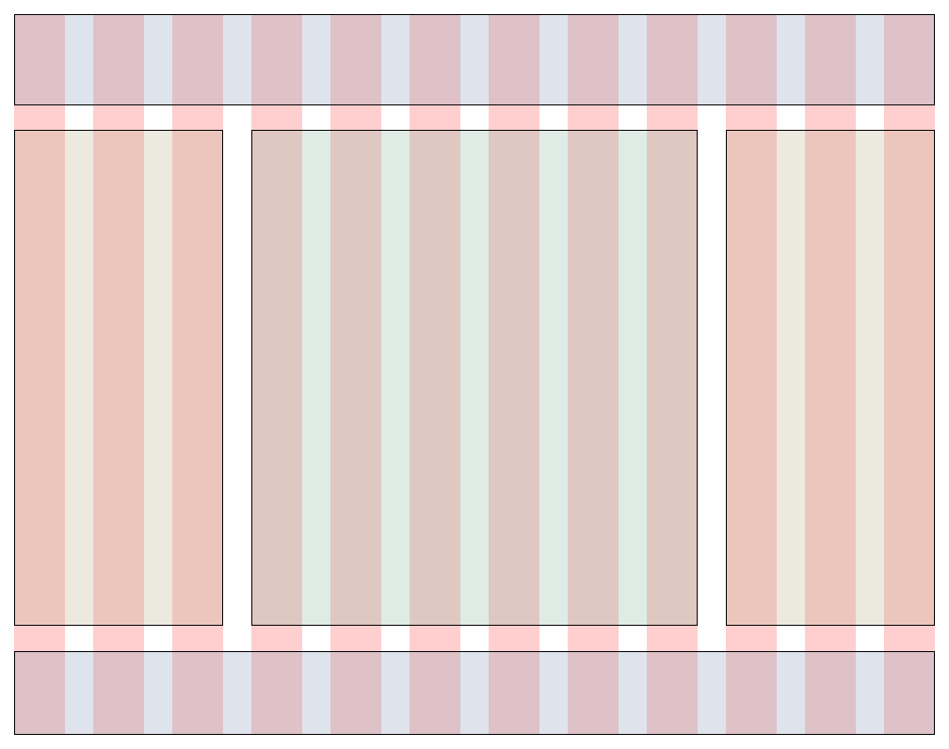
Yale 978 Grid
Omega is based on the 960 grid system
Yale Grid:
978 px wide
12 columns
15 px margins
30 px gutters
19 regions

Slide 13
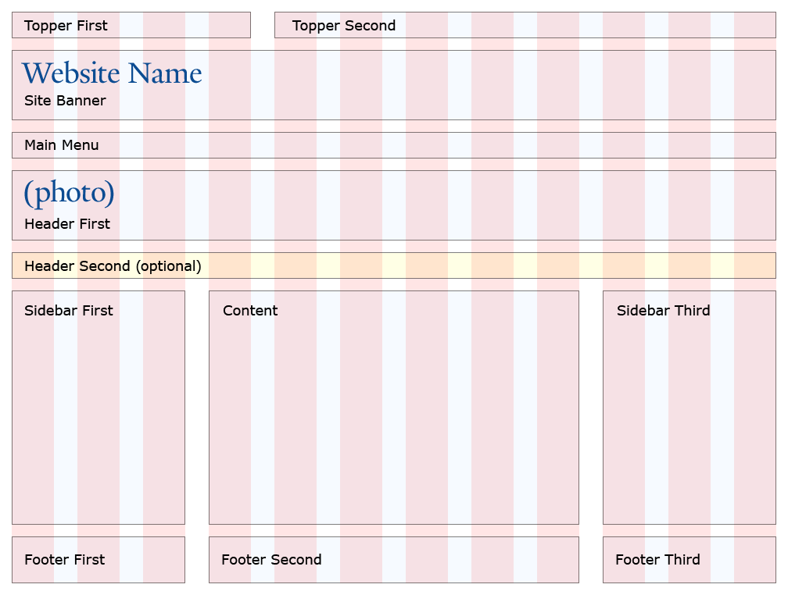
Primary Regions

Slide 14
Sections • Zones • Regions
Header Section
Topper Zone
Banner Zone
Menu Zone
Content Section
Header Zone
Content Zone
Footer Section
Footer Zone

Slide 15
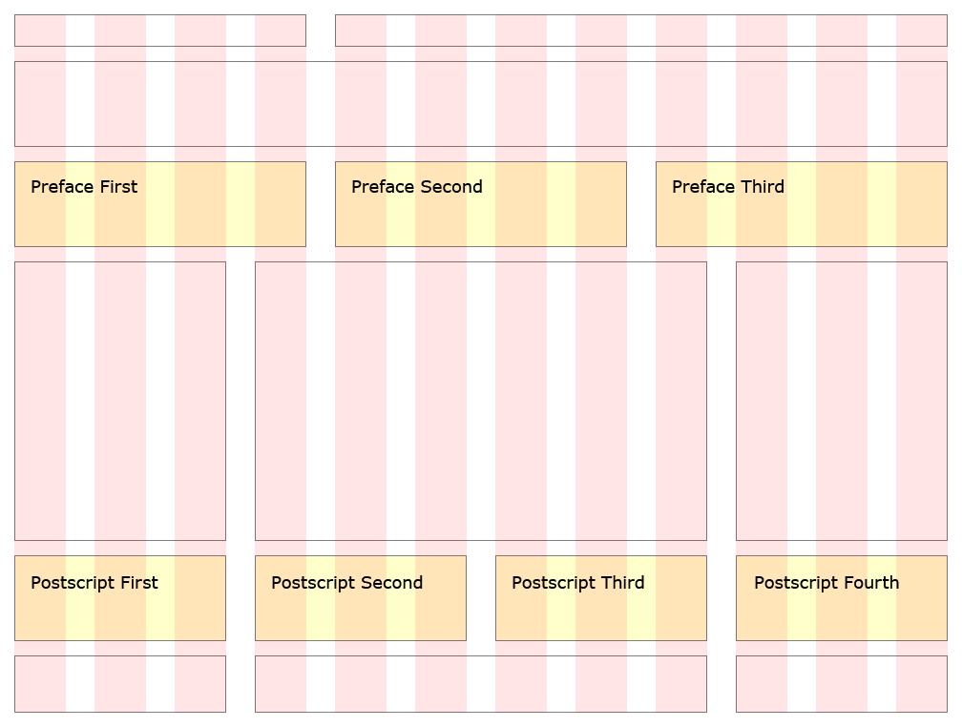
Additional Regions

Slide 16
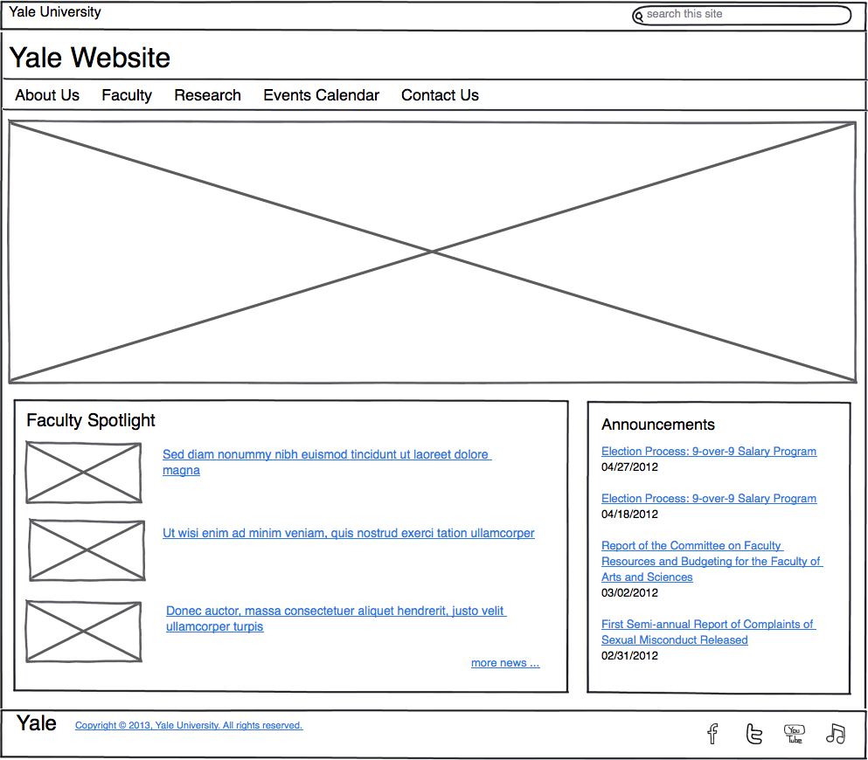
Layout Options

Slide 17
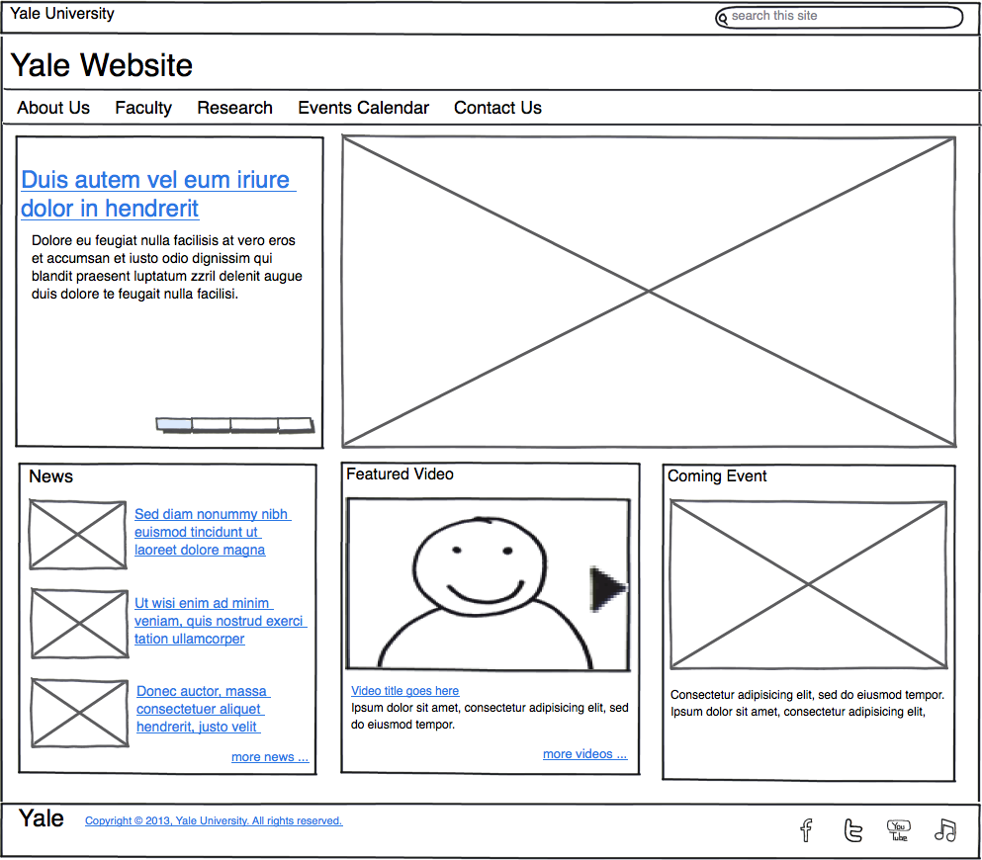
Layout Options

Slide 18
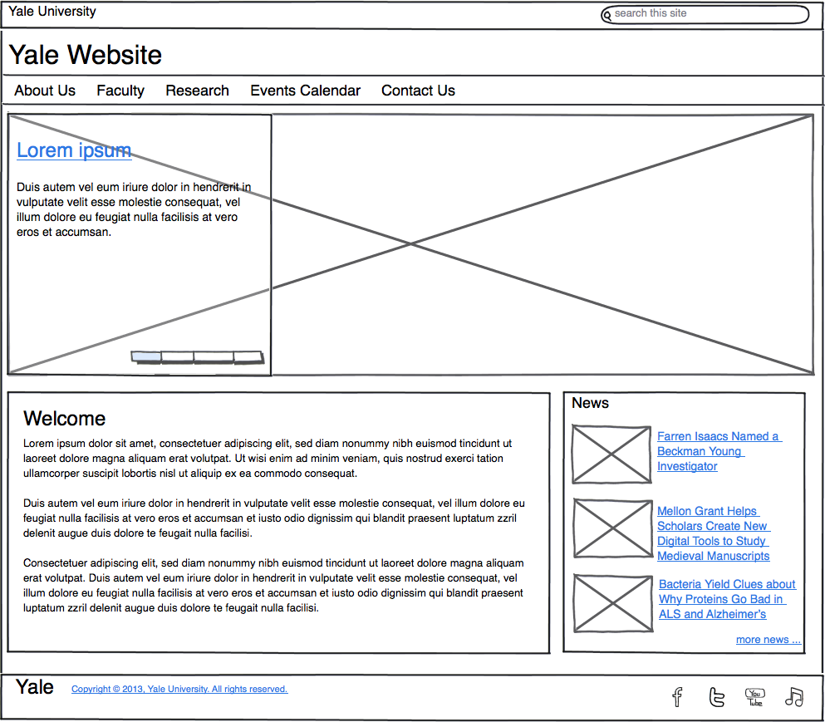
Layout Options

Slide 19
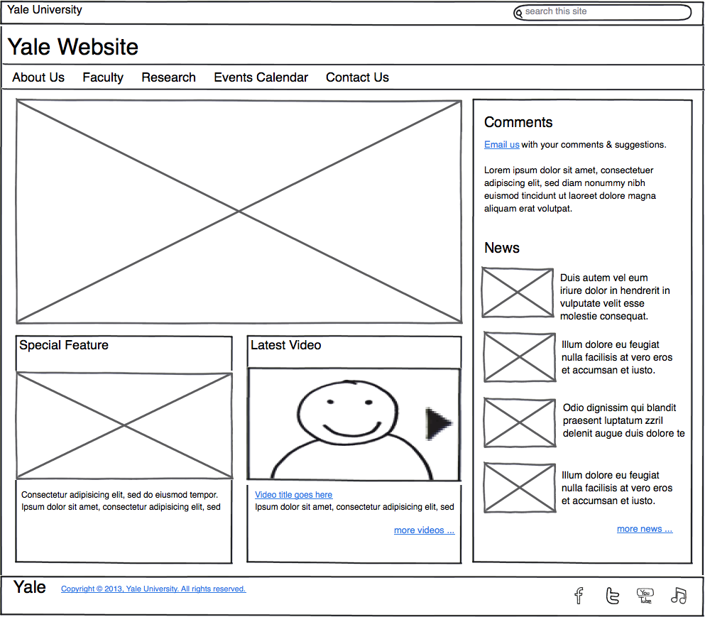
Layout Options

Slide 20
Example Layout Changes
Start with the Yale Boxed theme
New site design requires the footer to be included inside the pagebox
Content Zone defines pagebox
Footer is below the Content Zone

Slide 21
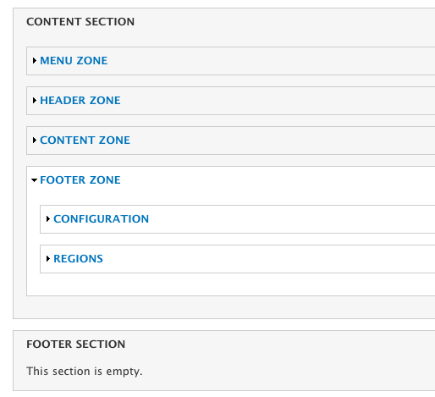
Change Theme Settings
Move footer zone inside content section
Content Section
By moving its default placement we can include the footer inside the pagebox.
Simply leave default footer section empty

Slide 22
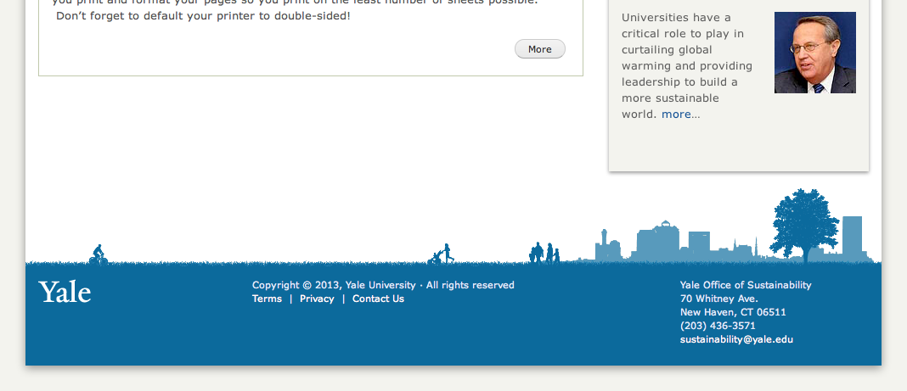
New Footer with Styling
Pagebox now includes the footer

Slide 23
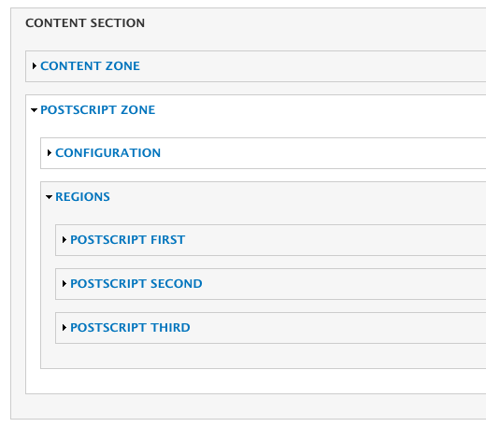
Using Postscript Regions
Enable regions in Delta Theme Settings

Slide 24
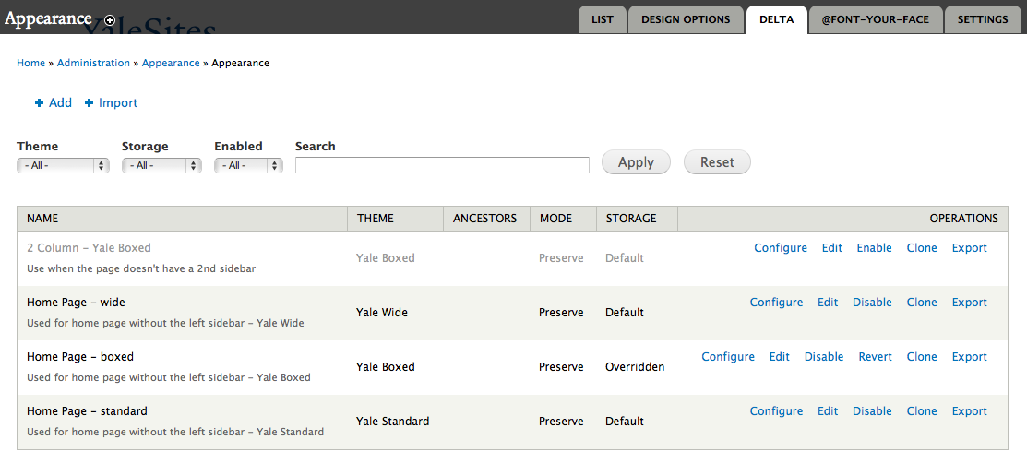
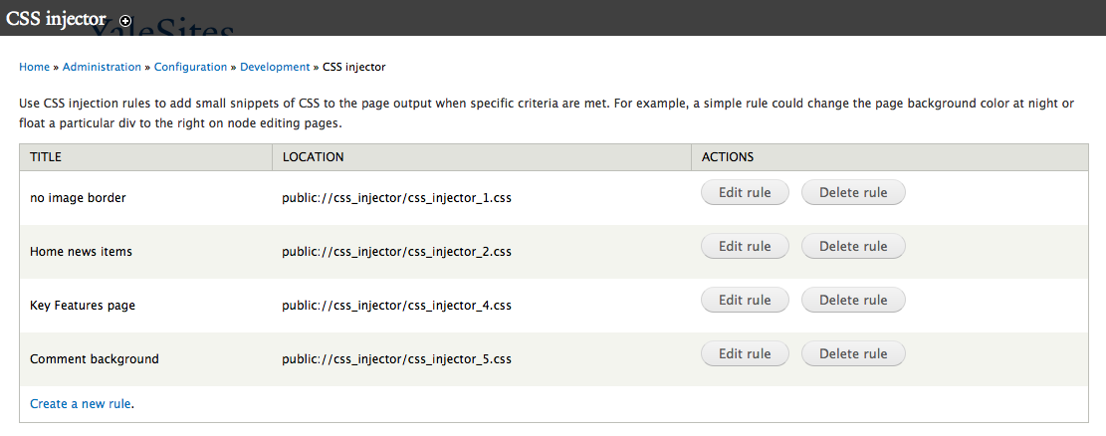
Delta & Context Modules • CSS Injector

Slide 25
Yale Typeface
Yale web font for page headings
Auto ligature replacement
Auto typographer’s quotes & apostrophes
Auto widow control
http://yalesites.yale.edu/book/formats-and-styles
http://www.yale.edu/printer/

Slide 26
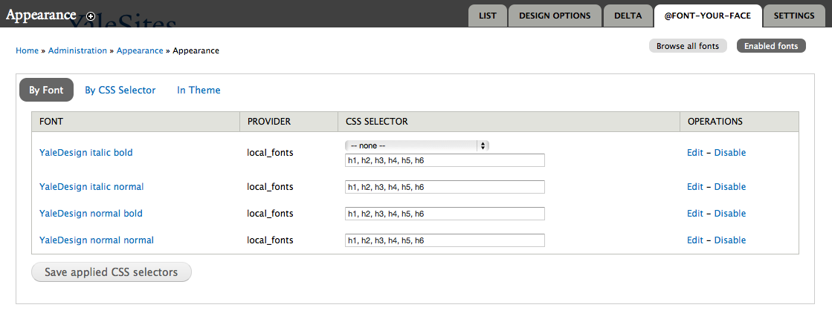
Web Font Support
Can use the Yale web font with any Drupal 7 theme via @Font-Your-Face module

Slide 27
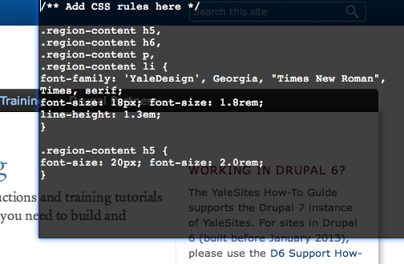
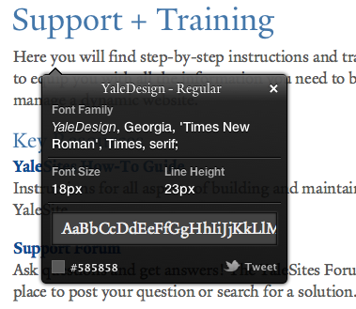
Tools
Firebug for Firefox, Safari or Chrome Web Inspector
CSS Terminal: http://barberboy.github.com/css-terminal/
WhatFont: http://chengyinliu.com/whatfont.html
960 Grid System: http://www.slideshare.net/fourkitchens/accelerated-grid-theming-using-ninesixty http://speakerdeck.com/nathansmith/960-grid-system

Slide 28
YaleSites Style Sheets
Global Styles & Accent Colors
http://yalesites.yale.edu/sites/all/themes/yale_omega_base/css/global.css
http://yalesites.yale.edu/sites/all/themes/yale_omega_base/css/accents.css
Yale Standard
http://yalesites.yale.edu/sites/all/themes/yale_standard/css/custom.css
Yale Boxed
http://yalesites.yale.edu/sites/all/themes/yale_boxed/css/custom.css
Yale Wide
http://yalesites.yale.edu/sites/all/themes/yale_wide/css/custom.css

Slide 29
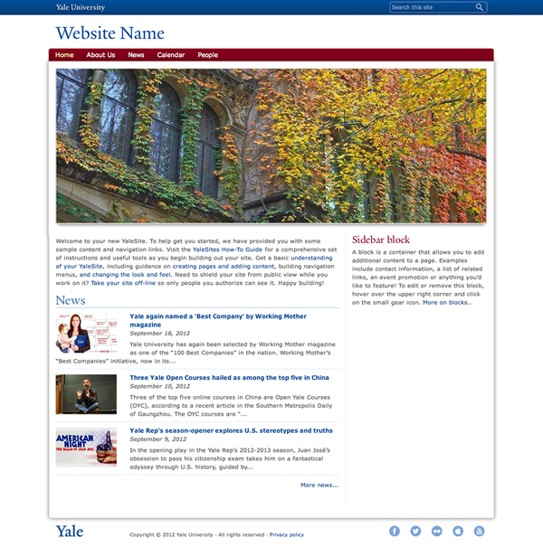
Thanks!
drupalcamp.yalesites.yale.edu/designing-yalesites
Victor Velt
Office of Public Affairs
and Communications
victor.velt@yale.edu

