Slide 1
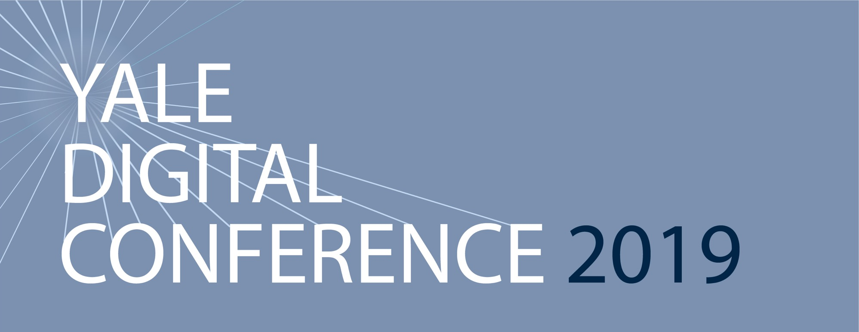
Yale Digital Conference 2019
Amy Kundrat
Director of Digital at Yale SOM

Slide 2
So You Want to Launch a Podcast? A non-expert’s guide to launching a podcast.
Amy Kundrat
Director of Digital at Yale SOM
Notes:
About me: I’m equal parts product, project, digital, and social media director at SOM. So why am I talking to you about podcasts?
I’m in the car at least 2 hours every day commuting and I’ve been working here at Yale for nearly 7 years. If you do the math and that’s about 2,688 hours. In other words, I listen to a LOT of podcasts.

Slide 3
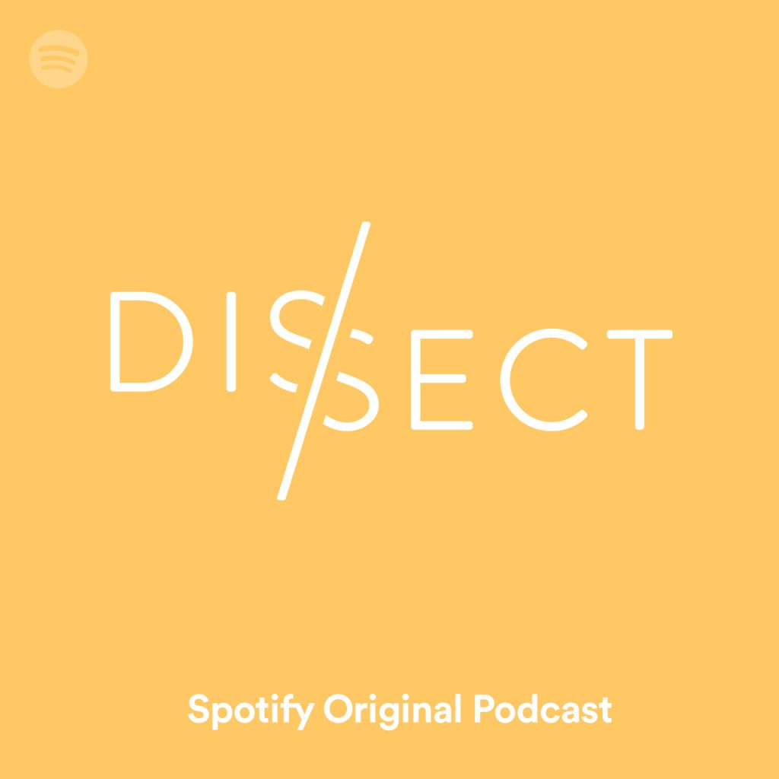
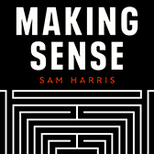
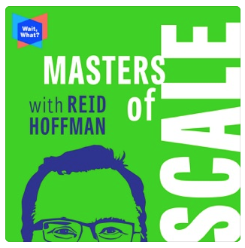
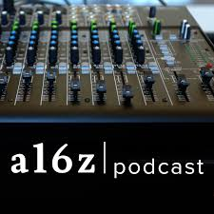
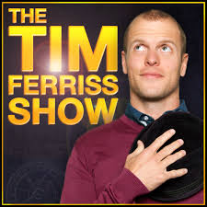
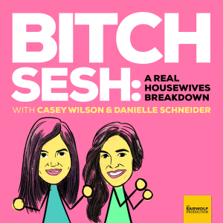
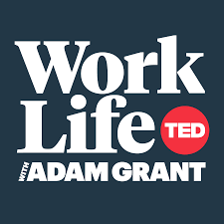
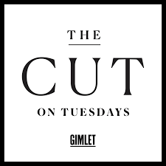

Slide 4
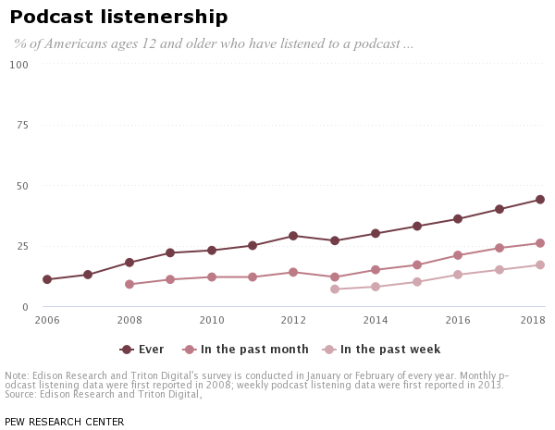
Why Podcasts?
Today: Podcasting is professionalizing
26% of Americans, monthly
College educated
Tomorrow: Positioned for Disruption Listen: A16z
Notes:
TODAY
I probably don’t need to make a case for podcasts because if you’re here, chances are you’re already a fan of the medium. If you’re following the industry, here are some key takeaways that matter to those of us who want to share faculty research, promote our programs and tell the stories of the University:
26% of Americans have reported listening to podcasts at least once a month.
Podcast listeners are more likely to have a college degree or have attended grad school. That’s good news if you’re producing content at Yale
TOMORROW:
If you’re interested in this space, where it’s going and why it is poised for disruption I recommend a recent episode on the A16z podcast.
Machine learning has made search in apps better: there's now full-text search in the Podcasts app, for example. When you look for a phrase someone uttered on a particular episode, it will pop up in search, pulling the quote from the transcript.

Slide 5
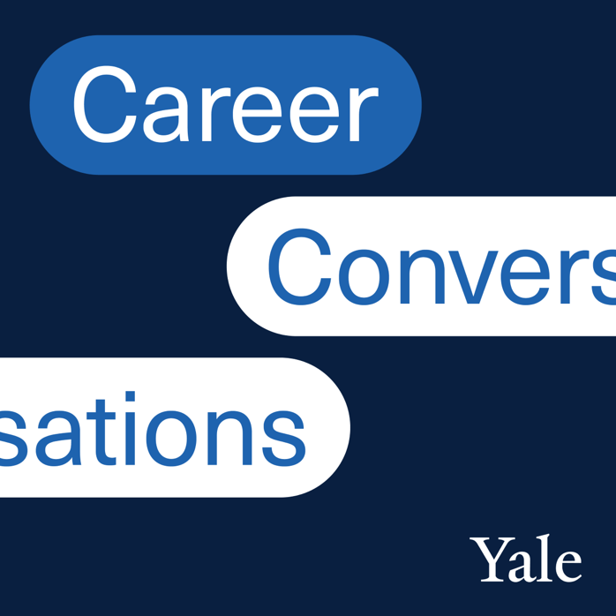
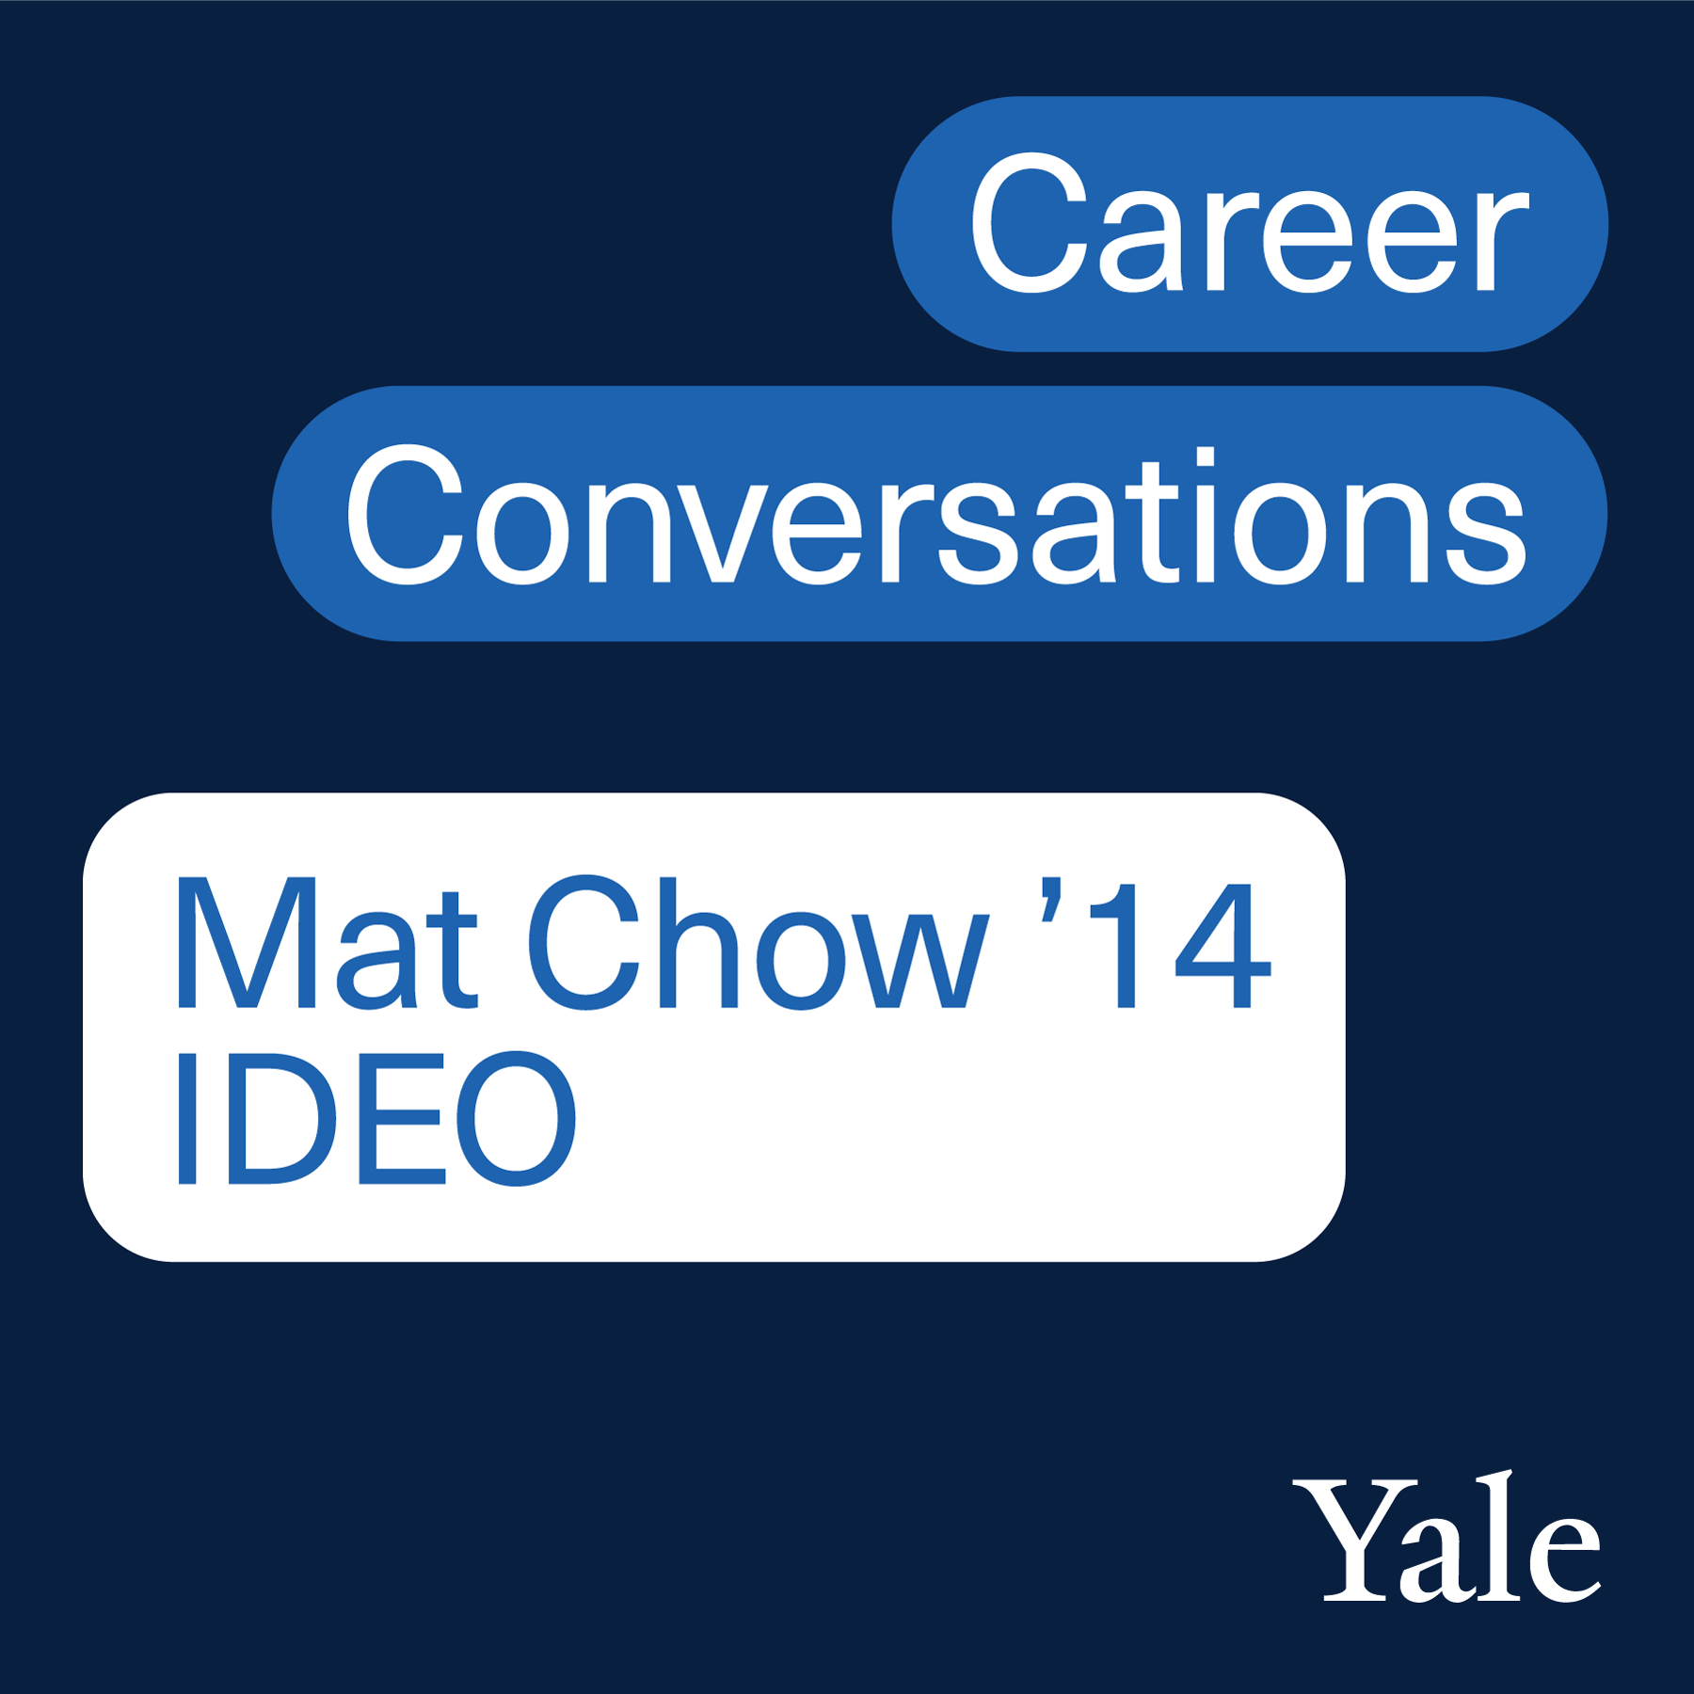
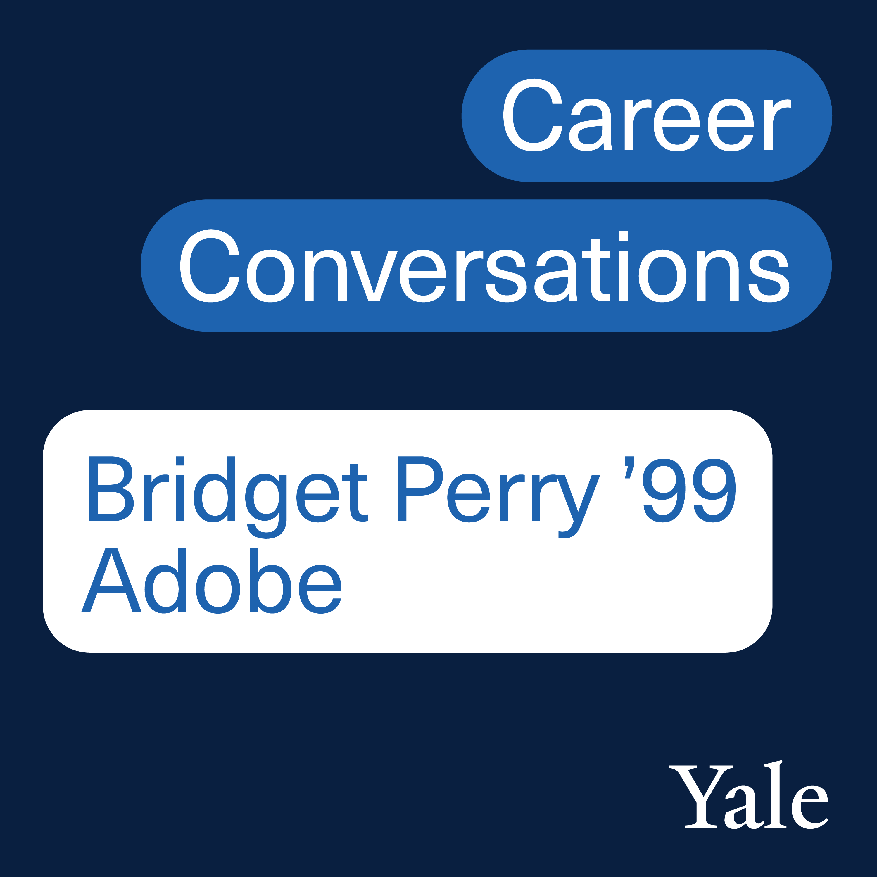
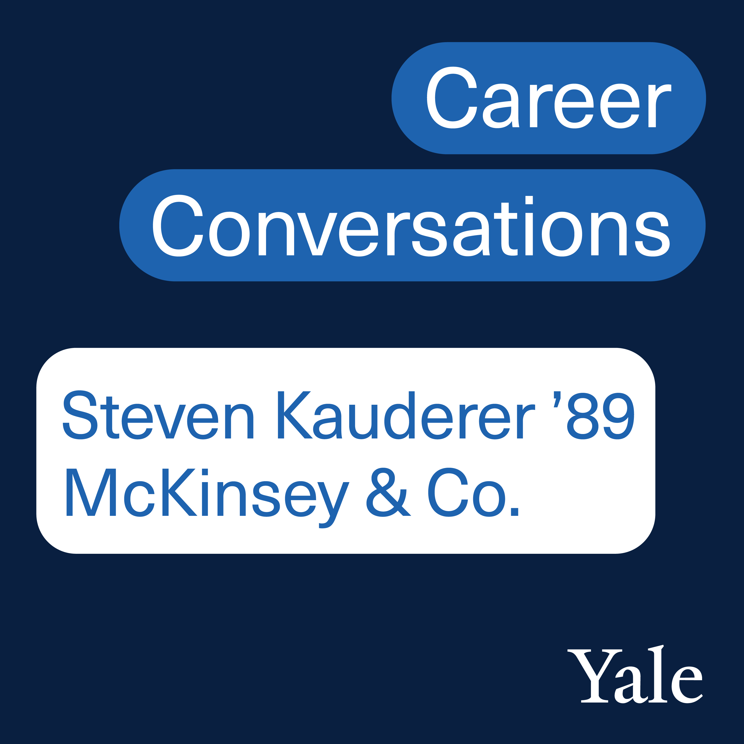
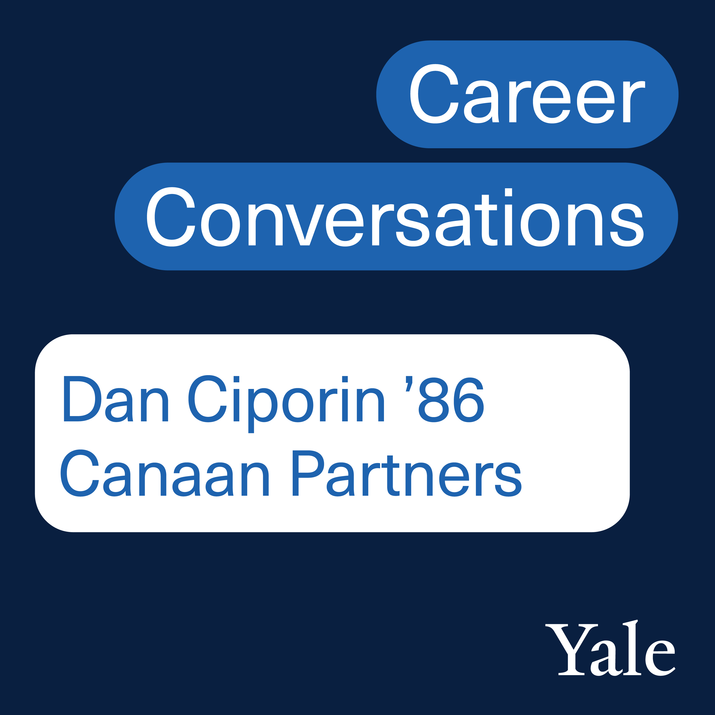
A Case Study: Career Conversations
Notes:
Meet Career Conversations, a podcast by the Yale School of Management
This is where I to see you all open your Podcast app and search for Yale Career Conversations and subscribe.
What is Career Conversations: In this podcast series, SOM students sit down with alumni for a series of candid conversations about career paths, industries, opportunities for MBAs, and discussions on various career topics including work-life balance and creating a meaningful impact in business and society.

Slide 6
Step 1: Strategy
Goal
Audience
Competitive analysis
USP / Hypothesis
Notes:
Spend time pondering your strategy. Sure, you can set up a microphone and begin recording, but the more time spent here, the less time you’ll spend wasting time and money in production.
GOAL
Community building exercise: Two Ways: in the way we are connecting students to alums in production, but also who we are reaching when we share these episodes
Sustaining and deepening bonds among SOM students, faculty, alumni, and our fans;
Supporting our mission of educating leaders for business and society; (vi content)
And ultimately if we are doing that well, we are also attracting applicants to SOM programs
AUDIENCE
SOM community
The Yale Community
Current and prospective MBAs
Anyone interested in careers
COMPETITIVE ANALYSIS
What are your peers and competitors up to?
WHAT IS OUR UNIQUE TAKE? Your Unique Selling Proposition.
For Career Conversations, we distilled our audience, our competitive analysis, and our available resources into this sketch:
Seasonality: We decided to embrace seasonality rather than a weekly or bi-monthly ongoing release schedule.
Length: We decided to aim for 20-30 minutes, more on the snackable side.
Quality: Clean and consistent sound. We decided to invest in quality, using studios when available, and on-site tape syncs for remote subjects.
Team: Define your team….Who is actually producing it? Editing it? Promoting it?
Although we have a small budget for this, we hired a co-producer to help pre-flight, it helped instill confidence and ensure our success.

Slide 7
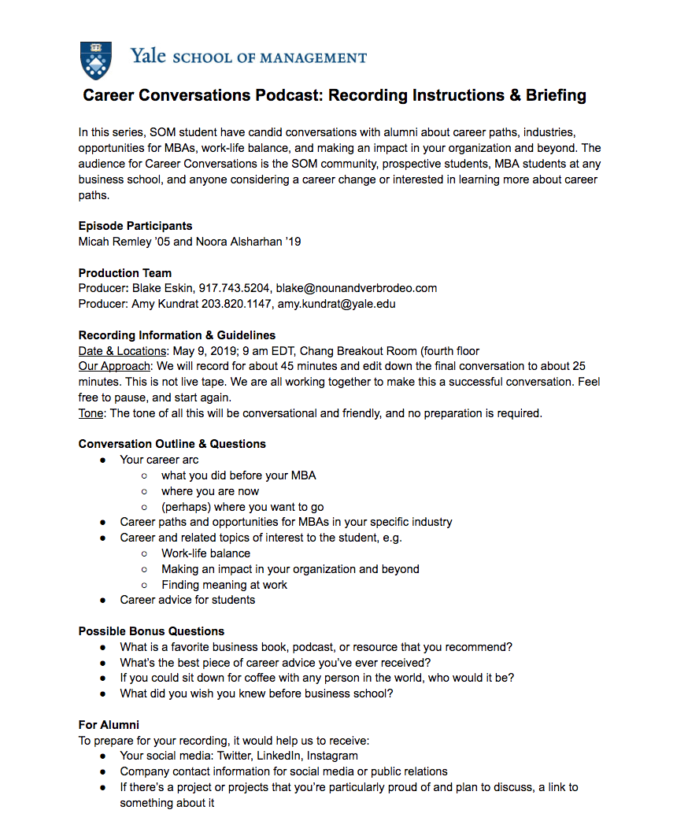
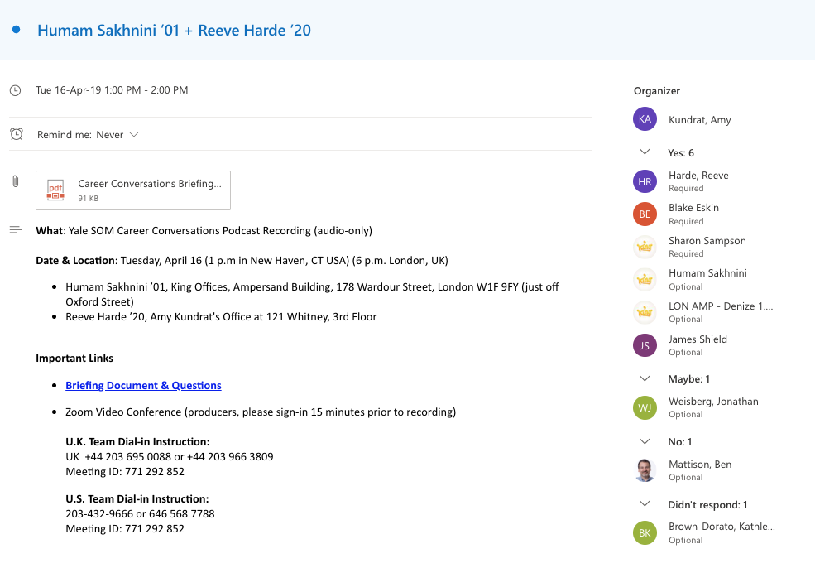
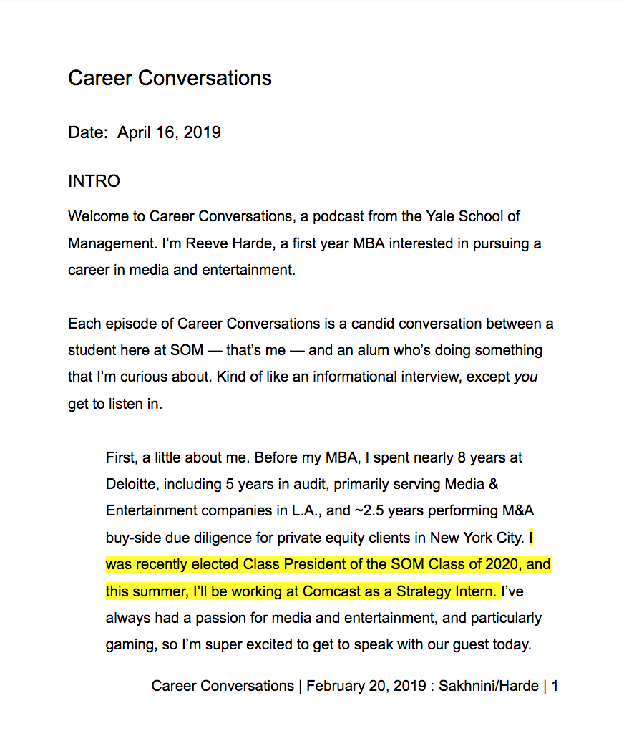
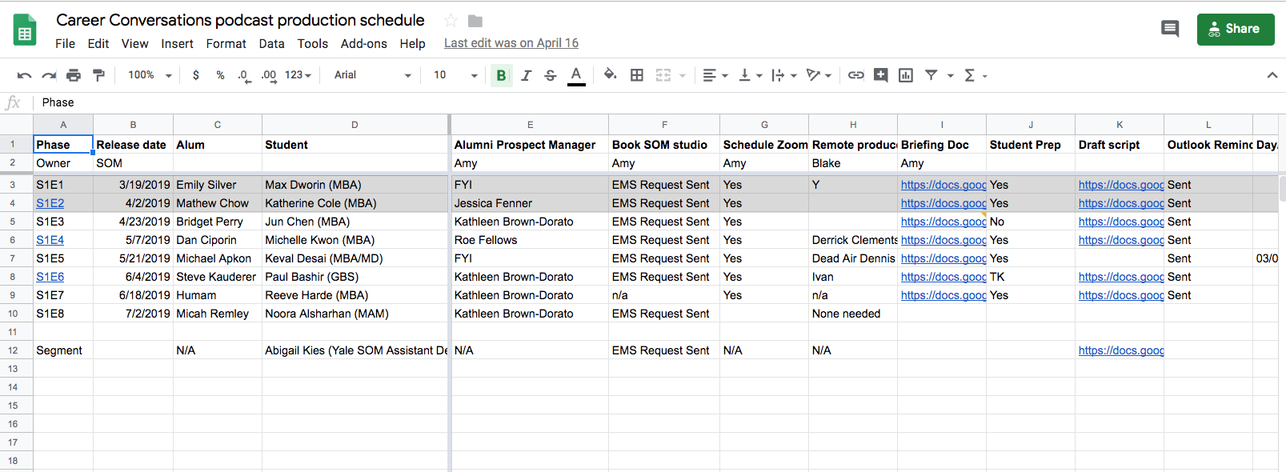
Step 2: Pre-Production
Production Schedule
In-person prep
Develop Scripts & Briefing Docs
Secure audio/tape-sync/studio
Send out 1,982 Outlook reminders!
Notes:
For each episode, my rough checklist was:
Create a script
Draft an episode brief
Send script for comments and updates
Update Intros/Outros
Send Outlook Invites
Update the invite
Prep the student interviewer IN PERSON.

Slide 8
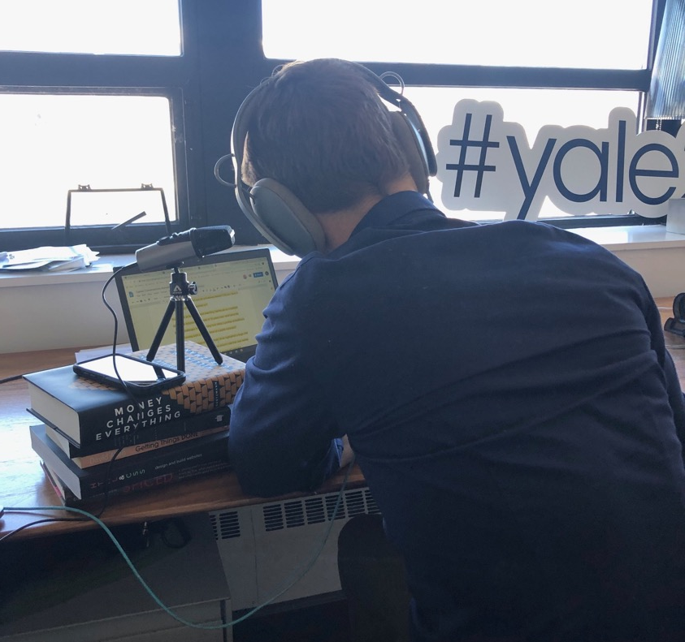
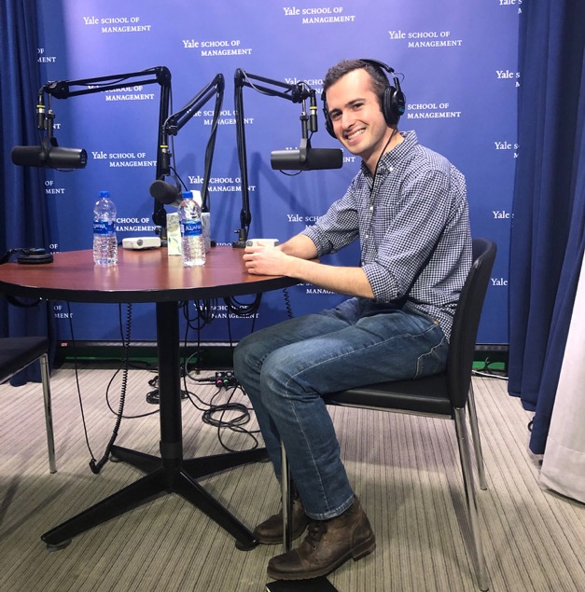
3. Production
The Reality
How we
envision most
episodes:

Slide 9
Production Questions to Ask Yourself
What’s your audio style?
What is your budget?
Have you consulted an expert?
• Yale Broadcasting Center • Yale SOM Media Center • Yale Center for Teaching & Learning
Notes:
Define your production approach.
What’s your tolerance for sound quality?
Would you be okay with using Skype to record? Do you need pristine studio sound quality of a studio?
Budget
What is your budget? At one of the spectrum, you’re bootstrapping your production with A Yeti microphone and recording through an online VOIP like Zencastr.
At the other end, you’re booking studio time. If you think the latter is easier and better because it is a studio, think again. Studios have busy schedules too and if you’re subject can only speak during an hour window at 6 GMT, you may have to figure our your Plan B.
Always have a backup recording. Most if not all studios will, but if you’re recording yourself, use your iPhone or buy a good quality tape backup.
When in doubt: consult with Yale experts. I am not one of them but Yale Broadcast Center, Yale SOM Media Services, and Center for Teaching and Learning can point you in the right direction. Depending on where you work, it may also be available to you.

Slide 10
3. Post-Production Checklist
√ Editing & mixing
√ MP3 & ID3 tagging
√ Show notes
√ Transcripts
√ Courtesy Review
√ Audiograms & Promotion
Notes:
EDIT + MIXING
Are you going to edit this yourself or subcontract an editor?
We use mostly external editors. They work fast and they are competitively priced and will provide the MP3 and ID3 tagging. If I attempted to edit any of my episodes, it takes about 5x as long and I’m never as happy as when I outsource this part of the podcast workflow.
SHOWNOTES & TRANSCRIPTS
Notes or links to what is mentioned in the episode or how to follow your guests. They are also for SEO and increasing your accessibility.
COURTESY REVIEWS
I tend toward the adage of “better to ask for forgiveness than permission” … but I also want our participants who are our students and alumni to be happy with the finished product. I always send a preview listen to participants for a courtesy review. I am not asking them for edits, but I am letting them know I am going to publish the episode and the timeframe.

Slide 11
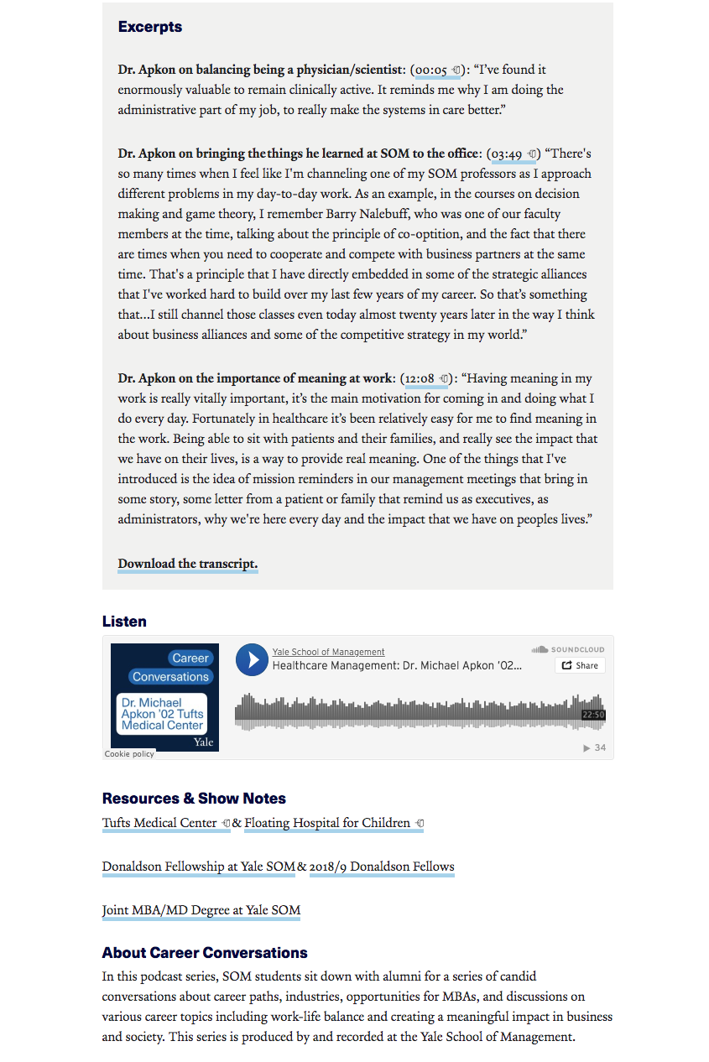
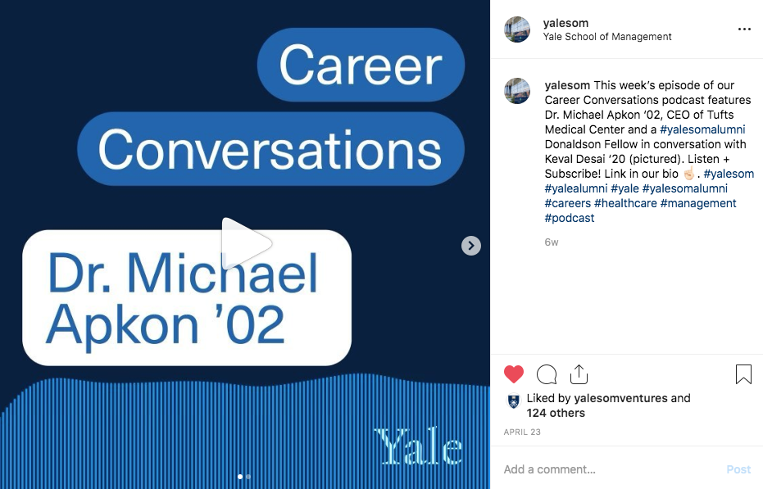
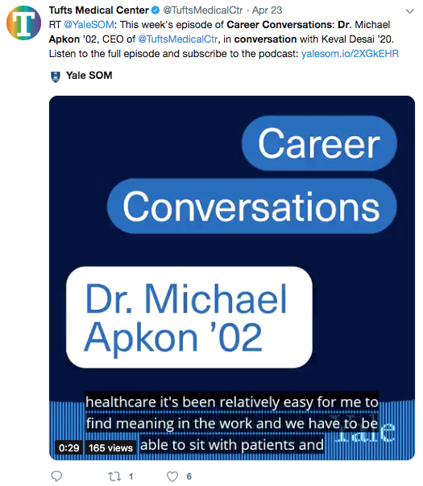
4. Publish & Promote
Notes:
An Audiogram is a clip pulled from the episode paired with a static image that can be used to promote the episode across social media platforms. I’ve used the Headliner App for ours.

Slide 12
Lessons Learned
Set aside 2x the time
3x your budget
Create a trailer
Always Have a Plan B
And Plan C, and Plan D
Notes:
Sure, podcasting can be done. Truly, if I can do it, you all can. BUT, KNOW, it takes much more time, money, and resources than you think:
TIME Plan for it to take 5x more time than you think it will.
Dr. APKON Iis the CEO of Tufts Medical Center and a practicing physician. So it’s not surprising he rescheduled 3 TIMES. This isn't like rescheduling a phone call. Scheduling an hour with him required 4 people (his assistant, chief of staff, and our development office), and weeks of back and forth. And every time he canceled, we have to reschedule 3 other variables: the on-site tape sync person recording Dr. Apkon at Tufts, our studio at SOM, and work around our MD-MBA student’s schedule.
BUDGET Triple your budget: You’ll want to invest in recording equiptment or pay for studio time and/or an on-site tape sync recording. Editing takes time and money or software. For theme music, you’ll want to pay music rights or compose something original. Hosting your podcasts requires a monthly fee. Don’t forget design and promotion.
It’s not IF something will go wrong, it’s WHEN it will go wrong.
HUMAM There are no studios available, so you hire a tape sync to record the conversation. But what happens when that person calls you sick, unable to record. You aren't going to tell the high profile (in this case the President and COO of a major media company) that we can't record them since this is the only 45 minutes available in his schedule all month.
What you do is you run (literally) to the Apple store and buy a microphone and hastily test it in order to pull together some high quality audio that you hope an editor can work their magic on.
KAUDERER This last example is when you think you're ahead of everything. You have a studio, you have the audio tests done, your student interviewer arrives on time. BUT, the interviewer can't hear the interviewee. I stepped in and recorded one side of the conversation, and then had the student come back in to re-record the questions I asked.

Slide 13
When in doubt…
D I Y
Notes:
Yale has resoures but the best way to launch a podcast is to bootstrap it yourself. If I haven’t scared you out of launching your podcast, then I would scale back your expectations and boot strap an episode or mini season with the resources you have at arms reach.
Plan and strategize seriously, but assume no matter how much you invest (time, money) into your first episode or season, you will most likely iterate, and that’s if you decide to keep going.

Slide 14
The DIY Quick Start Guide
√ Strategy
√ Pick a Platform: LibSyn, Podbean (free), Blubrry
√ Audio: Zencastr
√ Launch & Promo Plan
Notes:
Launch + Trailer
Why do podcasters release trailers? They help set up your initial feed. For Apple, this can mean anywhere between 3 days to 2 weeks. And it also gives your audience an opportunity to subscribe. So it primes your podcast pump.
For ongoing promotion, here are a few tools I’ve found most helpful:
Audiograms, etc.
There are lots of ways to promote your episodes. We’ve tested audiograms., episode-specific graphics. There is SO much more we can do.
Here is what we do at Yale:
Publishing an episode takes me about a half-day from start-to-finish. I already have the file, but I:
Upload to my LibSyn
Add copy, images, tags
SEO

Slide 15
Resources & Platforms
podcaster.apple.com
Libsyn podcast hosting
Headlinr.app audiograms
Audacity free, open source audio software
Zencastr high fidelity podcasting
Rev.com quick transcripts
Notes:
An abbreviated list of some resources to get you started.

Slide 16
Thanks!
Amy Kundrat
Director of Digital at Yale SOM

