Slide 1
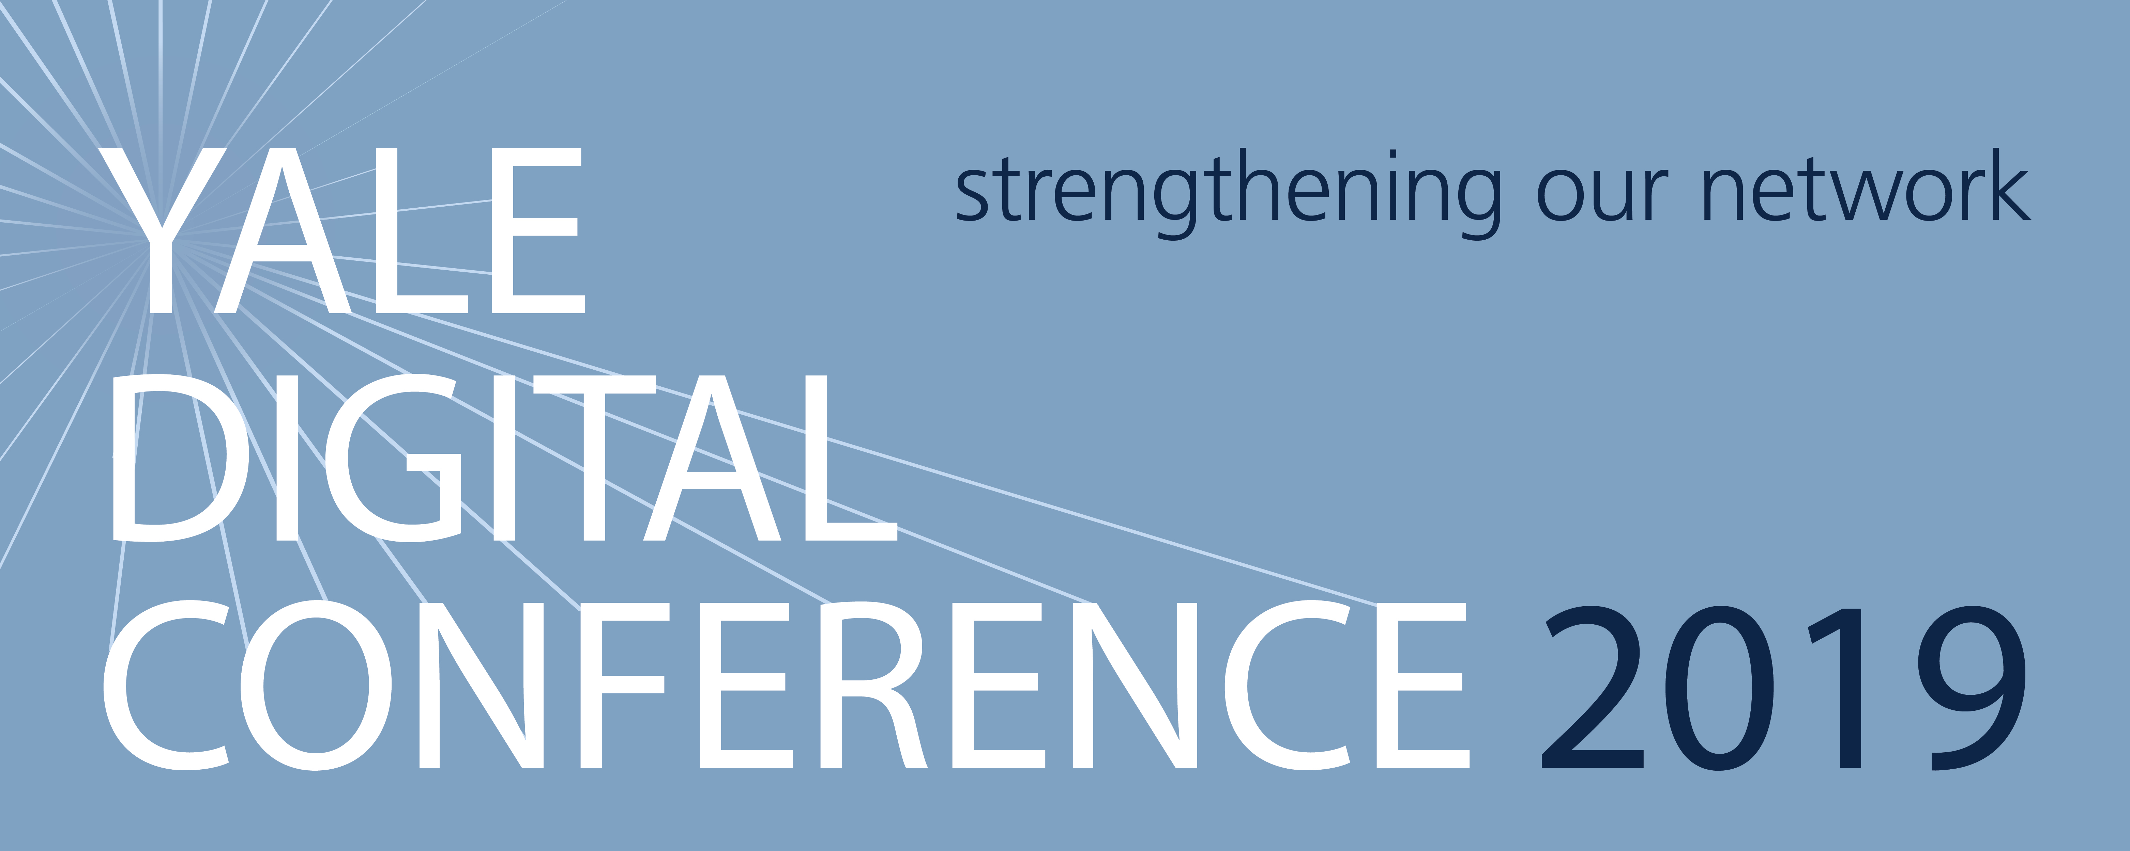
Amber Garrard
Senior Manager, Yale Office of Sustainability

Slide 2
Making websites more sustainable
Amber Garrard
Senior Manager, Yale Office of Sustainability

Slide 3
Where to begin?!
Do you ever feel like your website contains too much content?
Is it overwhelming to navigate or manage?
Do you ever want to scrap it and completely reorganize?

Slide 5
Key challenges
Too much content
Notes:
More than 450 url’s associated with the sustainability.yale.edu website

Slide 6
Key challenges
Too much content
Too many layers→ info too buried

Slide 8
Key challenges
Too much content
Too many layers→ info too buried
Too customized→ hard to maintain

Slide 10
Key challenges
Too much content
Too many layers→ info too buried
Too customized→ hard to maintain
Not accessible

Slide 11
Notes:
Too much content housed in pdf form; graphics used to tell stories but not accessible

Slide 12
Key challenges
Too much content
Too many layers→ info too buried
Too customized→ hard to maintain
Not accessible
Too many cooks in the kitchen→ inconsistent voice, layout
Notes:
Information architecture wasn’t completely clear. When site was designed, a lot of voices, no one fully got what they wanted.
As a result, information was hard to find, buried, and inconsistent.
First inherited the website, many different students able to update content; Can’t be so many voices—needs to be one voice, that spells out who we are, and what we do, and multi-faceted but has to be cohesive at the end of the day
Where does this leave us??? So fed up, and in need of:

Slide 14
Hitting reset
Revisit our goals
Re-evaluate our priorities
Notes:
Goals:
website content (who is our audience, what do we want them to know, what do we need to convey)
Maintenance—needed to do a reality check on what we can update in a realistic manner

Slide 15
Notes:
University has an Office of Sustainability
One of first schools to make GHG reduction target (2005), 2 subsequent 3 year sustainability plans- operational focus 2016 launched YSP 2025 with a broader focus (engage with academic part of university, go beyond our borders, 9 year time horizon)

Slide 16
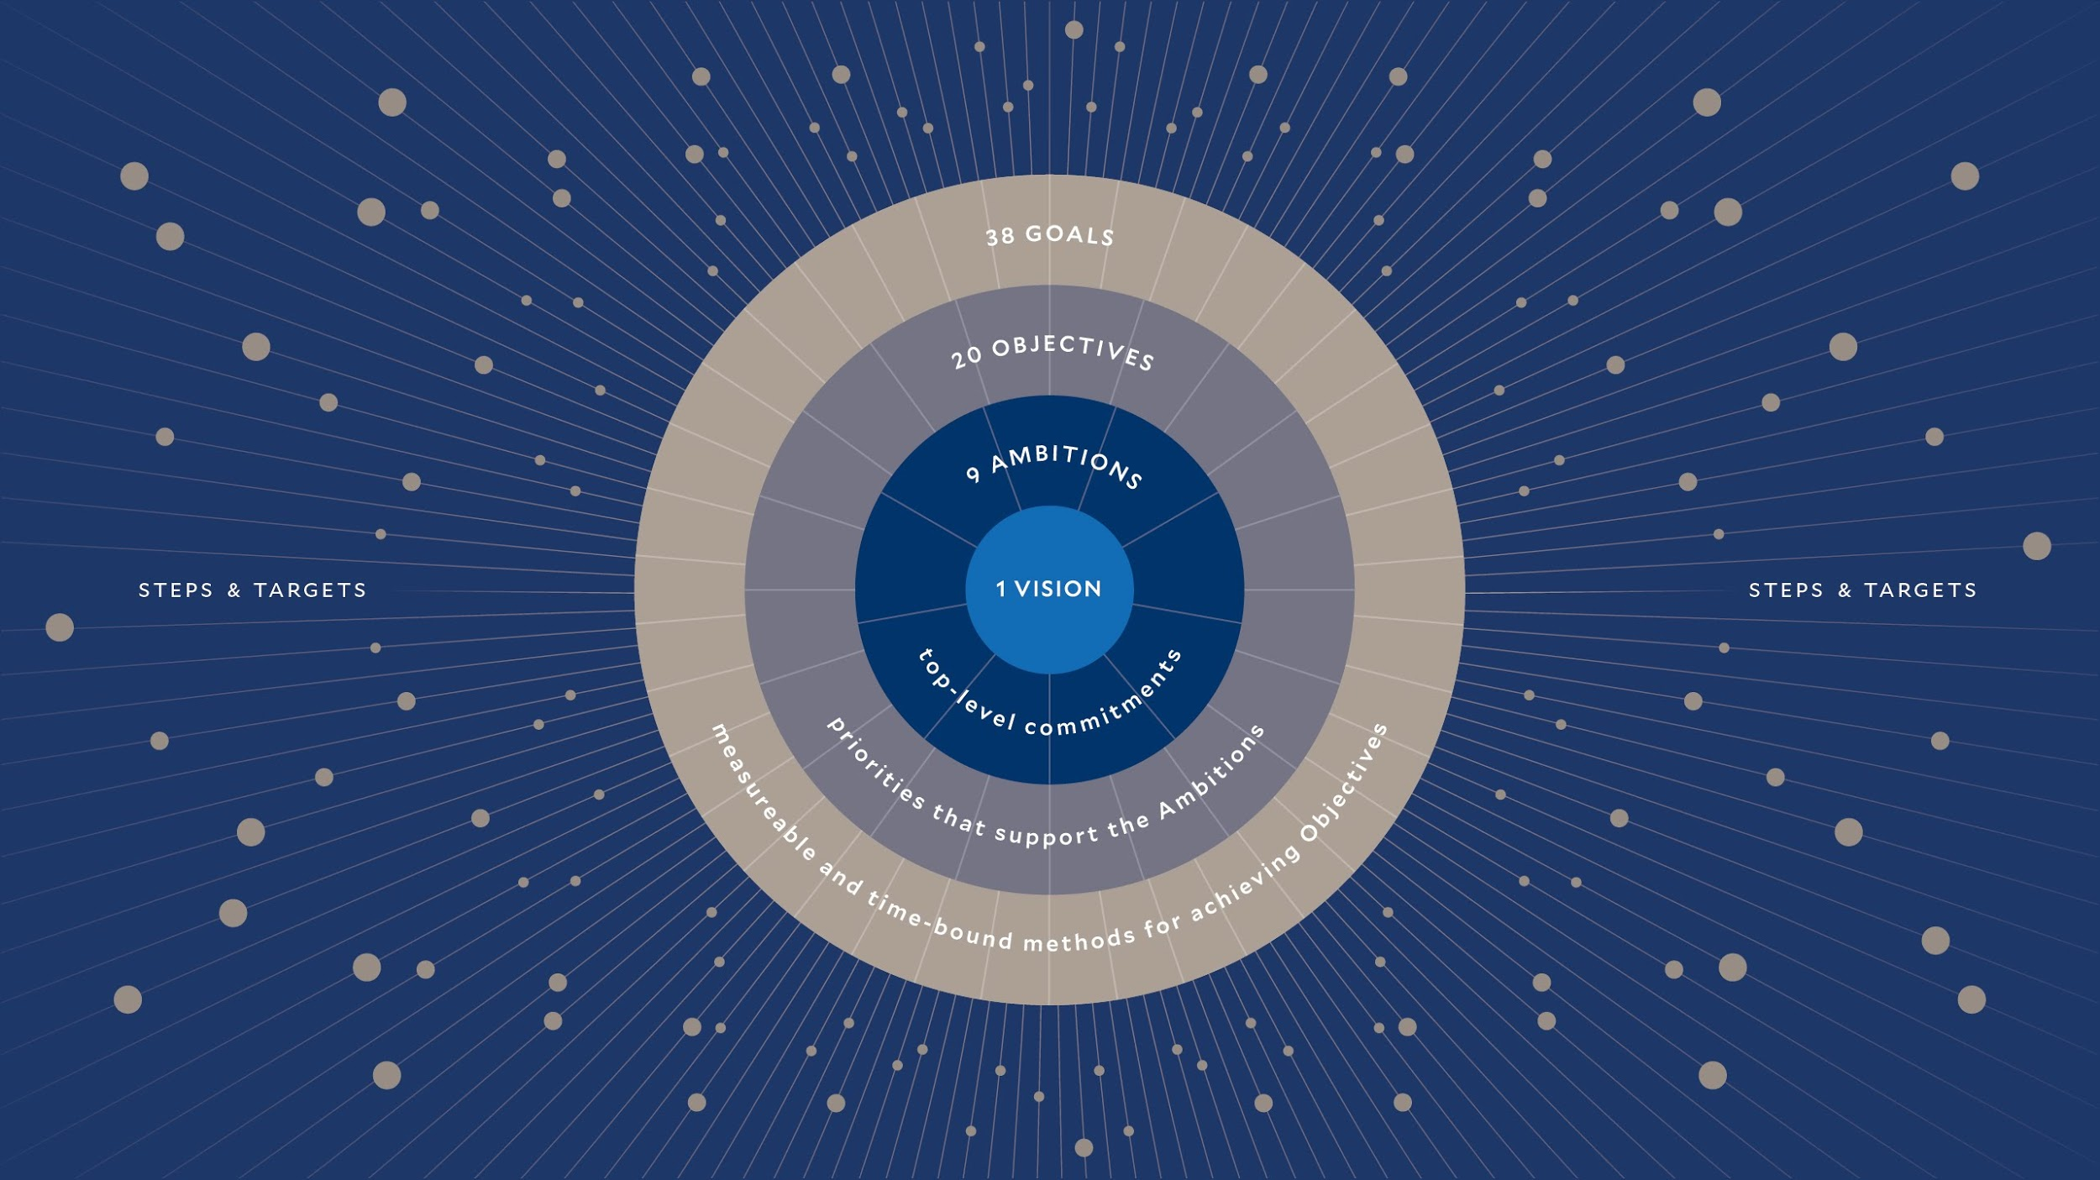
Notes:
vision for Yale’s sustainability, which is made actionable through our objectives and goals that guide our steps and targets

Slide 17
YSP 2025: communications goals
Yale’s efforts on campus
Progress toward out goals
Ways you can help
Notes:
Challenging to organize this content previously.
Goals; progress and work on campus; how can people actually make a difference.
Wanted to make all these relatively easy to find and navigate.
(Pull up home page → scroll down to YSP)
(Priorities & Progress→ what we mean by this ambition; what we’re doing; goals and progress)
(Progress Report- previously had been a downloadable PDF (Accessibility) with graphics. Wanted a web version of this, but still updated only annually.) Worked with OUP on graphics.)
(Take Action→ different organization using tags we hoped were more relatable; Programs on sidebar and then topic-specific things to do).

Slide 18
Resources: communications goals
Clear organization
Easy to manage and maintain
Available
Notes:
Resources
(Show organization (resource type/topic) )
Housed on Box- easier to manage and replace
Cross posted in Resources Section and on Take Action page for easier access
(Sustainability Tour)

Slide 19
Have we achieved our goals?
Content
Management
Overall visibility
Notes:
Content: making it more accessible, shorter & tighter, fewer clicks; more internal (e.g. TO)
Management: 2 owners; clear processses for updating content
Overall visibility: not as much as wanted. Get traction from Yale News sites, but want more.
INTERACTIVE: help me identify ideas for driving traffic to our site. Are there resources you can link to an promote from your sites? Giveaways? Content/Sustainability Scavenger Hunt (e.g. through out Sustainability Tour)?

Slide 20
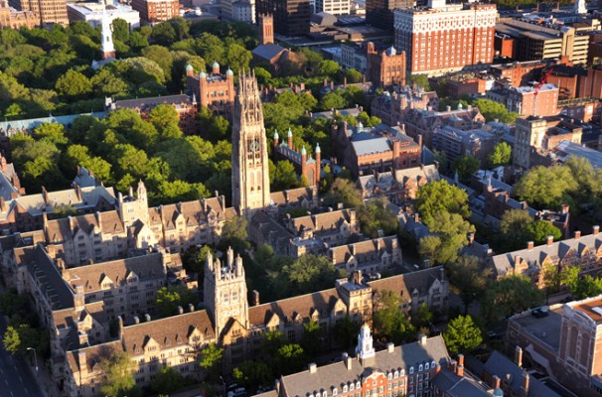
Yale is committed to building a more sustainable world. By doing what we do best—integrating science, the humanities, and our community—Yale creates, tests and adopts innovative solutions to the environmental and social challenges we all face.

